Slide 1
All Hands Communications Meeting August 9, 2012 Keith Jackson President & CEO

Slide 2
Corporate Strategy Enhancing Value to our Worldwide Customers
Expand our product portfolio through organic development and M&A
Increase applications expertise to support complex customer designs
Expand global operations and infrastructure to support customer globalization
Improve economies of scale and demand management to provide competitive cost and stable supply
Maintain world-class manufacturing, quality and supply chain logistics

Slide 3


Road to ZERO
High Impact Excursions
Financial Impact– Warranty Claims
Reputation – Lost Opportunity
Customer Scorecards
Resource Drain
Counter Measures
Root Cause Corrective Action
Robust Change Mgt
Process, Materials, Test
Process Discipline
Design for Manufacturability (DFM)
“Quality Mindset”
Quality Focus
ZERO Excursions
ZERO Test/Maverick Escapes
ZERO Repeat Incidents
ZERO Customer Line Downs
ZERO Customer Claims
ZERO Defects

Slide 4

ON Semiconductor - A Global Leader Emerging
Evolution
Aspiration
#48
#18
Top 10
2003
($MM)
2011
2015
Total Semiconductor (CY2011)
Multimarket Semiconductor (CY2011) ⁽¹⁾
Rank | Company | Revenue (M$) | Share (%)
1 | Intel | 50,669 | 15.5
2 | Samsung Electronics | 27,366 | 8.9
3 | Toshiba | 11,769 | 3.8
4 | Texas Instruments | 11,754 | 3.8
5 | Renesus Electronics | 10,650 | 3.5
6 | Qualcomm | 9,998 | 3.3
7 | ST Microelectronics | 9,535 | 3.1
8 | Hynix Semiconductor | 9,388 | 3.1
9 | Micron Technology | 7,643 | 2.5
10 | Broadcom | 7,160 | 2.3
・・・ | ・・・
18 | ON Semiconductor (including SANYO Semiconductor) | 3,449 | 1.1
 | TOTAL Semiconductor | 306,843 | 100.0
Rank | Company | Revenue (M$) | Share (%)
1 | Infineon Technology | 1,742 | 8.5
2 | Toshiba | 1,570 | 7.7
3 | ON Semiconductor (including SANYO Semiconductor) | 1,405 | 6.9
4 | ST Microelectronics | 1,291 | 6.3
5 | Renesus Electronics | 1,210 | 5.9
6 | Mitsubishi | 1,176 | 5.8
7 | Vishay | 1,063 | 5.2
8 | Rohm | 1,060 | 5.2
9 | NXP | 1,058 | 5.2
10 | Fairchild Semiconductor | 1,010 | 4.9
 | TOTAL | 20,428 | 100.0
Top
20
Top
3
Source : Gartner, Market share ranking
(1) Multimarket is from Discrete data
Source : Gartner, Market share ranking

Slide 5
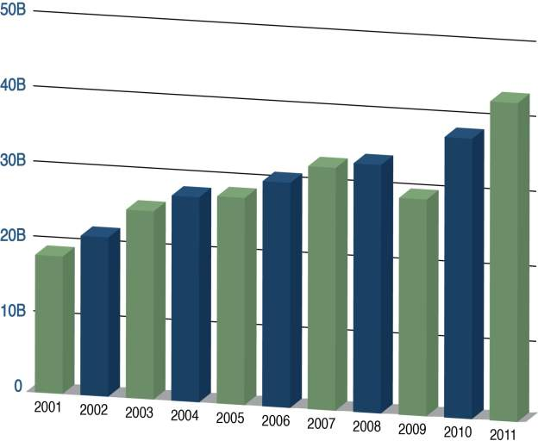
Global Units Shipped
ON Semiconductor shipped ~6 units
per person in the world during 2011
Capacity Investment
Units
Shipped
Investment Area | 2011 (M$) | 2012 F (M$)
ON Semi FE Mfg | 90 | 94
ON Semi BE Mfg | 130 | 81
SANYO Semi | 59 | 80
Other | 36 | 15

Slide 6
Financial Overview
Revenue
Adjusted EBITDA ⁽¹⁾
($MM)
($MM)
Y-o-Y Growth (%):
EBITDA Margin (%):
27.0
16.5
58.2
55.3
49.5
32.6
-14.5
-17.8
25.1
25.1
19.2
18.7
18.9
15.9
16.1
17.3
Cash, Equivalents & ST Investments Balance
Net Debt Balance ⁽²⁾
($MM)
($MM)
(1) See Appendix for GAAP Net Income to Adjusted EBITDA reconciliation. Adjusted EBITDA includes the impact of stock-based compensation.
(2) See Appendix for Reconciliation of Non-GAAP Net Debt.

Slide 7
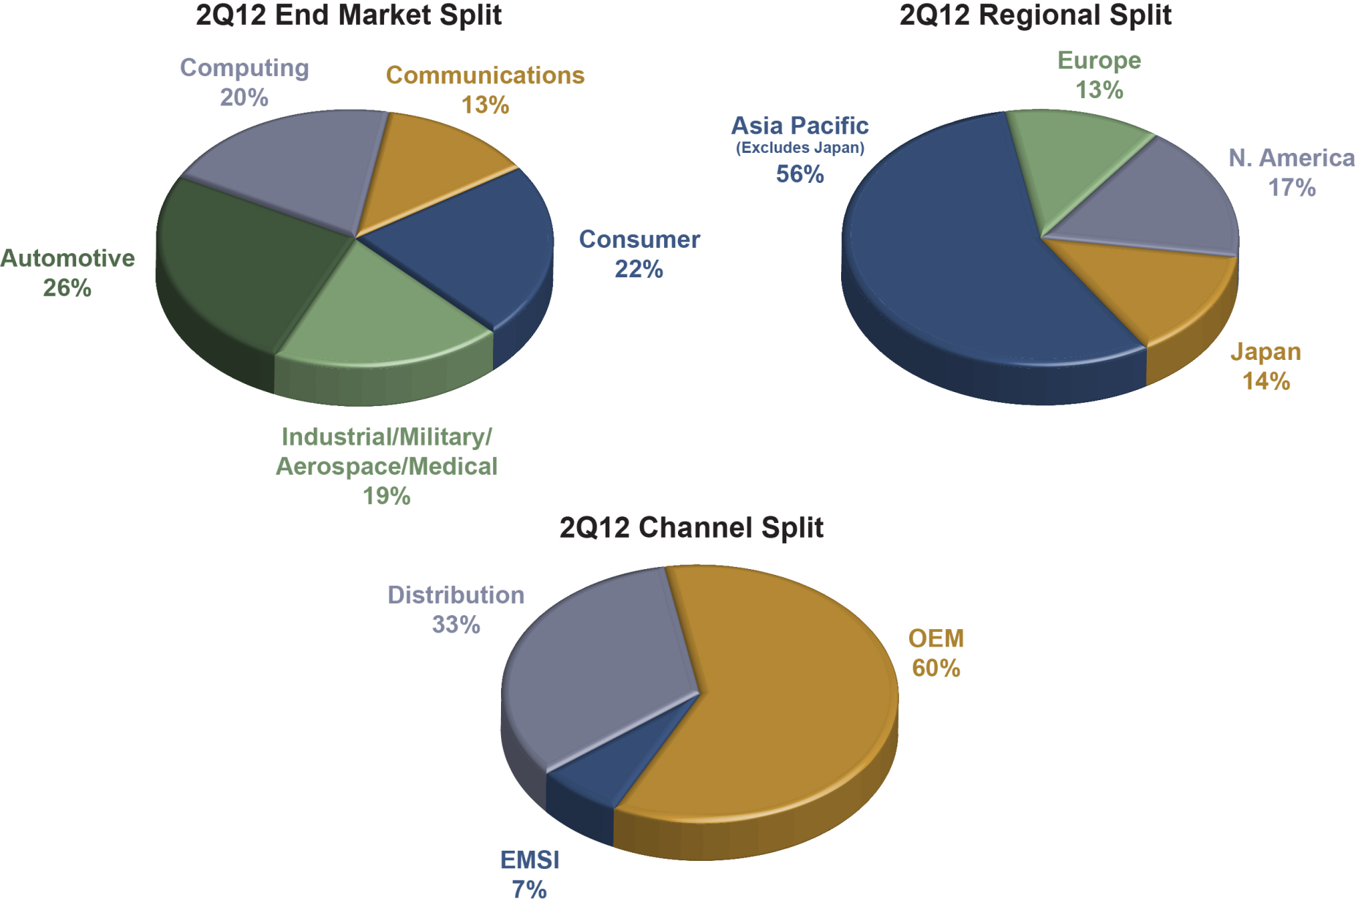
Diverse Segment and Regional Profile
2Q12 Revenue = $745M

Slide 8
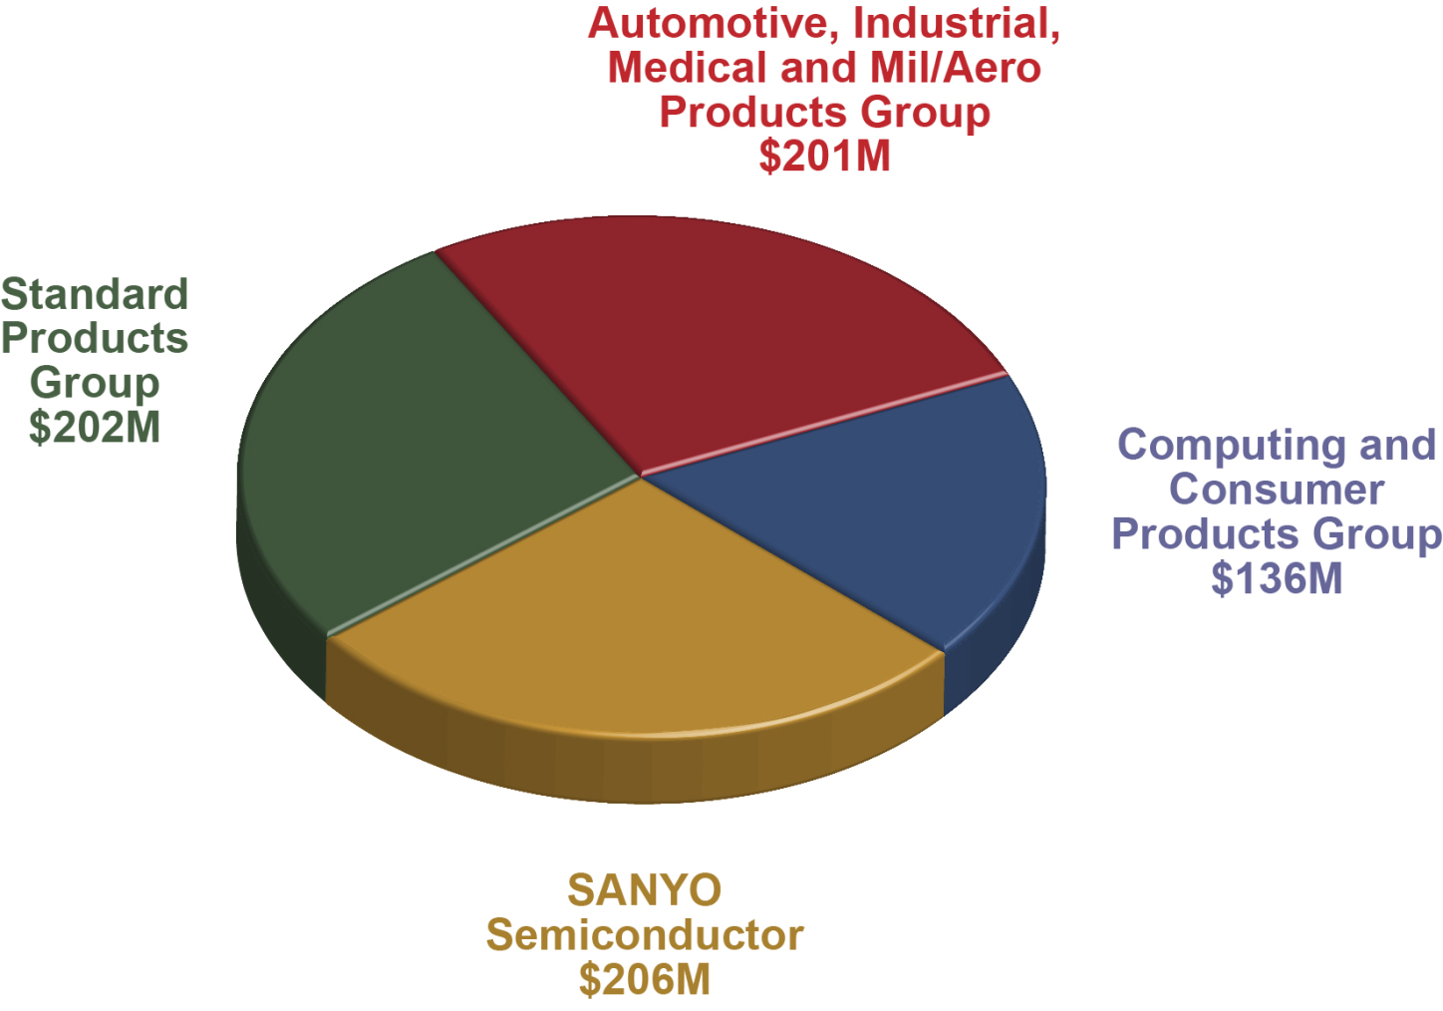
2Q12 Business Group Revenue Results

Slide 9
Global Macroeconomic Environment
Global GDP growth expected to slow year on year in 2012 and flatten in 2013
The IMF forecasts 3.5% global GDP growth in 2012 with a downward risk bias and trimmed 2013 to 3.9%
WSTS lowered their 2012 semiconductor growth forecast from 2.6% to 0.4% in June
China GDP grew 7.6% in 2Q12 with full year outlook of 8.2% versus official government target of 7.5%
EU zone in recession, expected to contract (-0.3%) in 2012
Governments taking renewed action to stimulate economic growth
China launched new subsidies for energy efficient appliances ($4.2B), cars ($1B), LED Lighting ($350M)
ECB states it will “do whatever it takes to preserve the Euro”
FIGS (France, Italy, Germany, Spain) agree to $164B economic stimulus package (details tbd)
US Federal Reserve contemplating “QE3”; Brazil, Korea and other central banks cutting interest rates
Stalling global growth is prompting governments to enact economic stimulus
Source: The Economist Jun’12, IMF World Report Jul’12

Slide 10
ON Semiconductor “Competitive Basket” Analysis
Competitive Basket TAM $M | 4Q11 | 2011 | 1Q12 | 2Q12 | 3Q12f | 4Q12f | 2012 | 1Q13f
Quarters | 10,850 |  | 10,370 | 11,131 | 11,280 | 11,406 |  | 11,178
QonQ | -8.7% |  | -4.4% | 7.3% | 1.3% | 1.1% |  | -2.0%
Years |  | 47,268 |  |  |  |  | 44,186
YonY |  |  |  |  |  |  | -6.5%
End-Markets and Applications Outlook
Expect 2H12 seasonal growth in smartphone and media tablet sales
Wireless infrastructure down -10% year on year as carriers delay CAPEX in response to the economy
Global TV shipments expected to be flat year on year
Expect sub-seasonal PC sales in Q3 as buyers wait for Windows 8 launch
EMEA premium car manufacturers beginning to forecast a slow down based on reduced demand from China
Global light vehicle unit sales projected to grow ~4% and auto semi sales ~10% in 2012 on Japan recovery and US strength
Government energy efficiency mandates continue to drive LED lighting growth
Source: Bloomberg, Aug 2012
ON Semi up ~6% on a “sell in” basis
Expect 2H12 sales to flatten at 2Q run rate and overall basket to decline ~6% year on year in 2012 for second consecutive year of contraction

Slide 11
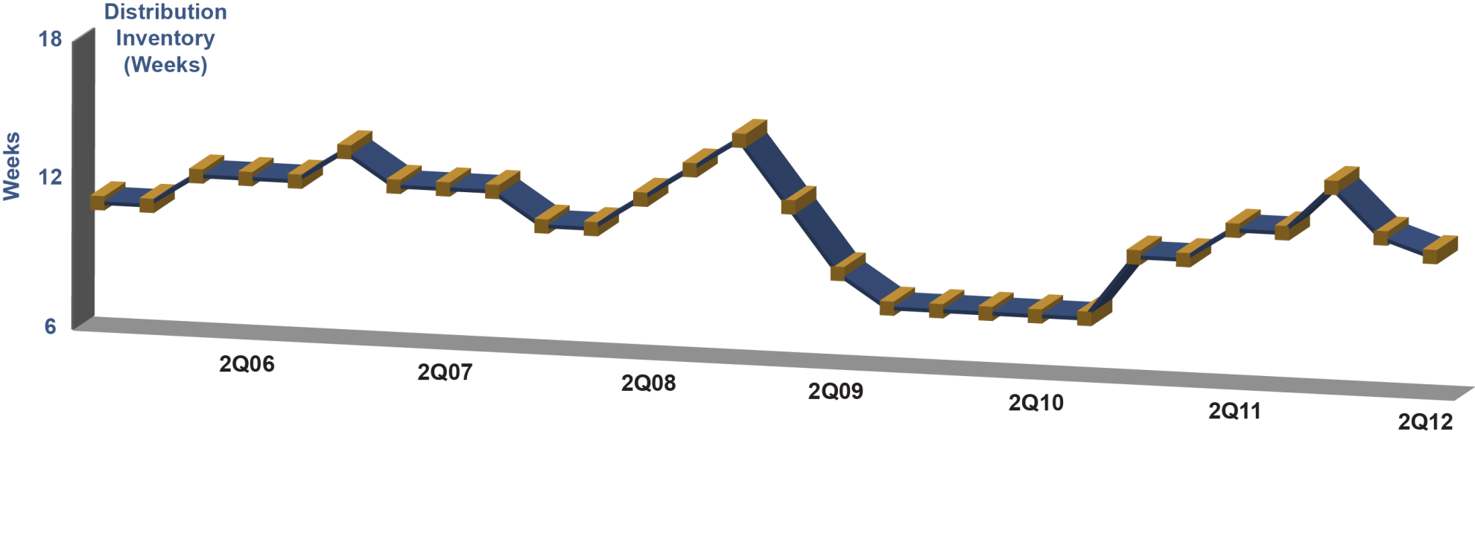
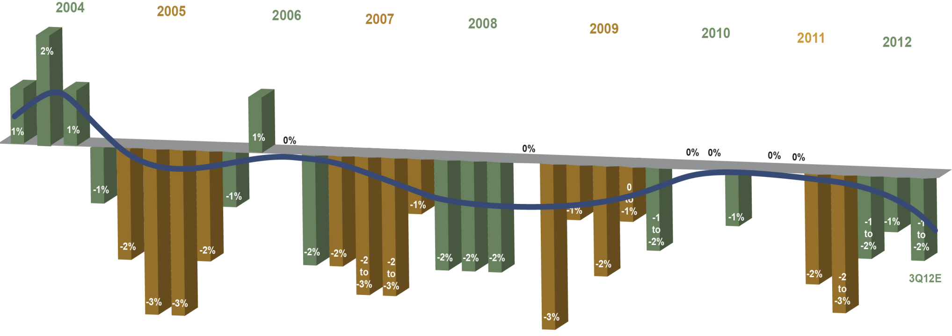
Inventory Levels and ASP Trend
Internal inventory at ~123 days, includes ~13 days of bridge inventory
Distribution inventories were at approximately 10.5 weeks exiting 2Q12
2Q12 ASPs declined ~1%
Expect 3Q12 ASP decline of 1%-2%

Slide 12
Business Group Revenue Trend
Year on Year Change (2Q11 – 2Q12)
-12%
-14%
-25%
-18%

Slide 13
2012 Global Cost Reduction Actions
SANYO Semiconductor Group
Closed Gifu and Gunma Fabs in 1H12
Executed ~10% workforce reduction in 1H12
Manufacturing shutdowns in 2H12
Mandatory vacation in 2H12
Reduction in discretionary spend (travel, meetings, etc)
ON Semiconductor
Manufacturing shutdowns in 2H12
Planning ~10% non-manufacturing workforce reduction in 3Q12
Aizu Fab closure in 4Q12 with workforce reduction
Reduction in discretionary spend (travel, meetings, marketing programs, etc)
Reduction in consulting and temporary employee costs
Targeting to reduce quarterly Non-GAAP operating expenses by approximately $10M-$15M

Slide 14
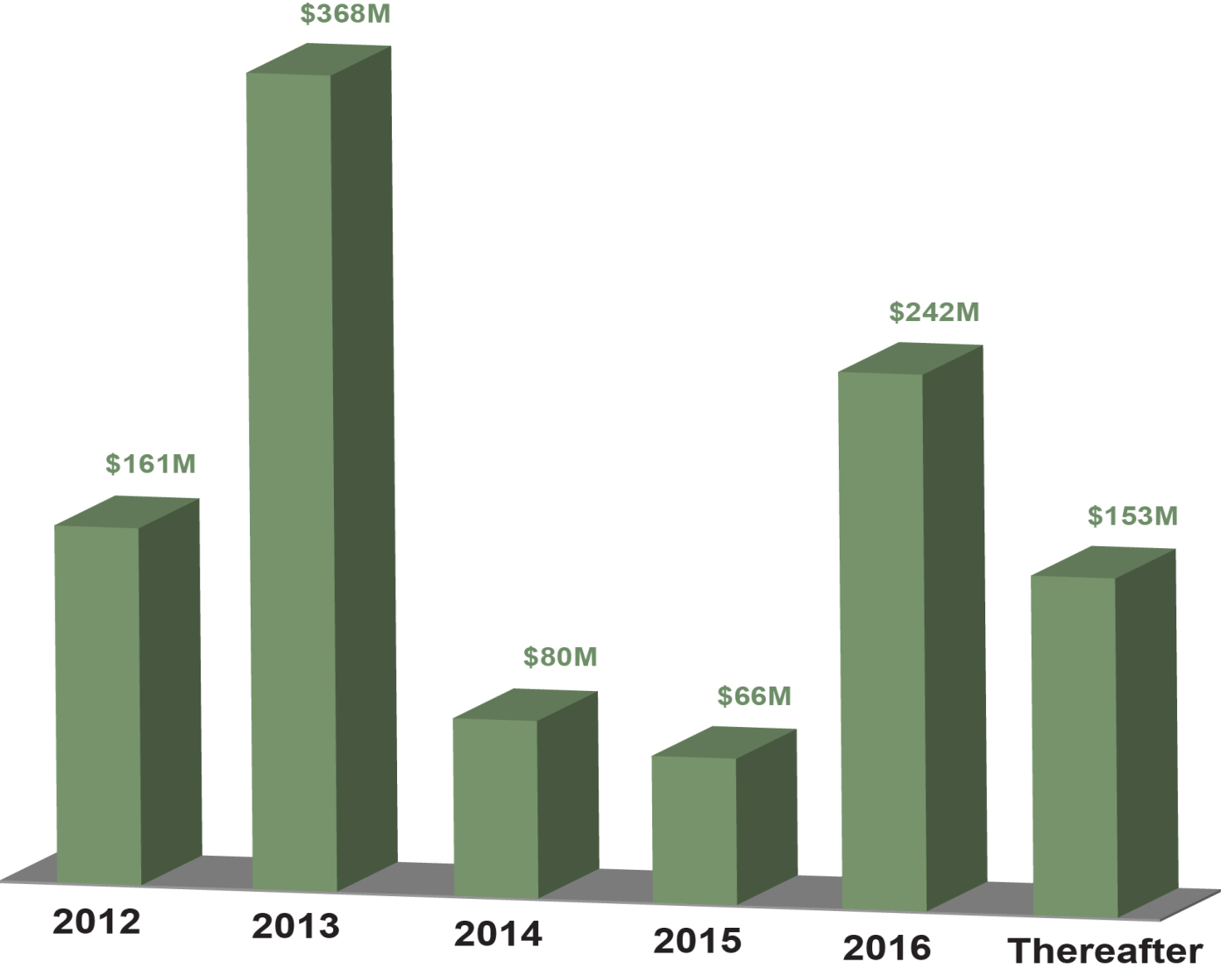
Current GAAP Debt Amortization Schedule (Convertible Notes Net of Discount (FSP APB 14-1) )
Exited 2Q12 with approximately $756M of cash, cash equivalents & short-term investments and a net debt position of approximately $314M
In 2Q12, repurchased $96M of ON Semiconductor’s zero coupon convertible senior subordinated notes due 2024 & retired the notes in full.

Slide 15
Stock Repurchase Program
The Board of Directors has authorized a share repurchase program of up to $300M of common stock during the next 3 years
Management intends to begin implementing the program later this month (August)
“We believe the company has sufficient cash available – beyond what is needed to repay our debt and effectively run the business – to buy back some stock,” said Keith Jackson, ON Semiconductor president and CEO. “This stock repurchase program is a strategic move designed to help strengthen and support the overall value of our stock. We believe it is an effective use of some of our cash reserves.”

Slide 16
Key Takeaways
Global economy is weakening
Slower growth in China and ongoing European economic malaise
Looming US “fiscal cliff” contributing to market uncertainty
Expect global semiconductor sales to be flat for a second consecutive year and ON Semiconductor “competitive basket” to decline by ~6% YonY in 2012
ON Semiconductor focus and actions in response to market environment
Execute on new product development and design wins to grow top line revenue
Continue to aggressively cross-sell SANYO – ON Semiconductor product portfolios
Realign costs to revenue outlook in order to maintain strong free cash flow
Maintain quality and customer service
Execute stock repurchase program to strengthen the value of our stock

Slide 17

Questions and Answers

