Slide 1
http://ic.sjtu.edu.cn/ic/dic/wp-content/uploads/sites/10/2013/04/CMOS-VLSI-design.pdf

Slide 2
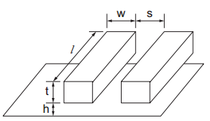
Introduction
Interconnect: conductive path
Ideally: wire only connects functional elements (devices, gates, blocks, …) and does not affect design performance
This assumption was approximately true for “large” design, it is unacceptable for sub- micrometer technology

Slide 3
Interconnection => major role in the performance of systems
The wires are packed very closely together and thus a large fraction of their capacitance is to their neighbors.
A wire switches, it tends to affect its neighbor through capacitive coupling, this effect is called crosstalk.
Signal integrity issues =>noise sources, delay, which affects reliability
Considering all of these factors, the Physical Design Layout is now as crucial task in the conception flow

Slide 4
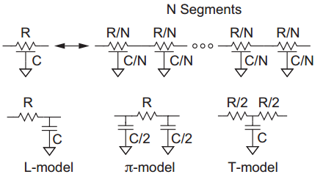
Interconnect modeling
A wire is a distributed circuit with a resistance and capacitance per unit length
Its behavior can be approximated with a number of lumped elements
To evaluate the effect of interconnects on design
performance we have to model them

Slide 6
Outline
Introduction to parasitic extraction
Resistance extraction
Capacitance extraction

Slide 7
Introduction

Slide 8
Real wire has:
Resistance
Capacitance
Inductance
Therefore wiring forms a complex geometry that introduces capacitive, resistive and inductive parasitics. Effects:
Impact on delay, energy consumption, power distribution
Introduction of noise sources, which affects reliability
To evaluate the effect of interconnects on design
performance we have to model them

Slide 9
InterConnect modeling
A wire is a distributed circuit with a resistance and capacitance per unit length
Its behavior can be approximated with a number of lumped elements

Slide 10
Parasitic Extraction
As design get larger, and process geometries smaller than 0.35μm, the impact of wire resistance, capacitance and inductance (parasitics) becomes significant
Give rise to a whole set of signal integrity issues
Challenge
Large run time involved (trade-off for different levels of accuracy)
Fast computational methods with desirable accuracy

Slide 11
Introduction to parasitic extraction
Resistance extraction
Problem formulation
Extraction techniques
Numerical techniques
Other issues
Capacitance extraction

Slide 12
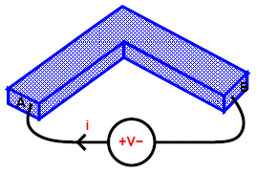
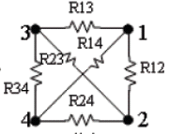
Problem formulation
A simple structure
Two-terminal structure
Multi-terminal (port) structure
L
W
i
H
i
A
B
+
-
V
NxN R matrix

Slide 13


Extraction techniques
Square counting
Analytical approximate formula
For simple corner structure
2-D or 3-D numerical methods
For multi-terminal structure; current has irregular distribution
Solve the steady current field for i under given bias voltages
Set V₁ = 1, others all zero,
flowing-out current
Repeating it with different settings

Slide 14
Extraction techniques – numerical method
Field Solver (Laplace equation – PDE – Boundary )

Slide 15
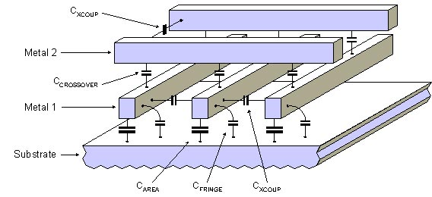

Capacitance exists anywhere !
Single conductor can have capacitance
N – conductor system => capacitance matrix is defined

Slide 16
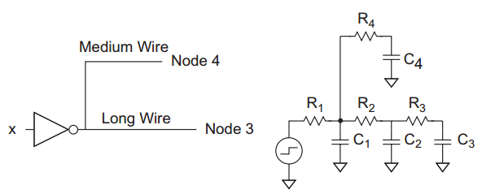
Impact
Increase delay

Slide 17
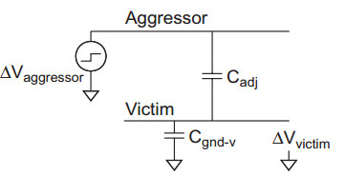
Impact
Crosstalk
Cc
Cs
http://www.eetimes.com/document.asp?doc_id=1275823

Slide 18
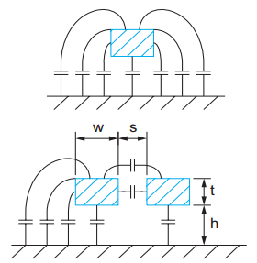
Capacitance Extraction
Different from resistance, capacitance is a function of not only wire’s own geometry, but its environments
c₁₂
m2
For multiple conductors of any shapes and materials, and in any dielectric, there is a capacitance between any two conductors
m1
c₂₃
Mutual capacitance between m1 and m2 is C₁₂ = q₁/v₂
c₁₃
m3
Capacitance is often written as a symmetric matrix
c₁₁
-c₁₂
-c₁₃
C =
-c₂₁
c₂₂
-c₂₃
Mutual cap between wires
-c₃₁
-c₃₂
c₃₃

Slide 19
Capacitance extraction
Geometric extraction – poor accuracy
3D numerical methods
FEM
Boundary element method
Stochastic method
Field Solver Q3D , Raphael, FastCap, Magma

Slide 20
An interconnect is a thin-film wire that electrically connects 2 or more components in an integrated circuit.
Interconnects can introduce parasitic (unwanted) components of capacitance, resistance, and inductance. These “parasitics” detrimentally affect
performance (e.g. propagation delay)
power consumption
reliability
As transistors are scaled down in size and the number of metal wiring layers increases, the impact of interconnect parasitics increases.
Need to model interconnects, to evaluate their impact

Slide 21
Effect of interconnect Scaling
Interconnect delay scales as square of L
minimize interconnect length!
If W is large, then it does not appear in R_{wire}C_{wire}
Capacitance due to fringing fields becomes more significant
as W is reduced; C_{wire} doesn’t actually scale with W for small W
Coupling capacitance (Cc) effects interwire spacing – loading, crosstalk

Slide 22
A
B
C
oxide
Si substrate
Wire A simply has capacitance (C_{pp} + C_{fringe}) to substrate
Wire B has additional sidewall capacitance to neighboring wires
Wire C has additional capacitance to the wire above it

Slide 23
Coupling capacitance virtually exists only between adjacent wires or crossing wires
Cx
Cx
Cx

Slide 24
C : beetwen wire and substract
Cc: beetwen 2 wire
Post layout analysis : Parasitic extractor tool
Geometric extraction: poor accuracy
Field Solver :3D modeling – Physical approch
Good results
More precision => time processing increase
Use a compute farm
Methodology : Used in analog and Digital flow

