Slide 1
Design for Testability
Scan – ATPG in Digital flow
Patrice Delpy – 2017

Slide 2
Inroduction:
The purpose of this document is to present the role of the test in the development cycle of a product.
- General concept
- Implementation in digital flow with ATPG

Slide 3
Murphy’s laws
“If you don’t test it, it won’t work!” (Guaranteed)

Slide 4
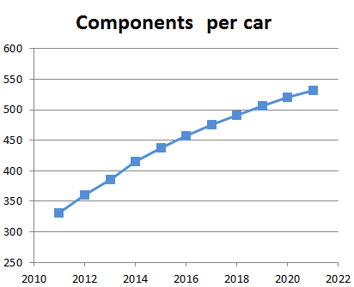
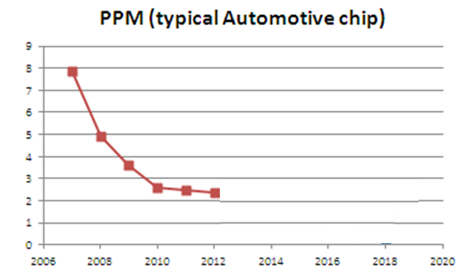
Challenge:
Quality is fondamental for automotive circuits
Zero defects
?

Slide 5
How to guarantee quality ?
The test ensures the quality of the products
It’s an integral part of the design cycle and its main role is to detect defective parts after their manufacture,
A well structured method for testing needs to be followed to ensure high yield and proper detection of faulty chips after manufacturing. Design for testability (DFT) is a matured domain now, and thus needs to be followed by all the designers

Slide 6
Test versus verification
Specification
Hardware design
Verification
≠
Netlist
Manufacturing
Test
Silicon

Slide 7
Test concept
The fabrication process is imperfect and introduce manufacturing defects
cause malfunction of the device
Improve yield and reject undesirable parts
2 types of yield loss : random effects or process variations
Test catch defectives parts

Slide 8
Defect
A defect is the unintended difference between the implemented hardware and its intended design
Defects occur either during manufacture or during the use of devices

Slide 9
Defects in fabrication
Decreasing feature size (reduce device dimention, technology scale shrink ) increases probability of defects during manufacturing process
These defects come from many sources :
Defects in the base silicon.
Oxide breakdown (crystal defects)
Optical deformation (photolithography)
Dust or contamination on mask, in the fab or on wafer.
Misalignment. Over-etch or under-etch.
Metalization defect
…….

Slide 10
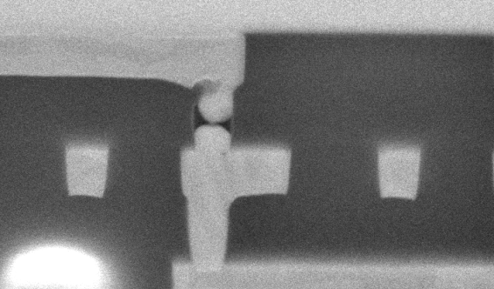
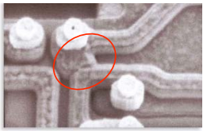
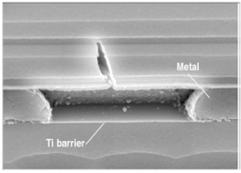
Defects illustrations

Slide 11
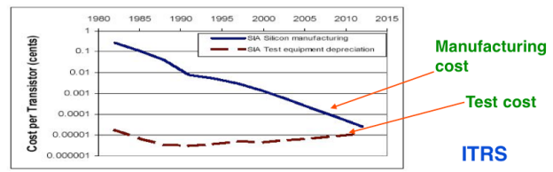
Importance of the test
Yield of any chip is < 100% , no process is perfect !
The role of testing is to detect whether something went wrong
Effectiveness of testing is most important for quality products
Today, test cost as more 60% of the total manufacturing cost

Slide 12
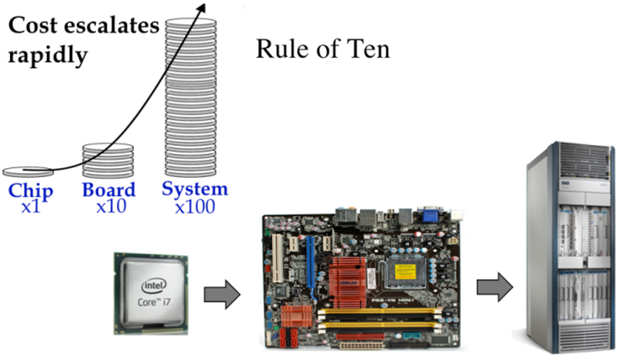
Motivation of testing
Identify a defective component as soon as possible,
before it is distributed, assembly in board and
integrated in system
If it’s doesn’t detected, the costs and penalty are very
importants
Intel bug (1994): 1M units shipped, recall cost $450M

Slide 13
Benefits of testing
Quality and economy are two major benefits of testing, these two attributes are greatly dependent and can not be defined without the other 
Quality means satisfying the user’s needs at a minimum cost 
Need to weed out all bad products before delevery to customers 
Understanding the principles of manufacturing and test is essential for design a quality product

Slide 14
Manufacturing
Testers (ATE) are very expensive
Time is money
Minimize time on tester
Careful selection of test, choose the most appropriate tests

Slide 15
Testability
Two important concept are higlhy associated woth testability:
• Controllability : ease of observing a node by watching external output pins of the chip
• Observability : ease of forcing a node to 0 or 1 by driving input pins of the chip

Slide 16
Focus to digital test
Aim: observe and control logic stucture
Combinational logic is usually easy to observe and control
It’s difficult to test sequential circuit behave
Idea: Modify sequential circuitery of the design
This technique is called scan design and is a part of the DFT methodology

Slide 17
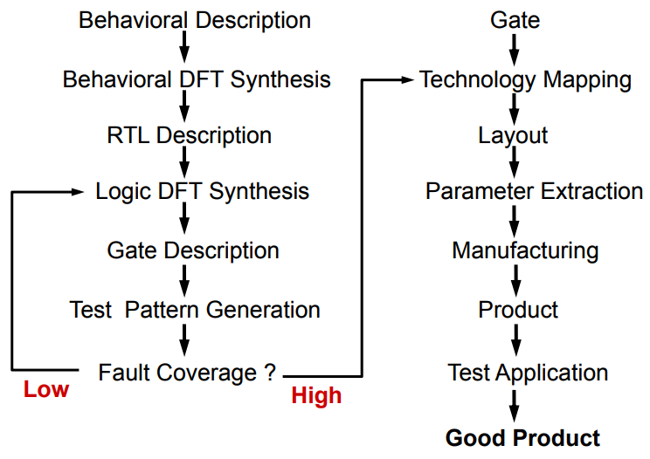
DFT implementation

Slide 18
Fault models

Slide 19
Terminology: Defect, Fault, and Error (1)
Defect :
- A defect is the unintended difference between the implemented hardware and its intended design 
Fault :
- A representation of a defect at the abstracted function level 
Error : 
- A wrong output signal produced by a defective system 
An error is caused by a Fault or a design error
Defect --> Fault ---> Error ---> Failure

Slide 20

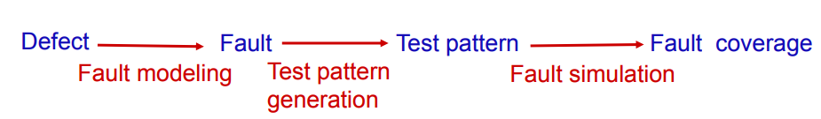
Terminology: Defect, Fault, and Error (2)

Slide 21
Faults models (1)
A fault model is a descriptions or assumptions which describe the logical behaviour (reaction) that a digital circuit has to physical defects.
• Advantages
  Complexity of test is reduce : different defects are often represented by the same fault
  Technology independant.
• Disadvantages
  Fail to identify certain process specific faults like floating gates
  Detects static faults only.

Slide 22
Fault models (2)
Fault models considered in this document:
  Stuck-at fault (gate level)
  Bridging fault
  Path-delay / Transition fault
  IDDQ fault
A delay or transition fault alters the signal propagation delay
along the faulty line As a result, signals can arrive at the outputs of
the circuit before or after the time expected.
Bridge
Faults
IDDQ
Transition
Stuckat
Most frequent faults

Slide 23
Fault model : example
Inputs and outputs can either be “stuck-at” a high (Vdd) or low (Ground)
A
B
Y
Pattern | A | B | Y | Faults Detected
1 | 0 | 0 | 0 | A: SA1 (#2) B: SA1 (#4) Y: SA1 (#6)
2 | 0 | 1 | 0 | A: SA1 (#2) B: SA0 (#3)
3 | 1 | 0 | 0 | A: SA0 (#1) B: SA1 (#4) Y: SA1 (#6)
4 | 1 | 1 | 1 | A: SA0 (#1) B: SA0 (#3) Y: SA0 (#5)
Fault Number | Fault Description
#1 | Input A is (shorted to Gnd): SA0
#2 | Input A is (shorted to Vdd): SA1
#3 | Input B is (shorted to Gnd): SA0
#4 | Input B is shorted to Vdd) : SA1
#5 | Output Y is (shorted to Gnd): SA0
#6 | Output Y is (shorted to Vdd) : SA1

Slide 24
Stuck at faults
Permanent or static faults
a short is formed by connecting points not intended to be connected; signal stuck to VDD or GND
a open results from the breaking of a connection.

Slide 25
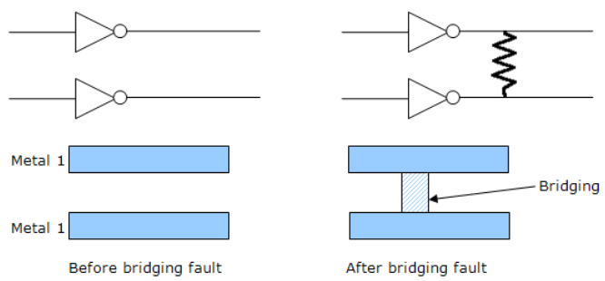
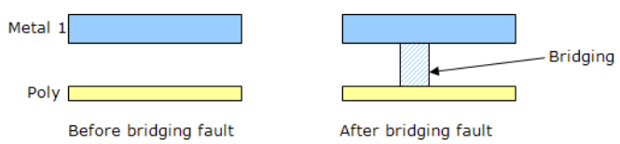
Bridging faults (1)
The bridging fault model tests for resistive shorts between two normally unconnected in wires, which could be caused by a piece of metal from the sputtering process
Bridging faults can be intra-layer and inter-layer c

Slide 26
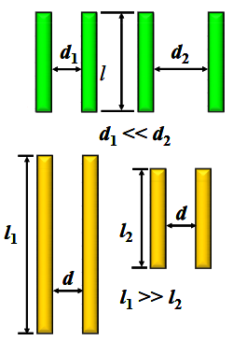
Bridging faults (2) : interconnect defects
Two or more adjacent wire are shorter together
EDA tool extract capacitive coupling based bridge pairs from physical design (frindge capacitance)
Higher capacitance indicating the higher probability of bridge occurence
Onsemi script analyze output database to identifiy the potential bridge
The designer can filter the results to select or ignore nodes that are suceptible to create a bridge.
The new netlist is given to ATPG tool to generate the
bridge detection patterns used by ATE
High probability
of bridging faults

Slide 27
Bridging faults (3) : layout analysis
Detects bridging pair nets:
examining the physical database for parallel or close proximity wires
Algorithm calculates a possibility of bridging
if two nets are close together over a long distance, the probability is high

Slide 28
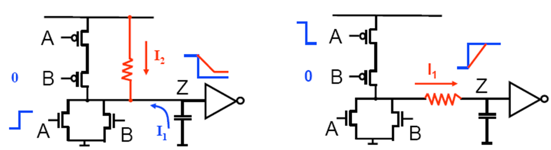
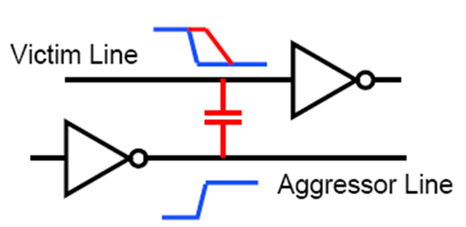
Transistion faults
Certain manufacturing defects do not change the logic function but can cause timing issues,
Delay transistion: increase the input to output delay of one logic gate (slow to rise or to fall)
Delay path : propagation delay of the path exceeds the clock interval
(timing violation)
Resistive bridges
Resistive opens

Slide 29
IDDQ faults (1)
Measure supply current in quiescent state (not switching and inputs are statics)
Leakage and bias current value expected is less than 10uA
Advantage:
- IDDQ test can detect (catch) bridge that are not detectable or other
faults that are not found by saf vectors
Inconvenience :
- Compared to scan chain test, Iddq test is time consuming (slow)
- Leakage current closer to quiescent current for deep submicron

Slide 30
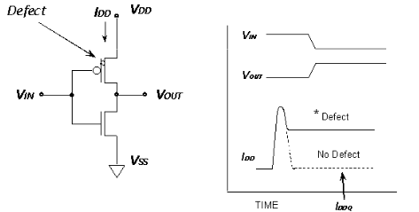
IDDQ faults (2)
Normal IDDQ: 1nA
Abnormal : > 10µA
VDD
IDD
inputs
outputs
circuit
VSS

Slide 31
Coverage
Fault Coverage
# Faults Detected
100
# Faults Modeled
Test Coverage
# Faults Detected
100
# Testable Faults

Slide 32
DFT - SCAN CHAIN

Slide 33
Scan path design
Scan is the most popular DFT technique:
- Rule-based design
- Automated DFT hardware insertion
- Combinational ATPG
Advantages:
Design automation
High fault coverage, hierarchical
Disadvantages:
Large test data volume and long test time
Increase die size (~10%) and doesn’t run at nominal speed

Slide 34
Scan design overview
Internal scan (or scan design) is the internal modification of your design’s circuitry to increase its testability.
Extra hardware
Goal of scan : make a difficult to test sequential circuit behave (during the testing process) like an easier to test combinational circuit
Replacing sequential cells (FF) with scannable scan cells and then stitching the scan cells together into scan registers, or scan chains. You can then use these serially-connected scan cells to shift data in and out when the design is in scan mode.

Slide 35
Sequential -> combinational
Problem: ATPG works for combinational logic while most ICs are sequential
Solution: Provide a test mode in which flip flops can be accessed directly
- Replace flip flop (FF) with scan flip flop (SFF): extra multiplexer on data input
- Connect FF to form one or more scan chains
- Connect multiplexer control signal to scan enable
Flip-flop
Data in
0
Flip-flop
D
Q
Q
Scan in
1
clk
clk
Scan Mode

Slide 36
SCAN chain : unactive, normal mode
All the flops are connected in form of a chain, as a shift register
Combinational logic
D
0
FF
D
0
FF
D
0
FF
Q
Q
Q
SI
1
SI
1
SI
1
clk
clk
clk
SE
SE
SE
Normal mode SE = 0

Slide 37
SCAN chain : active, scan mode
Combinational logic
D
0
FF
D
0
FF
D
0
FF
Q
Q
D
Q
SI
1
SI
1
SI
1
clk
clk
clk
SE
SE
SE
Scan mode SE = 1

Slide 38
Scan process
Scan chain operation involves 3 stages: Scan-in, Scan-capture and Scan-out
- Shifting in and loading all the flip-flops with an input vector. During scan- in, the data flows from the output of one flop to the scan-input of the next flop not unlike a shift register
- Once the pattern is loaded, one clock pulse (capture) is applied to excite the combinatorial logic block (evaluation) and the output is captured .
- The data is then shifted out and the signature is compared with the expected signature
During response shift-out, next pattern can be
concurrently shifted in.
Shift-In
Capture
Shift-Out
time

Slide 39
ATPG - concept

Slide 40
ATPG essentials
Netlist
ATPG algorithms use fault models to
generate patterns and to give a fault
coverage result & fault classes list
A fault model is a digital representation of a
real manufacturing/silicon defect
Fault coverage 100 % ≠ 0 ppb
ATPG
Algorithms
User
ATPG
engine
Fault
models
ATPG Tool
Patterns

Slide 41
ATPG overview
Sets of 1 and 0 placed in each inputs pins during the manufacturing test process to determine if the chip is functioning properly
When the test pattern is applied, the tester determines if the circuit is free from manufacturing defects by comparing the fault-free output—which is also contained in the test pattern—with the actual output measured by the ATE
If no test vector exists for a fault, the fault is said untestable

Slide 42
Understand ATGP
ATPG tool uses deterministic test pattern generation when it creates a test pattern intended to detect a given fault.
Procedure
pick a fault from the fault list
create a pattern to detect the fault
fault simulate the pattern
check to make sure the pattern detects the fault

Slide 43
How to test digital blocks ?
Input Patterns
Output Response
-1011
11-00
-0-1-
01--0
0-101
Circuit under
Test
(CUT)
1-001
0011-
-1101
1001-
01-11
Stored
Correct
Response
Comparator
Test result
The stimuli are called test patterns or test vectors

Slide 44
Fault detection process
Process is called : path sensitization
Faults detection works by comparing the response of a known-good version of the circuit with the actual circuit, for a given stimulus set. A fault exists if there is any difference in the responses.
ATPG tool construct a vector which apply to input and tries to propagate the fault effect to output,
When successful, the tool create a stimulus set (or test pattern) to detect the fault,
Next step, verify fault coverage of patterns trought fault simulation

Slide 45
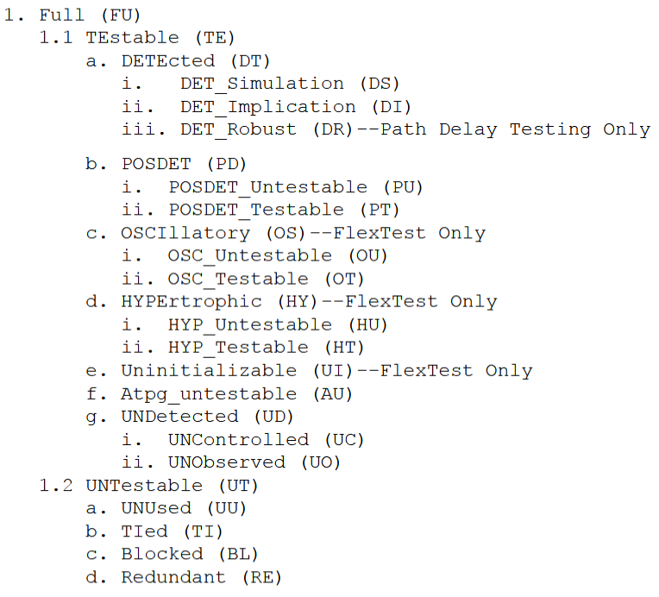
Fault classes
ATPG tool categorize faults into fault classes, based on how the faults were detected or why they could not be detected.

Slide 46
What is STIL files ?
Standard Test Interface Language : international format
Language to define the test vectors applied to the device under test (DUT). Describe bits sequences
This stimulus file introduces the faults, it’s input datas of scan chain

Slide 47
What is Tessent ?
Tessent suite is set of DFT tools from Mentor Graphics
It’s a design-for-test environment within which you can perform all the tasks required to insert DFT hardware, generate manufacturing test patterns, and post-silicon tasks such as diagnosis and yield analysis
Tessent provides a graphical user interface (GUI), DFTVisualizer, that allows you to edit and introspect designs, and adjust object attributes

Slide 48
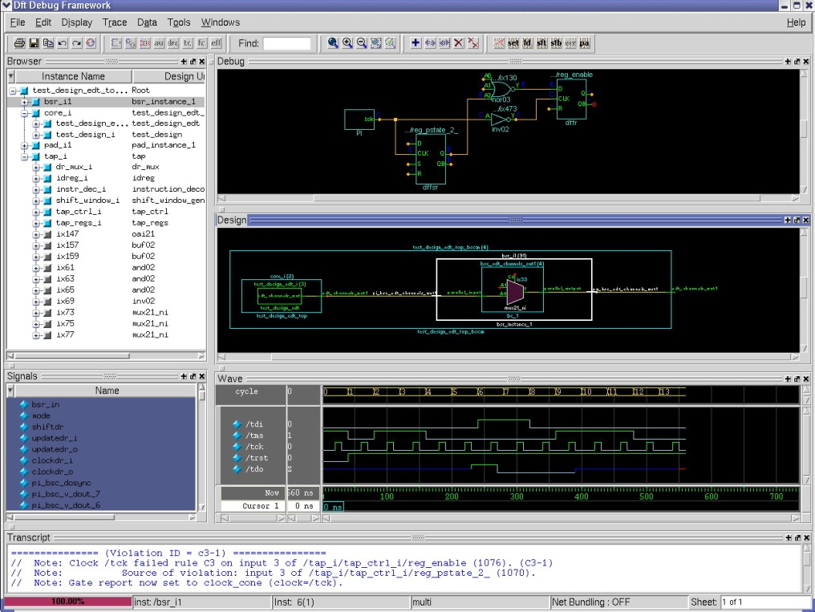
DFT VISUALIZER - Diagnosis tool
DFT debug environment in Tessent
Tool to visally investigate the causes of DRC low converage
Intuitive and effective GUI to reduce DFT debug effort
Eases design navigation & exploration
Helps to debug DFT related issues
  DRC violations
  Low coverage
  Test procedures

Slide 49
Tetramax from Synposys ….

Slide 50
ATPG – implementation

Slide 51
ATPG digital flow features
For each project, a set of patterns must be generated.
In digital environment a set of scripts stored in templates allows to:
  Generate vectors in STIL format compatible with tester
  Generate testbench and vectors in Verilog format
  Simulate Verilog vectors with timings back annotation
  Provide cadence cells with auto-check embedded vectors for top cell simulation
  Estimate realistic stuck-at fault test coverage

Slide 52
Directory structures & files templates
Several files (do file, lib files, contraints sdf, parameters) are needed to perform pattern generation and for testbenchs simulations
mkblock.csh script creates a dedicated directory under DIG_BLOCKS/<digital_block name>/tool_data/tessent

Slide 53
Directory template
  /tessent
  tessent_patt_saf.do : tessent dofile to generate stuck at fault vectors
    tessent_patt_sbf.do : tessent dofile to generate static bridge fault vectors
    tessent_patt_tft.do : tessent dofile to generate transient fault vectors
    tessent_patt_iddq.do : tessent dofile to generate IDDQ vectors
    tessent_cov.do : tessent dofile to estimate coverage
    tessent_testproc.do : tessent procedures file used by dofiles
    param_file : tessent options for .stil format
    run_patt.sh : tessent command for pattern generation
    run_cov.sh : tessent command for coverage estimation
    atpg_wrapper.v : wrapper around digital block= netlist for vectors generation
    generate_patterns.sh : script to generate patterns and create files for top cell simulation
    simulate_patterns.sh : script simulating all generated patterns in worst & best conditions
    /vectors : directory to store vectors and re-simulate them
      scan_map.txt : text file template for scan pins mapping
      header.txt : text file template for .stil header compatible with eagle tester
    /reports : directory containing tessent reports
    /top_cell_sim : directory to store deliverables for top cell simulation
To be completed by Designer

Slide 54
Extra files
Create a symbolic link on the following files:
- Verilog code (gate level) of blocks
Library
SDF files constraints

Slide 55
Generate vectors 1/13 : wrapper concept
Test wrapper is the logic added around topdig to provide test access to the embedded core : Normal mode or Test mode
Make access to cell and isolate it from rest of the circuit
Only scan pins are accessible
Input must be assigned to consistent value with top cell state in scan mode
Output are unconnected
Vectors will be generated at atpg_wrapper level
Completed by Designer from atpg_wrapper template available in template dir.

Slide 56
Generate vectors 2/13 : wrapper topology
scan_in
atpg_wrapper.v
scan_clk
scan_rstb
scan_en
Input fixed levels
Switcher_dig.v
Top_dig.v
Analog_top.v
scan_out
Output no connected

Slide 57
Generate vectors 3/13 : wrapper example
To be completed … on going

Slide 58
Generate vectors 4/13 : tessent.testproc file
This file is called by tessent dofile. Its describes all procedures used during scan (shift, capture, test setup) and timing events during one tester cycle (timeplate) to be aligned with test engineer.
  This file is written for a one-scan chain design. It needs to be changed if multiple scan chains.
  This file is compatible with eagle tester with following sequencing:
  Procedures are basic ones and run at 1Mhz.
pulse clock
0
T
CLK
set inputs
measure outputs

Slide 59
Generate vectors 5/13 : Patterns generation
In tessent directory, use generate_patterns.sh script that includes several sub command:
Launch tessent trought run_patt.sh to generate vectors and test benchs
Call gen_stil_4_eagle.pl to make STIL vectors compatible with eagle tester
Call generate_top_vectors.pl to write cadence test benches for top cell simulations.
Usage: sh generate_patterns.sh cellname block1 block2 …. blockN
Example: sh generate_patterns.sh DigTop scv78565_dig switcher_dig

Slide 60
Generate vectors 6/13 : Faults models analysis
tessent -shell \
-dofile tessent_patt_saf.do \
-logfile tessent_patt_saf.log -replace
# Transition fault
tessent -shell \
-dofile tessent_patt_tft.do \
-logfile tessent_patt_tft.log -replace
# Static bridging fault
tessent -shell \
-dofile tessent_patt_sbf.do \
-logfile tessen_pattt_sbf.log -replace
# IDDQ
tessent -shell \
-dofile tessent_patt_iddq.do \
-logfile tessent_patt_iddq.log -replace
./run_patt.sh launch a generation of the vectors on the 4 models of faults present of the file

Slide 61
Generate vectors 7/13 : output files
    Here is the list of files outputted by Tessent through run_patt.sh script:
  under tessent/
    tessent_patt.log -> drc rules report
  under reports/
    <block_name>_scan_chains.rpt -> lists registers in chains from output to input
    <block_name>_drc_C6.rpt -> report of C6 violations, flops to be masked
    <block_name>_wrapper_faults_au.rpt -> provides list of untestable faults
    <block_name>_wrapper_coverage.rpt -> provides coverage information
    Note: use run_cov.sh to get real coverage

Slide 62
Generate vectors 8/13 : vectors created
  under vectors/
    <block_name>_chain.v
    <block_name>_chain.v.0.vec -> set of Verilog data + auto check testbench
    <block_name>_chain.v.cfg for shift in / shift out vector (scan check integrity)
    <block_name>_chain.v.po_name
    <block_name>_serial.v
    <block_name>_serial.v.0.vec -> set of Verilog data + auto check testbench
    <block_name>_serial.v.cfg for first 10 vectors (shift and capture)
    <block_name>_serial.v.po.name
    <block_name>_serial_full.v
    <block_name>_serial_full.v.0.vec -> set of Verilog data + auto check testbench
    <block_name>_serial.v.cfg for all vectors (shift and capture)
    <block_name>_serial_full.v.po.name
    <block_name>_parallel.v
    <block_name>_parallel.v.0.vec -> set of Verilog data + auto check testbench
    <block_name>_parallel.v.cfg for all vectors (capture only) for debug purpose
    <block_name>_parallel.v.po.name
    <block_name>_parallel.v.chain.name
    <block_name>.stil -> all vectors in stil format

Slide 63
Generate vectors 9/13 : STIL post processing
Compatible with eagle test program, the header of stil file generated by Tessent must be modified.
Inputs must be masked and outputs receive hi-Z during the first tester cycle.
scan_map.txt (in vectors/ directory) must be manually updated with top cell scan pin names and number of chains in the design:
Example scv78565: nb_chain =1
scan_clk = scan_clk
scan_rstb = scan_rstb
scan_en = scan_en
scan_in1 = scan_in
scan_out1 = scan_out
header.txt (in vectors/ directory):
  Must be changed only if multiple scan chains to add other scan_in/scan_out pins.
  Scan pins will be replaced by their top cell names by gen_stil_4_eagle.pl script.

Slide 64
Generate vectors 10/13 : STIL post processing
script gen_stil_4_eagle.pl performs those modifications in vectors/ directory:
usage: perl $TOOLS_SCRIPT/scan/gen_stil_4_eagle.pl -in <block_name>.stil
-map scan_map.txt
-rev <x.px>
[-reset digital | analog]
[-active 0 | 1]
By default if reset and active (reset polarity) options are not used, reset is considered to digital and active low.
  The generated file <project>_<block>_<date>_<rev>.stil outputted by the script can be delivered to test team.

Slide 65
Generate vectors 11/13 : topcell vectors generation
You must run scan simulation at to topdig level to verify correct pins control and tessent vectors that were created.
A new module is designed and it can be used by Verification
atpg_wrapper is no more instantiated but scan signals are directly inputs/outputs of the tessent module.
<block_name>_xxx.v
atpg_vector_chain
top_cell
atpg_wrapper
digital
control
top
hard coded
digital
control
top

Slide 66
Generate vectors 12/13
The generate_patterns.sh script calling generate_top_vectors.pl inside top_cell_sim/ directory to modify the testbench files generated by Tessent in vectors/ directory :
      usage: perl $TOOLS_SCRIPT/scan/generate_top_vectors.pl
      -vec <block_name>_chain.v | serial.v | parallel.v
      -map scan_map.txt
      -delay < in us>
      -block b1 –block b2 …. block N
What the script does ?:
Modify Tessent testbench file :
  - Remove atpg_wrapper instantiation and create scan pins inputs and outputs
  - Change relative to absolute paths for called files, insert delay scan process execution from <delay> us
  - Replace atpg_wrapper_inst by digital hierarchical path in top cell test bench
  - Rename modules in atpg_shift_vectors atpg_capture_vectors or atpg_parallel_vectors according to type
  - Copy other files from vectors/ directory
  - Create testbenches in top_cell_sim/ for re-simulation including .trn logging

Slide 67
Generate vectors 13/13
Here are the files generated:
under vectors/
  <block_name>_chain.v
  <block_name>_chain.v.0.vec
  <block_name>_chain.v.cfg
  <block_name>_chain.v.po_name
  <block_name>_serial.v
  <block_name>_serial.v.0.vec
  <block_name>_serial.v.cfg
  <block_name>_serial.v.po.name
  <block_name>_parallel.v
  <block_name>_parallel.v.0.vec
  <block_name>_parallel.v.cfg
  <block_name>_parallel.v.po.name
  <block_name>_parallel.v.chain.name
under topcell_sim/
  atpg_ <block_name>_ shift_vectors.v
  <block_name>_chain.v.0.vec
  <block_name>_chain.v.cfg
  <block_name>_chain.v.po_name
  tb_scan_shift.v
  atpg_ <block_name>_ capture_vectors.v
  <block_name>_serial.v.0.vec
  <block_name>_serial.v.cfg
  <block_name>_serial.v.po.name
  tb_scan_capture.v
  atpg_ <block_name>_ parallel_vectors.v
  <block_name>_parallel.v.0.vec
  <block_name>_parallel.v.cfg
  <block_name>_parallel.v.po.name
  <block_name>_parallel.v.chain.name
  tb_scan_parallel.v
New modules atpg_<block_name>_[shift | capture | parallel]_vectors can be imported in cadence as functional views through verilogin.
Other files (.0.vec, .cfg, .po.name , .chain.name) will be directly accessed by people in charge of top cell simulation.

Slide 68
Simulate vectors 1/4
To ensure quality of release to test team, vectors have been saved in Verilog format and must be simulated with timing back-annotation on final post layout digital netlist.
The generated modules for top cell sim must also be re-simulated for sanity check:
In Tessent directory, use simulate_patterns.sh, it will:
Call runsim_atpg.pl to simulate tessent generated vectors (chain, serial, parallel) in worst and best conditions.
Call runsim_top_atpg.pl to simulate modified vectors for top cell simulation (shift, capture, parallel) in worst and best conditions.
        Usage: sh simulate_patterns.sh

Slide 69
Simulate vectors 2/4
Features of runsim_atpg.pl
      perl $TOOLS_SCRIPT/scan/runsim_atpg.pl -vec <block_name>_saf_chain.v
      <block_name>_saf_serial.v
      <block_name>_saf_parallel.v
      -cond worst | best | none
      -block b1 - block b2 ….. Block N
      [-norun -help]
  Must be used in vectors/ directory
  Modify tessent testbench to generate .trn file for Simvision in case of debug
  Compile sdf file corresponding to condition switch
  Generate annotation file with correct scope to digital top for timing back-annotation
  Launch Irun simulation on tessent Verilog testbench and vectors
  norun option allows to print Irun command without running the simulation if design is too specific and Irun command must be modified
  help option indicates how to use the script

Slide 70
Simulate vectors 3/4
Features of runsim_top_atpg.pl:
      perl $TOOLS_SCRIPT/scan/runsim_top_atpg.pl -vec tb_scan_shift_vectors.v
      tb_scan_capture_vectors.v
      tb_scan_parallel_vectors.v
      -cond worst | best | none
      -block b1 - block b2 ….. Block N
      [-norun -help]
  Must be used in top_cell_sim/ directory
  Compile sdf file corresponding to condition switch
  Generate annotation file with correct scope to digital top for timing back-annotation
  Simulate vectors module with corresponding tb_scan<shift | capture | parallel>.v testbench
  Generate atpg_shift.trn, atpg_capture.trn, atpg_parallel.trn files
  norun option allows to print Irun command without running the simulation if design is too specific and Irun command must be modified
  help option indicates how to use the script

Slide 71
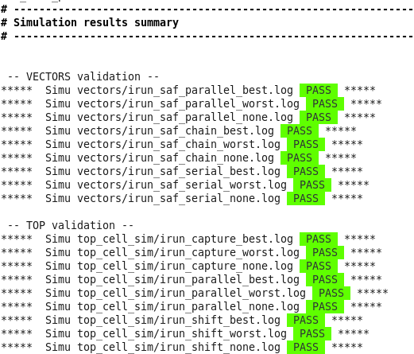
Simulate vectors 4/4
You can find a script called simulation_pattern.sh that include runsim_atpg.pl and runsim_top_atpg.pl
It set all parameters needed to start simulation and automate simulation vectors process
At the end of the script, the status_simul.pl
command allows you to check all the simus
log files and make a summary

Slide 72
ATPG with ITC loop back

Slide 73
What for ?
This methodology was developed by ONSEMI and should allow a better test coverture.
With this DFT technique we take into account the potential faults that can appear on the interconnections between the digtop block and the digital functions implanted in the analog blocks

Slide 74
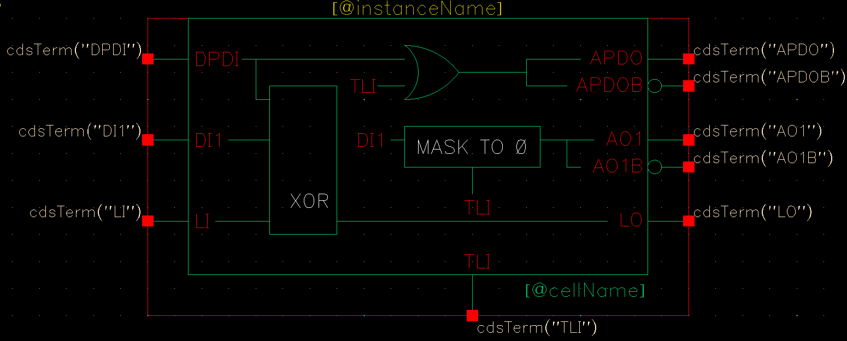
ITC cells concept
ITC = interconnect test coverage or loop back (include XOR)
Loopback cells must be placed inside analog blocks
Topdig
cmd
in
ITC
digital
Analog block
Loop
out

Slide 75
Topdig
cmd
in
ITC
Analog block
Loop
out

Slide 76
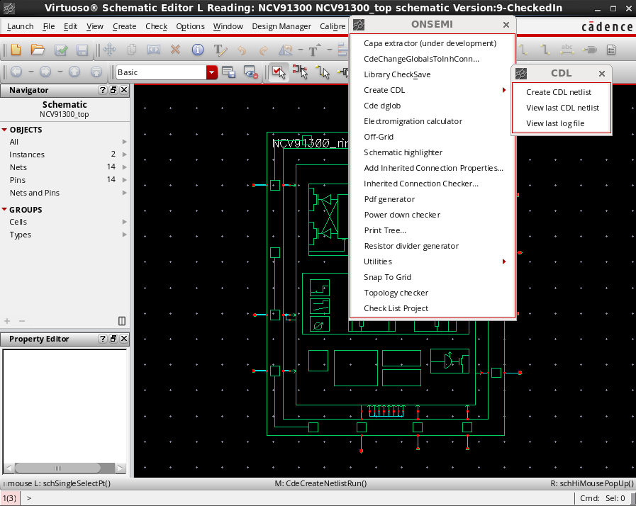
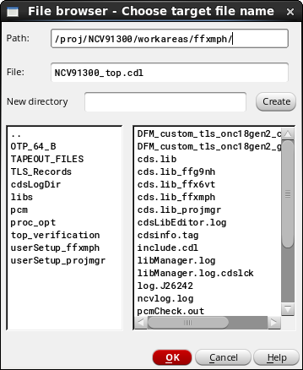
Netlist of the design: 1 /
Generate CDL netlist of the Topcell

Slide 77
Apply patch : 2/
In itc directory:
Apply patch.pl to CDL netlist to create a modified netlist.cdl
This script identify digital libraries and cells (TLS works with multiple dig blocks and Brno use only one)

Slide 78
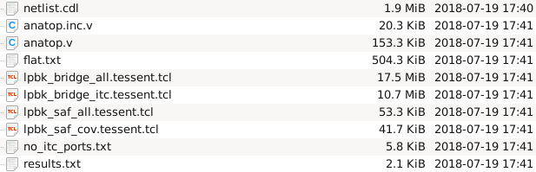
Interconnectes extraction: 3 /
We need to extract the connectivity (interconnects) between the ITC cells placed inside analogs macro blocks and the topdig cell
./cdl_itc.pl -cmd
cmd not detailed here
Before going to the next step, check the files no_itc_port.txt and results.txt to make sure the consistency of the nets will be tested.
results.txt : List of warning
no_itc_port.txt : List of nets that will not be tested , may be forgottent ?
Output files

Slide 79
What is Anatop ?
This module is build by cdl_itc.pl
Illustation à prévoir
Analog_top.v
ITC_bloc1
ITC_bloc2
…
ITC_blocN
atpg_wrapper.v
scan_out
Output no connected

Slide 80
lpbk_saf_all_tessent.tcl : faults descriptions
Ipbk_saf_cov_tessent.tcl

Slide 81
Replace instance name: step4
Build excuded_ports.txt file
Grep command contains regular expression to change

Slide 82
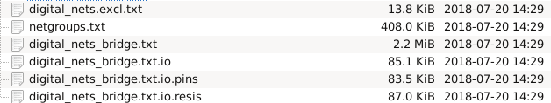

Slide 83
Bridge extraction and ATPG
The mentor provide an innovative tool with LADB
- Need to extract from layout or DEF
- Need to take critical area into account
Extract bridge pairs

Slide 84
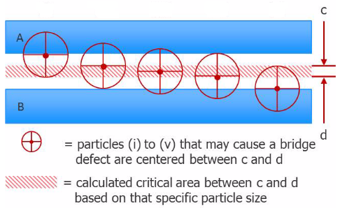
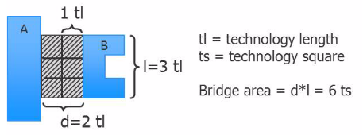
What is critical area ?
The area in which the center of a spot defect must fall to cause the bridge
Total critical area (TCA) is the sum of all individual CAs weighted by the probability of occurrence of that spot size

Slide 85
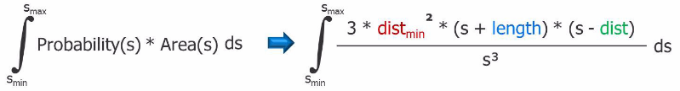
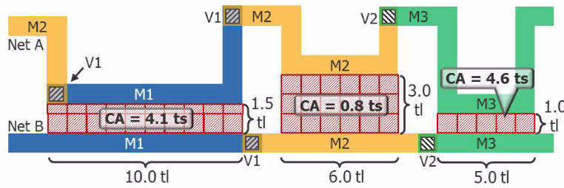
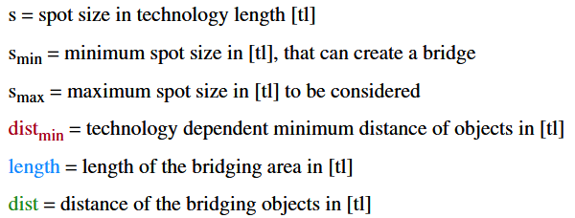
Critical area calculation

Slide 86
Critical area flow
LADB
Creation
Bridge
Extraction
Pattern
Generation
.DEF
Reports
LADB
UDFM
.LEF
.STIL

Slide 87

Tetramax faults list generation ????

Slide 88
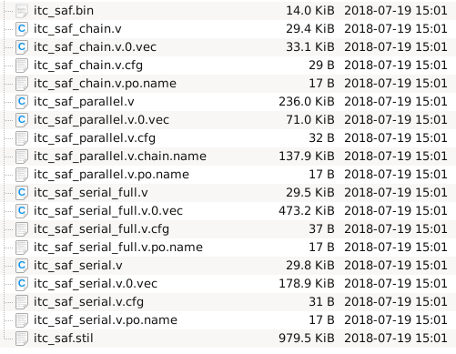
ATPG generation
Step 1:Execute Tessent cmd to launch vectors generation in Tessent directory
Created file inside/vectors

Slide 89
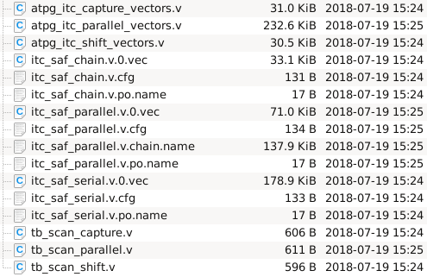
Step 2: Execute generate_top_vectors.pl to modify vectors generated by Tessent and stored in /vectors
/top_cell_sim

Slide 90
Step3 : It’s necessary to simulate generated vectors (to check generation) before to send it to test team.

Slide 91
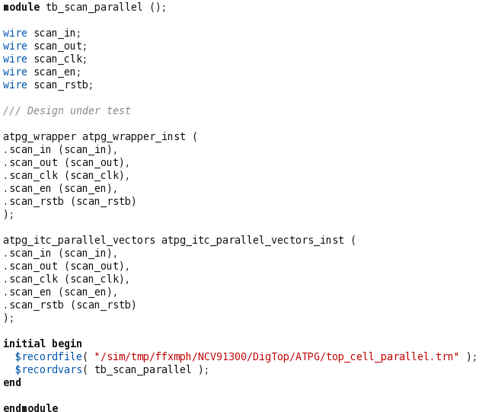
we will create an ATPG box that can be used by the verification team to simulate the behavior of the scan on the topcell.

Slide 92
Summary
Scan design is a methodology used for Design For Test (DFT) to add testability features to a hardware design.
Scan design makes Automatic Test Pattern Generation (ATPG) easier to implement as logic depth is constrained.
There is always a trade-off. Full scan design typically adds 10%-15% more area.
100% fault coverage may be impossible due to undetectable faults
Your goal should be to achieve the highest coverage of defects as possible. Because high test coverage directly correlates to the quality of the parts shipped
Think about testing from the beginning of Design

Slide 93
Bibliography
Digital Systems Testing and Testable Design IEEE press
Testing of Digital Systems , Cambridge
VLSI Test principles and architectures The Morgan Kaufmann Series
Essentiials of electronic testing , Bushnell - Agrawal
An Introduction to logic circuit Testing , Morgan & Claypol
Electronic Design Automation: Synthesis, Verification, and Test

