Slide 1
Digital Design Crash Course
Mohamed Rayan

Slide 2
Overview
Quick review
Design Methodologies.
Difference between C/C++ and HDL.
Verilog HDL.

Slide 3
Quick Review

Slide 4
Common rules of any digital circuit:
1- 2’s Complement for signed operations.
2- Sequential Logic Circuits must be Synchronous only not Asynchronous.
3- Flip-Flops should be used not Latches.
4- Any Sequential Circuit should have Reset.

Slide 5

Q1 : Design a combinational circuit with three inputs and one output ?
If The output is 1 when the binary value of the inputs is less than 3.
The output is 0 otherwise.

Slide 6
Q2 : Design a sequential circuit with two D flip-flops A and B, and one input x_in ?
When x_in = 0, the state of the circuit remains the same.
When x_in = 1, the circuit goes through the state transitions
from 00 to 01, to 11, to 10, back to 00, and repeats.

Slide 7
Design Methodologies

Slide 8
There are two basic types of digital design methodologies :
a bottom-up design methodology and a top-down design
methodology.
Bottom-up (Traditional method of electronic design):
with the increasing complexity of new designs this approach is nearly impossible to maintain. New systems consist of ASIC or microprocessors with a complexity of thousands of transistors. These traditional bottom-up designs have to give way to new structural, hierarchical design methods. Without these new practices it would be impossible to handle the new complexity.
Top-down :
The desired design-style of all designers is the top-down one. A real top-down design allows early testing, easy change of different technologies, a structured system design and offers many other advantages. But it is very difficult to follow a pure top-down design.

Slide 9
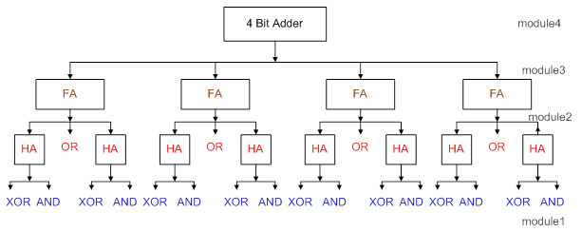

Slide 10
Typically, a combination of top-down and bottom-up flows is used. Design architects define the specifications of the top-level block.
Logic designers decide how the design should be structured by breaking up the functionality into blocks and sub-blocks.
At the same time, circuit designers are designing optimized circuits for leaf-level cells. They build higher-level cells by using these leaf cells.
The flow meets at an intermediate point where the switch-level circuit designers have created a library of leaf cells by using switches, and the logic level designers have designed from top-down until all modules are defined in terms of leaf cells.
Every time this intermediate point goes to abstracted level and this helps to cut the design cycle and reduce time of design due to designs complexity.

Slide 11
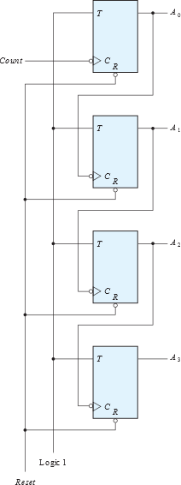
Example : 4-bit ripple carry counter.

Slide 12
Difference between C/C++ and HDL

Slide 13

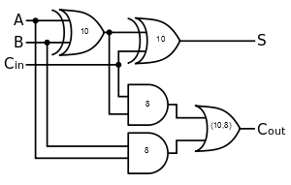
Difference between C/C++ and HDL
C Program
Foo.c
Compiler
Assembly
Foo.asm
Assembler
Machine language
Foo.o
Loader
Machine Language
Foo.exe
Linker
Layout & Fab.
Design Specs
HDL
Design.v
Synthesis Tool
Gate level Description

Slide 14
Difference between C/C++ and HDL
In C Program we have a series of instructions loaded into memory and to be executed by microprocessor in order (Sequentially) .
In C program we don’t have timing control to control its operation because the next statement will not be executed till finishing execution of the current statement.
Verilog Code will configure Hardware to do certain function. Statements in Verilog may have parallel “Concurrency” or sequential execution or both. Verilog Code must be synthesizable i.e the compiler must be able to generate logic that fits the description.
In Verilog we have timing control as we have gate delays and statements that may be executed in parallel.

Slide 15
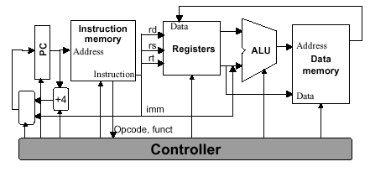
Difference between C/C++ and HDL

Slide 16

Verilog HDL
(HARDWARE DESCRIPTION LANGUAGE)

Slide 17
Verilog is a hardware description language is a language used to describe a digital system: for example, a network switch, a microprocessor or a memory or a simple flip-flop. This just means that, by using a HDL, one can describe any (digital) hardware at any level.
HDLs have two objectives
Allow for testing/verification using computer simulation
» Includes syntax for timing, delays
Allow for synthesis
» Synthesizable HDL
It allows us to design a Digital design at Behavior Level, Register Transfer Level (RTL), Gate level and Switch(Transistor) level.
Verilog allows hardware designers to express their designs with behavioral constructs, deferring the details of implementation to a later stage in the final design.
Verilog HDL is case sensitive
All Verilog keywords are lower case

Slide 18
Module in Verilog
Modules are the building blocks of Verilog designs.
The following figure shows starcture of any Verilog module :
Module name,
Port list, port delectation (if ports present),
Parameters (optional)
Declare Wires and Registers of variables used in the design.
Verilog code that describe operations of the module :
Always and Initial blocks
(having behavioral statements
e.g if and case )
Instantiation of lower level modules
End Module

Slide 19
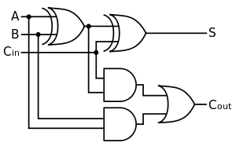
Module in Verilog
Definition of Full adder will be as follow :
module FullAdder(A,B,Cin,Cout,S);
// Design Body
endmodule
Ports :
Ports provide the interface by which a module can communicate with its environment. For example, the input/output pins of an IC chip are its ports. The environment can interact with the module only through its ports.
Verilog Keyword | Type of Port
input | Input port
output | Output port
inout | Bidirectional port

Slide 20
Module in Verilog
input [range_val:range_var] list_of_identifiers;
output [range_val:range_var] list_of_identifiers;
inout [range_val:range_var] list_of_identifiers;
Definition of 1-bit Full adder will be as follow :
module FullAdder(A,B,Cin,Cout,S);
input A, B, Cin;
output Cout, S;
// Design Body
endmodule
Definition of 4-bit Full adder will be as follow :
module FullAdder(A,B,Cin,Cout,S);
input[3:0] A, B;
input Cin;
output Cout,;
output [3:0] S;
// Design Body
endmodule

Slide 21
Module in Verilog
Instantiating a module:
A module may be consisting of logic and some lower level modules, e.g: Full adder of 4-bit needs to be designed using 1-bit Full adder, in the top level of 4-bit adder we will instantiate 4 1-bit adders.
module_name instance_name ( connecting ports);
e.g : FullAdder Bit0 ( .A (A[0]) ,
.B (B[0]) ,
.Cin (Cin) ,
.S (result[0]) ,
.co (c1)
);
A module may be instantiated multiple times within top module.

Slide 22
Module in Verilog
Connecting Ports to External Signals :
There are two methods of making connections between signals specified in the module instantiation and the ports in a module definition. These two methods cannot be mixed:
1- Connecting by ordered list (Implicit):
all module ports is connected by order without defining the actual ports of the instantiated modules
e.g : FullAdder Bit0 (A[0] ,
B[0] ,
Cin ,
result[0],
c1);
2- Connecting ports by name (Explicit):
all module ports is defined with its connected port
e.g : FullAdder Bit0 ( .A (A[0]) ,
.B (B[0]) ,
.Cin (Cin) ,
.S (result[0]) ,
.co (c1) );

Slide 23
Module in Verilog
Port Connection Rules:
The Verilog simulator complains if any port connection rules are violated.
Inputs : Internally, input ports must always be of the type net. Externally, the inputs can be connected to a variable which is a reg or a net.
Outputs : Internally, outputs ports can be of the type reg or net. Externally,
outputs must always be connected to a net. They cannot be connected to a reg.
Inouts : Internally, inout ports must always be of the type net. Externally, inout
ports must always be connected to a net.
Width matching: It is legal to connect internal and external items of different
sizes when making inter-module port connections. However, a warning is
typically issued that the widths do not match.
Unconnected ports : Verilog allows ports to remain unconnected. For
example, certain output ports might be simply for debugging, and you might not
be interested in connecting them to the external signals.
e.g : fulladd4 fa0(SUM, , A, B, C_IN); // Output port c_out is unconnected

Slide 24
Parameterized Modules
Parameterized modules are modules that can be defined with different characteristics values e.g input/output width.
Assume that we need counter of various widths, Instead of create counter modules every module having different width, We can define only one parameterized module and instantiate it multiple times with needed width.
A parameter is defined by Verilog as a constant value declared within the module structure (Global Constants).
module RAM ( Reset, Clock , address , data , we );
parameter DATA_WIDTH = 8 ;
parameter ADDR_WIDTH = 8 ;
parameter RAM_DEPTH = 1 << ADDR_WIDTH;
// Actual code of RAM here
endmodule
Reusability : Different modules can use RAM module with different data widths and address widths.

Slide 25
Parameterized Modules
The value can be used to define a set of attributes for the module which can characterize its behavior as well as its physical representation.
Parameters of RAM module may be overridden at instantiation time if they declared global . If an overriding value is not specified, the default parameter declaration values are used.
module RAM_Controller ();
//Insatiate RAM here
RAM#( .DATA_WIDTH(16),
.ADDR_WIDTH(8),
.RAM_DEPTH(256))
RAM_instance (Reset, Clock, address, data, we);
//continue code
endmodule
Parameter Override using defparam
module RAM_Controller ();
//Insatiate RAM here
RAM RAM_instance (Reset, Clock, address, data, we);
//continue code
defparam RAM_instance.DATA_WIDTH = 4;
defparam RAM_instance ADDR_WIDTH = 10;
endmodule

Slide 26
Parameterized Modules
Local parameters (constants) that will be declared only within the same module can defined as follow:
module FSM ();
localparam [1:0] S0 = 2’b00,
S1 = 2’b01,
S2 = 2’b10,
S3 = 2’b11;
//continue code
endmodule
In general using Parameters/Constants will lead to easy Reusability and easy later modifications, So it will be better if you make your design parameterized .

Slide 27
Data types
Verilog Language has two primary data types:
Nets - represent structural connections between
components.
Registers - represent variables used to store data.
Every signal has a data type associated with it:
Explicitly declared with a declaration in your Verilog
code.
Implicitly declared with no declaration when used to
connect structural building blocks in your code. Implicit
declaration is always a net type "wire" and is one bit wide.

Slide 28
Register Data Types
Registers store the last value assigned to them until another assignment statement changes their value.
Registers represent data storage constructs.
You can create regs arrays called memories.
register data types are used as variables in procedural blocks.
A register data type is required if a signal is assigned a value within a procedural block
Procedural blocks begin with keyword initial and always.
reg [3:0] A; // A is signal unsigned by default of width 4 bits.
reg signed[3:0] B; // B is signal signed represented in 2’s complement of width 4 bits.
integer C; //C is signed variable of 32 bits.
Note : Of all register types, reg is the one which is most widely used.

Slide 29
Signal Values and Comments in Verilog
‘0’ represents low logic level or false condition.
‘1’ represents high logic level or true condition.
‘X’ represents unknown logic level.
‘Z’ represents high impedance logic level.
Comments:
here are two forms to introduce comments.
Single line comments begin with the token // and end with
a carriage return
Multi line comments begin with the token /* and end with
the token */

Slide 30
Numbers in Verilog
Verilog HDL allows integer numbers to be specified as
Sized or unsized numbers (Unsized size is 32 bits)
In a radix of binary, octal, decimal, or hexadecimal
Radix and hex digits (a,b,c,d,e,f) are case insensitive
Spaces are allowed between the size, radix and value
Syntax: <size>'<radix><value>;
Examples:
Verilog expands <value> filling the specified <size> by working from right-to-left
When <size> is smaller than <value>, then leftmost bits of <value> are truncated
When <size> is larger than <value>, then leftmost bits are filled, based on the value of the leftmost bit in <value>.
  Leftmost '0' or '1' are filled with '0'
  Leftmost 'Z' are filled with 'Z'
  Leftmost 'X' are filled with 'X'
Integer | Stored as
1 | 00000000000000000000000000000001
8'hAA | 10101010
6'b10_0011 | 100011
'hF | 00000000000000000000000000001111

Slide 31
Verilog Operators
Operator Type | Operator Symbol | Operation Performed | Number of Operands
Arithmetic | * / + - % ** | multiply divide add subtract modulus power (exponent) | two two two two two two
Logical | ! && || | logical negation logical and logical or | one two two
Relational | > < >= <= | greater than less than greater than or equal less than or equal | two two two two
Equality | == != | equality Inequality case equality case inequality | two Two two two

Slide 32
Verilog Operators Cont’
Operator Type | Operator Symbol | Operation Performed | Number of Operands
Bitwise | ~ & | ^ ^~ or ~^ | bitwise negation bitwise and bitwise or bitwise xor bitwise xnor | one two two two two
Reduction | & ~& | ~| ^ ^~ or ~^ | reduction and reduction nand reduction or reduction nor reduction xor reduction xnor | one one one one one one
Shift | >> << >>> <<< | Right shift Left shift Arithmetic right shift Arithmetic left shift | two two two two
Concatenation | { } | Concatenation | Any number
Replication | { { } } | Replication | Any number

Slide 33
Abstraction levels of designs using Verilog

Slide 34
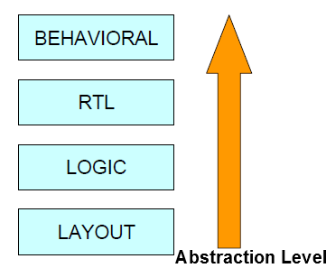

In complex designs the number of gates is very large. Thus, designers can design more effectively if they concentrate on implementing the function at a level of abstraction higher than gate level.
The higher abstraction level the lower details .
Designs with more details may have more errors hence less verification time.
Verification is about 50 – 60 % of design time.

Slide 35
Gate Level Design
At gate level, the circuit is described in terms of gates (e.g., and, nand most commonly because any gate can be done using it and its transistor circuit is easy to fabricate ).
Hardware design at this level is about one-to-one correspondence between the logic circuit diagram and the Verilog description. See the following example:
module FullAdder(A,B,Cin,Cout,S);
input A, B, Cin;
output Cout, S;
wire w1, w2, w3, w4;
xor (w1, A, B);
and (w2, A, B);
and (w3, w1, Cin);
xor (S, w1, Cin);
or (Cout, w3, w2);
endmodule

Slide 36
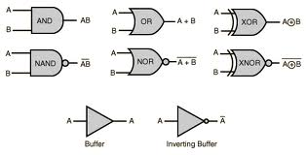
Gate Level Design
To define a gate in verilog :
and/nand/or/….. Instant_name (OUT, IN1, IN2,IN3,IN4,…….);
buf instant_name(OUT, IN); not n1(OUT, IN);
Gate propagation delay can be simulated in Verilog but sure it is not Synthesizable, Synthesis will be done with actual delays of mapped gate in Technology library.
There are three types of delays from the inputs to the output of a primitive gate.
Rise delay is associated with a gate output transition to a 1 from another value.
Fall delay is associated with a gate output transition to a 0 from another value.
Turn-off delay is associated with a gate output transition to the high impedance
value (z) from another value.
and #(rise_delay,fall_delay,turnoff_delay) and_gate (OUT, IN1, IN2,IN3,IN4,…….);

Slide 37
Gate Level Design
module FullAdder(A,B,Cin,Cout,S);
input A, B, Cin;
output Cout, S
wire w1, w2, w3, w4;
xor #(10) (w1, A, B); // delay time of 10 units
and #(8) (w2, A, B);
and #(8) (w3, A, Cin);
and #(8) (w4, B, Cin);
xor #(10) (S, w1, Cin);
or #(10, 8)(Cout, w2, w3, w4); // (rise time of 10, fall 8)
endmodule
If No Delay is specified then it is assumed 0 .
Every delay value may have a range minimum, maximum and typical values.
(min_rise:typical_rise:maximum_rise, min_fall:typical_fall:maximum_fall)

Slide 38
Back to Q1 : Design using Verilog a combinational circuit with three inputs and one output ?
If The output is 1 when the binary value of the inputs is less than 3.
The output is 0 otherwise.

Slide 39
Register Transfer Level Design
The modules of a digital system are best defined by a set of registers and the operations (done by some gates) that are performed on the binary information stored in them. Examples of
Register operations are shift, count, clear, and load . Registers are assumed to be the basic components of the digital system.
A digital system is represented at the register transfer level (RTL) when it is specified by the following three components:
1. The set of registers in the system.
2. The operations that are performed on the data stored in the registers.
3. The control that supervises the sequence of operations in the system.
R1← R1 + R2 Add contents of R2 to R1 ( R1 gets R1 + R2 )
R3 ← R3 + 1 Increment R3 by 1 (count upwards)
R4 ← shr R4 Shift right R4
R5 ← 0 Clear R5 to 0

Slide 40
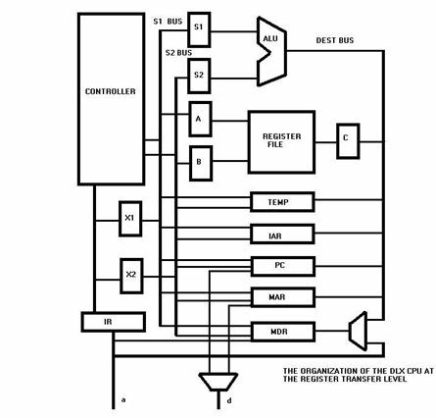
The type of operations most often encountered in digital systems can be classified into four categories :
1. Transfer operations, which transfer data from one register to another.
2. Arithmetic operations, which perform arithmetic (e.g., multiplication)
on data in registers.
3. Logic operations, which perform bit manipulation (e.g., logical OR) of
non numeric data in registers.
4. Shift operations, which shift data between registers.

Slide 41
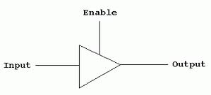
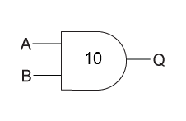
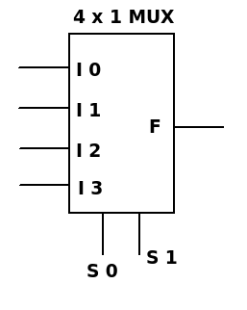
Assign Statement : is used for modeling only combinational logic and it is executed continuously. So the assign statement is called 'continuous assignment statement' .
Assign statement is applied for only wires.
EX: assign Output = (enable) ? Input : 1'bz;
assign out = data;
assign #10 out = in1 & in2;
assign F = ({s1,s0} == 2’b00)? I0:
({s1,s0} == 2’b01)? I1:
({s1,s0} == 2’b10)? I2:I3;
Use assign statement to model full adder?

Slide 42
Q : Synthesize the following code and get the corresponding circuit?
  module Prob (A, B, S, E, Q);
  input [1:0] A, B;
  input S, E;
  output [1:0] Q;
  assign Q = E ? (S ? A : B) : 'bz;
  endmodule

Slide 43

Behavioral(Algorithmic) Level Design
Design is a Black Box
It takes place at an algorithmic level where the designers do not necessarily think in terms of logic gates or data flow but in terms of the algorithm they wish to implement in hardware.
They are more concerned about the behavior of the algorithm and its performance.
Only after the high-level architecture and algorithm are finalized, do designers start focusing on building the digital circuit to implement the algorithm.

Slide 44
Behavioral(Algorithmic) Level Design
Procedural Blocks
Verilog behavioral code is inside procedure blocks, but there is an exception: some behavioral code also exist outside procedure blocks. We can see this in detail as we make progress.
There are two types of procedural blocks in Verilog : initial and always blocks
Procedural assignment statements assign values to reg, integer, real, or time variables and can not assign values to nets (wire data types).
Module may have more than one procedural block.
All behavioral statements must be inside an initial or always block only.
//Initialize clock at time zero //Toggle clock every half-cycle (time period = 20)
initial clock = 1'b0; always #10 clock = ~clock;

Slide 45
Behavioral(Algorithmic) Level Design
Procedural Blocks
initial : initial blocks execute only once at time zero (start execution at time zero) used in test benches.
always : always blocks loop to execute over and over again; in other words, as the
name suggests, it executes always.
module initial_example(); module always_example();
reg clk,reset,enable,data; reg clk,reset,enable,q_in,data;
initial begin always @ (posedge clk) begin
clk = 0; if (reset) begin
reset = 0; data <= 0;
enable = 0; end else if (enable) begin
data = 0; data <= q_in;
end end
endmodule endmodule

Slide 46
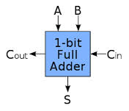

Behavioral(Algorithmic) Level Design
Always Block
Is the heart of Hardware modeling using Verilog HDL
always @(…..sensitivity list…..)
begin
//behavioral constructs e.g if/else, case that describe needed fuctionality
end
Sensitivity list : Without any signals in it the statements inside always block i.e between begin .. end will be executed forever. If we have signals in this list then statements inside always block will be executed if and only if these signals chagned .
Modeling Combinational Circuits e.g(Muxes, Decoders, Encoders, ……).
always @ (A,B,Cin) begin
{Cout,S} = A+B+Cin;
end
All signals in Right hand side must appear in the sensitivity list .

Slide 47
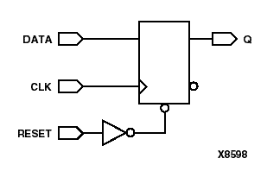
Behavioral(Algorithmic) Level Design
Always Block
Modeling Sequential Circuits e.g(Registers, Counters, ……).
always @ (posedge Clock, negedeg Reset) begin
if( !Reset)
Q <= 0;
else
Q <= D;
end
Clock and Asynchronous signals must appear in the sensitivity list .
Design may have any number of always block e.g we can model every register in an independent always block.
always @(posedge clk) always @(posedge clk)
R2 = R1; R4 = R3;
different always blocks are working independent on each other .
always @(posedge clk) blocks run in some undefined sequence.

Slide 48
Q : Modify the following design of Flip-Flop to have synchronous reset instead asynchronous one?
always @ (posedge Clock, negedeg Reset) begin
if( !Reset)
Q <= 0;
else
Q <= D;
end

Slide 49
Behavioral(Algorithmic) Level Design
Blocking and Nonblocking assignment
Blocking assignments(Modeling Combinational Circuits)
are executed in the order they are coded, hence they are sequential. Since they block the execution of next statement, till the current statement is executed, they are called blocking assignments. Assignment are made with "=" symbol. Example a = b;
Example :
reg x, y, z;
reg [15:0] reg_a, reg_b;
integer count;
initial begin
x = 0; y = 1; z = 1;
reg_a = 16'b0; reg_b = reg_a;
#15 reg_a[2] = 1'b1;
#10 reg_b[15:13] = {x, y, z};
count = count + 1;
end

Slide 50
Behavioral(Algorithmic) Level Design
Blocking and Nonblocking assignment
Nonblocking assignments(Modeling Sequential Circuits)
are executed in parallel i.e (at the same time e.g all registers and flip-flops must update their outputs at the same moment). Since the execution of next statement is not blocked due to execution of current statement, they are called nonblocking statement. Assignments are made with "<=" symbol. Example a <= b;
To generate Concurrent Statements.
Example :
reg x, y, z;
reg [15:0] reg_a, reg_b;
integer count;
initial begin
x = 0; y = 1; z = 1;
reg_a = 16'b0; reg_b = reg_a; 11
#15 reg_a[2] <= 1'b1;
#10 reg_b[15:13] <= {x, y, z};
count <= count + 1;
end

Slide 51
Behavioral(Algorithmic) Level Design
Blocking and Nonblocking assignment
initial begin
a = #1 1; // assignment at time 1
b = #3 0; // assignment at time 4 (3+1)
c = #6 1; // assignment at time 10 (6+3+1)
End
initial begin
#1 a <= 1; // assignment at time 1
#3 b <= 0; // assignment at time 3
#6 c <= 1; // assignment at time 6
end

Slide 52
Behavioral(Algorithmic) Level Design
Blocking and Nonblocking assignment
Question: What the difference between following codes?
a = 1; a<= 1;
b = a; b <= a;
c = b ; c <= b

Slide 53
Behavioral(Algorithmic) Level Design
Why we should use Non blocking assignment for sequential instead of blocking?
To Overcome Race condition, The following example will clarify why?
reg R1, R2, R3, R4;
always @(posedge clk) always @(posedge clk)
R2 = R1; R2 <= R1;
always @(posedge clk) always @(posedge clk)
R3 = R2; R3 <= R2;
always @(posedge clk) always @(posedge clk)
R4 = R3; R4 <= R3;
These run in some order, RHS evaluated when assignment runs
but you don’t know which. LHS updated only after all events
for the current instant have run.

Slide 54
Behavioral(Algorithmic) Level Design
Timing Controls and Delays
Timing controls provide a way to specify the simulation time at which procedural statements will execute.
If there are no timing control statements, the simulation time does not advance, and the simulator can’t track signals in the design.
There are three methods of timing control: delay-based timing control, event-based timing control, and level-sensitive timing control.

Slide 55
Behavioral(Algorithmic) Level Design
Delay-Based Timing Control
Delay-based timing control in an expression specifies the time duration between when the statement is encountered and when it is executed.
Delay-based timing control can be specified by a number, identifier,
or a (minimum, typical, maximum) expression.
There are three types of delay control for procedural assignments: regular delay control, intra-assignment delay control, and zero delay control.

Slide 56
Behavioral(Algorithmic) Level Design
Delay-Based Timing Control
Regular delay control: used when a non-zero delay is specified to the left of a procedural assignment .
initial begin
x = 0; // no delay control
#10 y = 1; // delay control with a number. Delay execution of // y = 1 by 10 units
#latency z = 0; // Delay control with identifier. Delay of 20 units
#(latency + delta) p = 1; // Delay control with expression
#y x = x + 1; // Delay control with identifier. Take value of y.
#(4:5:6) q = 0; // Minimum, typical and maximum delay values.
//Discussed in gate-level modeling chapter.
end

Slide 57
Behavioral(Algorithmic) Level Design
Delay-Based Timing Control
Intra-assignment delay control: Instead of specifying delay control to the left of the assignment, it is possible to assign a delay to the right of the assignment operator.
initial begin
x = 0; z = 0;
y = #5 x + z; //Take value of x and z at the time=0, evaluate
//x + z and then wait 5 time units to assign value to y.
end
//Equivalent method with temporary variables and regular delay control
initial begin
x = 0; z = 0;
temp_xz = x + z;
#5 y = temp_xz; //Take value of x + z at the current time and
//store it in a temporary variable. Even though x and z
//might change between 0 and 5, //the value assigned to y at time 5 is unaffected.
end
end

Slide 58
Behavioral(Algorithmic) Level Design
Delay-Based Timing Control
Zero delay control: Procedural statements in different always-initial blocks may be evaluated at the same simulation time. The order of execution of these statements in different always-initial blocks is nondeterministic. Zero delay control is a method to ensure that a statement is executed last, after all other statements in that simulation time are executed. This is used to eliminate race conditions. However, if there are multiple zero delay statements, the order between them is nondeterministic.
initial begin initial begin
x = 0; #0 x = 1;
y = 0; #0 y = 1;
end end

Slide 59
Behavioral(Algorithmic) Level Design
Event-Based Timing Control
An event is the change in the value on a register or a net. Events can be utilized to trigger execution of a statement or a block of statements. There are four types of event-based timing control: regular event control, named event control, event OR control, and level-sensitive timing control.
Regular event control: The @ symbol is used to specify an event control. Statements can be executed on changes in signal value or at a positive or negative transition of the signal value.
@(clock) q = d; //q = d is executed whenever signal clock changes value
@(posedge clock) q = d; //q = d is executed whenever signal clock does , a positive transition ( 0 to 1,x or z, x to 1, z to 1 )
@(negedge clock) q = d; //q = d is executed whenever signal clock does , a negative transition ( 1 to 0,x or z, x to 0, z to 0)
q = @(posedge clock) d; //d is evaluated immediately and assigned //to q at the positive edge of clock.
Regular event control: Verilog provides the capability to declare an event and then trigger and recognize the occurrence of that event .
event received_data; //Define an event called received_data
always @(posedge clock) //check at each positive clock edge
begin
if(last_data_packet) //If this is the last data packet
->received_data; //trigger the event received_data
end
always @(received_data) //Await triggering of event received_data, When event is triggered, store all four , packets of received data
data_buf = {data_pkt[0], data_pkt[1], data_pkt[2], data_pkt[3]};

Slide 60
Behavioral(Algorithmic) Level Design
Event-Based Timing Control
Event OR Control (Sensitivity List) : Sometimes a transition on any one of multiple signals //A level-sensitive latch with asynchronous reset .
always @( reset or clock or d) //Wait for reset or clock or d to change
begin
if (reset) //if reset signal is high, set q to 0. q = 1'b0; else if(clock) //if clock is high, latch
input q = d;
end

Slide 61
Behavioral(Algorithmic) Level Design
Event-Based Timing Control
When the number of input variables to a combination logic block are very large, sensitivity lists can become very cumbersome to write. Moreover, if an input variable is missed from the sensitivity list, the block will not behave like a combinational logic block. To solve this problem, Verilog HDL contains two special symbols: @* and @(*).
//Combination logic block using the or operator
//Cumbersome to write and it is easy to miss one input to the block
always @(a or b or c or d or e or f or g or h or p or m)
begin
out1 = a ? b+c : d+e;
out2 = f ? g+h : p+m;
end
//Instead of the above method, use @(*) symbol //Alternately, the @* symbol can be used //All input variables are automatically included in the //sensitivity list.
always @(*)
begin
out1 = a ? b+c : d+e;
out2 = f ? g+h : p+m;
end

Slide 62
Behavioral(Algorithmic) Level Design
Event-Based Timing Control
Level-Sensitive Timing Control : Event control discussed earlier waited for the change of a signal value or the triggering of an event (Not Synthesizable).
always wait (count_enable) #20 count = count + 1;
In the above example, the value of count_enable is monitored continuously. If count_enable is 0, the statement is not entered. If it is logical 1, the statement count = count + 1 is executed after 20 time units. If count_enable stays at 1, count will be incremented every 20 time units.
event received_event;
always wait (received_event) #20 count = count + 1;

Slide 63
Behavioral(Algorithmic) Level Design
The Conditional Statement if-else
(appears only in a procedural block)
The if - else statement controls the execution of other statements. In programming language like c, if - else controls the flow of program. When more than one statement needs to be executed for an if condition, then we need to use begin and end as seen in earlier examples.
Example :
Modeling Multiplexer 4-to-1.
What about Question 1 Now?
Don’t write if statement for Combinational Circuit without
declaring else statement if yes then u will have latch in your design.

Slide 64
Q : Design a 4-bit Counter with Asynchronous Reset ?
Q : Add Feature to the counter to count up or down ?
Q : Make it parameterized?
Take the feature of parameterized designs to be easily reused.

Slide 65
Behavioral(Algorithmic) Level Design
The Case Statement
(appears only in a procedural block)
The case statement compares an expression to a series of cases and executes the statement or statement group associated with the first matching case:
case statement supports single or multiple statements. Group multiple statements using begin and end keywords.
Syntax of a case statement look as shown below from the following example :
module mux_without_default (I0,I1,I2,I3,Sel,F);
input I0, I1, I2, I3;
input [1:0] Sel; //Sel0, Sel1
output F;
reg F;
always @ (I0 or I1 or I2 or I3 or Sel) begin
case (Sel)
0 : F = I0;
1 : F = I1;
2 : F = I2;
3 : F = I3;
endcase
endmodule
Don’t write Case statement for Combinational Circuit without
declaring default statement else u will have latch in your design.

Slide 66
Q : Design an 8-function ALU that takes 4-bit inputs a and b
and a 3-bit input signal select, and gives a 5-bit output
out. The ALU implements the following functions based
on a 3-bit input signal select. Inputs A, B and out should be
_{received in} registers and final output also . (Parameterize it)
Select Signal | Function
3'b000 | out = a
3'b001 | out = a + b
3'b010 | out = a – b
3'b011 | out = a *b
3'b100 | out = b
3'b101 | out = a << 1
3'b101 | out = a << 1
3'b110 | out = a >> 1
3'b111 | out = (a > b) (magnitude compare)

Slide 67
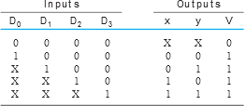
Q : Design a four-input (D0, D1, D2, D3) priority encoder with input D3 having the highest priority and input D0 the lowest priority

Slide 68
Behavioral(Algorithmic) Level Design
Looping Statements(appears only in a procedural block)
Looping statements appear inside procedural blocks only; Verilog has four looping statements like any other programming language.
forever (The forever loop executes continually, the loop never ends. Normally we use forever statements in initial blocks.)
reg clk;
initial begin
#1 clk = 0;
forever begin #5 clk = ! clk;
end
end
Repeat : repeat (< number >) < statement >
While : while (< expression >) < statement >
For : for (< initial assignment >; < expression >, < step assignment >) < statement >
E.g : array of registers initialization or assignements .
Most of time are Not Synthesizable.
Most commonly used in Test benches.

Slide 69
FSM Using Verilog
State machines or FSM are the heart of any digital design; of course a counter is a simple form of FSM. Controller of any processor is about a group of state machines.
There are two types of state machines as classified by the types of outputs generated from each. The first is the Moore State Machine where the outputs are only a function of the present state, the second is the Mealy State Machine where one or more of the outputs are a function of the present state and one or more of the inputs.

Slide 70
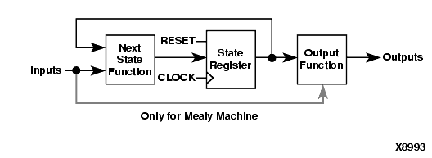
FSM Using Verilog
FSM code should have three sections:
Encoding Style .
Combinational Part (Next State Logic and output Logic).
Sequential Part (State Registers).
Take Q2 as an example for how to model FSM using Verilog .

Slide 71
FSM Using Verilog
Encoding Style:
Binary Encoding.
parameter [1:0] S0 = 2’b00;
parameter [1:0] S1 = 2’b01;
parameter [1:0] S2 = 2’b10;
parameter [1:0] S3 = 2’b11;
One hot Encoding.
parameter [3:0] S0 = 4’b0001;
parameter [3:0] S1 = 4’b0010;
parameter [3:0] S2 = 4’b0100;
parameter [3:0] S3 = 4’b1000;
Gray Encoding (Only 1-bit should change from previous value)
parameter [2:0] S0 = 3’b000;
parameter [2:0] S1 = 3’b001;
parameter [2:0] S2 = 3’b011;
parameter [2:0] S3 = 3’b010;

Slide 72
FSM Using Verilog
Combinational Part (Calculate next state):
always @ (*) begin
next_state = 0;
case(state)
S0 : begin
…
end
S1 : begin
…
end
S2 : begin
…
end
S3 : begin
…
end
default : next_state = S0; //Must have a default state not to refer latches
endcase
end

Slide 73
FSM Using Verilog
Combinational Part (Calculate next state):
always @ (*) begin
next_state = 0; //default value will be overwritten
case(state)
S0 : begin
…
end
S1 : begin
…
end
S2 : begin
…
end
S3 : begin
…
end
default : next_state = S0; //Must have a default state not to refer latches
endcase
end

Slide 74
FSM Using Verilog
Sequential Part (State Register and Output):
always @ (posedge Clock,negedge Reset) begin
if (!Reset) begin
current_state <= S0;
output_reg <= 0;
end
else begin
current_state <= next_state;
output_reg <= fn (current_state); //Moore output
output_reg <= fn (current_state,inputs); //Mealy output
end
end

Slide 75
Memories
Memory is a collection of storage cells together with associated circuits needed
to transfer information into and out of these cells.
Memory Interfaces for Accessing Data
Asynchronous (un-clocked):
A change in the address results in data appearing.
Synchronous (clocked):
A change in address, followed by an edge on CLK results in data appearing or
write operation occurring.
A common arrangement is to have synchronous write operations and asynchronous read operations.
Volatile:
Looses its state when the power goes off.
Nonvolatile:
Retains it state when power goes off.

Slide 76
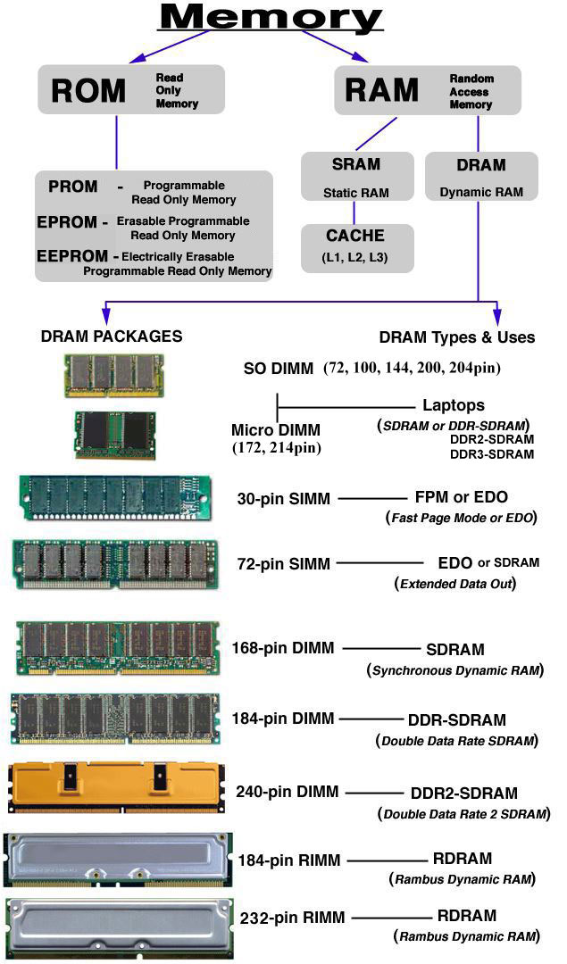

Slide 77
Memories
Modeling Memory using verilog :
Parameter WIDTH = 10;
Parameter DEPTH = 1024
reg [WIDTH -1:0] my_memory [0: DEPTH-1];
Storing Values my_memory[address] = data_in;
Reading Values data_out = my_memory[address] ;
Bit Read data_out_0 = data_out[0];
Initialization Memories :
we can use system task (command for compiler) $readmemb
and $readmemh. $readmemb is used for binary representation
of memory content and $readmemh for hex representation.
e.g : $readmemh("memory.list", my_memory);

Slide 78
Modeling of Single Port RAM using Verilog
module (clock, data_in, address, We, data_out);
Parameter WIDTH = 10;
Parameter Address_WIDTH = 10;
Parameter DEPTH = 1024;
input clock,We;
input [WIDTH -1:0] data_in;
input [Address_WIDTH -1:0] address;
output [WIDTH -1:0] data_out;
reg [WIDTH -1:0] my_memory [0: DEPTH-1];
always @ (posedge clock)
begin
if(We == 1’b1)
begin
my_memory[address] <= data_in;
end
else
begin
data_out <= my_memory[address];
end
end
endmodule
We
address
data_in
clock
Single Port RAM
data_out

Slide 79
Modeling of Synchronous ROM using Verilog
CS
RE
address
clock
ROM
data_out

Slide 80
Modeling of Synchronous FIFO using Verilog
Clock
Reset
Rd_en
FIFO
Wr_en
data_in
Full
Empty
data_out

Slide 81
Block Interface
Every block interface will be based on handshaking communication protocol.
For input and output we will have a strobe signal .
A strobe is a signal that is sent that validates data or other signals on adjacent parallel lines. In memory technology, the CAS (column address strobe) and RAS ( row address strobe ) signals are used to tell a dynamic RAM that an address is a column or row address. To get new input we should have load/valid signal that give me an announcement that we have a new input.
We will have strobe_in to catch inputs and strobe_out to validate block outputs.
Strop_in
Block ?
Strop_out
Input_real
output_real
Input_imag
output_imag
…….
Other inputs e.g design parameter (FFT size)

Slide 82
Q : Design Averaging Unit. Specification :
1- design should accept 16 successive numbers and accumulate them in an accumulator register and then calculate the average.
2- We receive this input vector (16 numbers) in 16 clock cycles.
3- After we calculate average of a vector we can receive another one.
4- Before starting in the design describe the block interface.

Slide 83
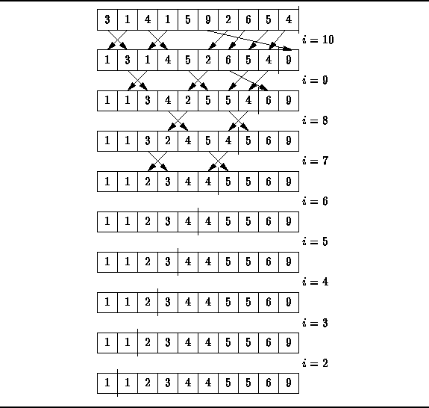
Q : Design a Bubble Algorithm , Specification :
1- Memory is needed here….Why????

Slide 84
Q : Design a traffic signal controller, using a finite state machine approach. Specification :
Consider a controller for traffic at the intersection of a main highway and a country road.
The traffic signal for the main highway gets highest priority because cars are continuously present on the main highway. Thus, the main highway signal remains green by default.
Occasionally, cars from the country road arrive at the traffic signal. The traffic signal for the country road must turn green only long enough to let the cars on the country road go.
As soon as there are no cars on the country road, the country road traffic signal turns yellow and then red and the traffic signal on the main highway turns green again.
There is a sensor to detect cars waiting on the country road. The sensor sends a signal X as input to the controller. X = 1 if there are cars on the country road; otherwise, X= 0.
There are delays on transitions from S1 to S2, from S2 to S3, and from S4 to S0. The delays must be controllable.

Slide 85
thanks

