Slide 1
Digital Flow
Verilog basics
Patrice Delpy 2017

Slide 2
Synthesis: Verilog -> Gates
Silicon compiler
Infer logic elements and generate a netlist of cells -> schematic
Technology independant
Optimizations, simplification, tradeoff area / speed
Map elements to the target design flow

Slide 3
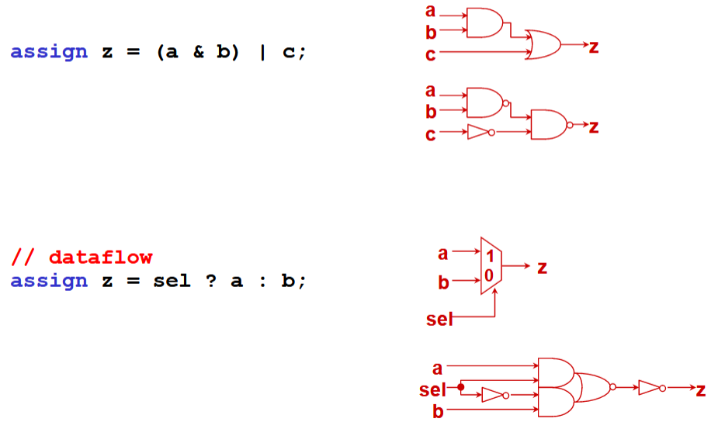
Logic synthesis

Slide 4
Synthesis of sequential logic
Synthesizer could create innappropriate cell
A part of HDL is not synthesizable, these constructs should be used only for testbench
Some struxture are unsupported

Slide 5
What is synthesis ?
Synthesis = translation + optimization + mapping

Slide 6
A variable belongs to one of two data types:
–Net
Must be continuously driven
Used to model connections between continuous assignments & instantiations
–Register
Retains the last value assigned to it
Often used to represent storage elements

