Slide 1
Digital Flow
Verilog basics
Patrice Delpy 2017

Slide 2
Basic Design Methodology
Requirements
RTL Model
Simulate
Synthesize
Gate-level
Model
Simulate
Test Bench
ASIC or FPGA
Place & Route
Timing
Model
Simulate

Slide 3
Overview of HDLs
Hardware description languages (HDLs)
  Computer-based hardware description languages
  Allow modeling, describing and simulating the functionnal behavior of digital circuits
Two main HDLs used by industry
  Verilog (C based, industry driven 60%)
  VHDL (aerosparial/defense)

Slide 4
History of Verilog = Verifying Logic
Need: a simple, intuitive and effective way to design complex digital circuits : CAD tool
Design are to complex to just draw schematics
Developed in 1984-85 by Philip Moorby
In 1990 Cadence opened the language to the public
Standardization of language by IEEE in 1995

Slide 5
Synthetis of HDLs
Takes a description of what a circuit DOES
Creates the hardware to do it
HDL may look like software, but they are not!
  Not a program
  Don’t confuse them !
Use HDL to test the designed hardware

Slide 6
HDL to gates
Simulation
  Input values are applied to the circuit
  Outputs checked for correctness
  Millions of dollars saved by debugging in simulation instead of hardware
Synthesis
  Transforms HDL code into a netlist describing the hardware (a list of gates and the wires connecting them)

Slide 7
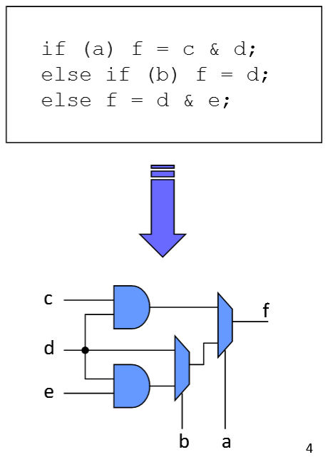
Hardware description

Slide 9
What is a HDL ? (I)
A Hardware Description Language (HDL) is a high-level programming language that offers special constructs with which you can model microelectronic circuits.
These special language constructs permit you to:
  Describe the operation of a circuit at various levels of abstraction
    The behavior of a circuit
    The function of a circuit
    The structure of a circuit
  Describe the timing of a circuit
  Express the concurrency of circuit operation

Slide 10
What is a HDL ? (II)
All HDLs share common features:
  Contains both low-level and high-level constructs to modeling hardware at multiple levels of abstraction
  An HDL permits you to describe the timing characteristics and requirements of the hardware
  you can express the concurrency of the hardware operation
Software programming languages typically have no concept of time, In hardware, there are delays associated with going from an input to an output. An HDL allows you to model these delays because it has a concept of time.

Slide 11
Why use an HDL (I)
More and more transistors can fit on a chip
  Allows larger designs!
  Work at transistor/gate level for large designs: hard
  Many designs need to go to production quickly
  Reduce cost and time
Abstract large hardware designs!
  Describe what you need the hardware to do
  Tools then design the hardware for you

Slide 12
Why use an HDL (II)
Simplified & faster design process
  Tradeoff : smaller, faster and lower power
Reduce the time spent to debugging the design
  Design errors still possible, but in fewer places
  Generally easier to find and fix
Can reuse design to target different technologies
  Don’t manually change all transistors for rule change

Slide 13
Important HDL features
Are highly portable (text)
Describe multiple levels of abstraction
Represent parallelism
Provides many descriptive styles levels
  Structural (gate level)
  Register Transfer Level (RTL)
  Behavioral
Serve as input for synthesis tools

Slide 14
Advantage of HDL
Verilog HDL allows a hardware designer to describer designs at a high level of abstraction
Allow to separate behavior from implementation at various levels of abstraction
Verilog programming style is very similar to C language
Verilog is easier to learn and use than VHDL
Hardware description languages are an essential part of modern digital design

Slide 15
Main rule in HDL
Once you can “think hardware”, you should be able to use any HDL fairly quickly
Important:
When describing circuits using an HDL, it’s critical to think of the hardware the code should produce

Slide 16
HDL vs programming language
In computer : microprocessor execute instructions in order Sequentially
We don’t have timing control to control its operation because the next statement will not be executed till finishing execution of the current statement.
Verilog describe Hardware, statements in Verilog may have parallel “Concurrency” or sequential execution or both.
In Verilog we have timing control as we have gate delays and statements that may be executed in parallel.

Slide 17
HDL specificity : modeling concurrency
An HDL is NOT a Software Programming Language (sequential)
Hardware, unlike software, behaves concurrently: a lot of parallel process occur at the same time
=> key difference from C: explicit notion of time

Slide 18
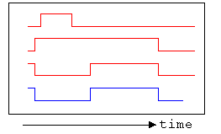
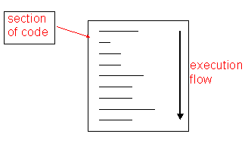
HDL Main concept
Procedural Statements
Time

Slide 19
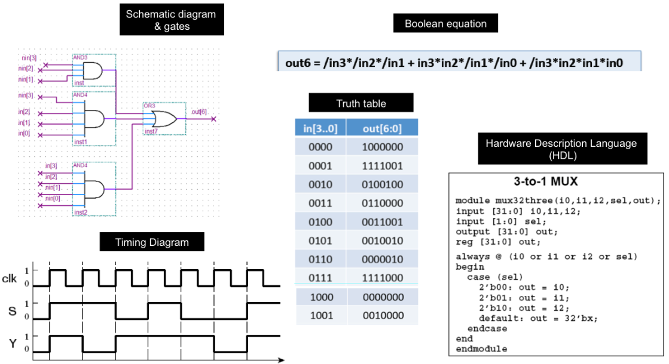
How to describe / specify digital circuits
Differents ways

Slide 20
Different Levels of Abstraction
Algorithmic
  the function of the system
RTL
  the data flow
  the control signals
  the storage element and clock
Gate
  gate-level net-list
Switch
  transistor-level net-list
Behavioral
High level
RTL
Gate (structural)
Low level
Layout (VLSI)

Slide 21
Modeling digital systems
Verilog HDL is for writing models of a system
Reasons for modeling
  requirements specification
  documentation
  testing using simulation
  formal verification
  synthesis
Goal
  most reliable design process, with minimum cost and time
  avoid design errors!

Slide 22
What is a model ?
HDL model specifies the relationship between input signals and output signals
HDL uses special constructs to describe hardware concurrency, operation, parallel activity flow, time delays and waveforms

Slide 23
Structural
  Describes the structure of the hardware
  netlist using gates like schematic but using text
  Hard to write, hard to decode
  continuous assignment using Verilog operators
Behavioral (RTL)
  describes what a component does, not how it does it
  what should be done in a module
  timing controls and concurrency
  procedural blocks (always and initial)
  registers and latches

Slide 24
Behavioural : high level, you only describe the hardware should behave without any reference to digitial hardware (physical cells)
Register – Transfert level (RTL) : Use registers and theres are synchronized by clock signal
Gate level: low level where each gate is descibed ans how these are connected together is specified

Slide 25
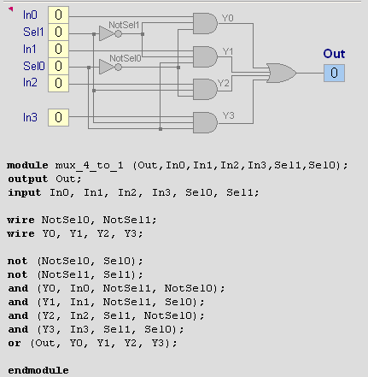
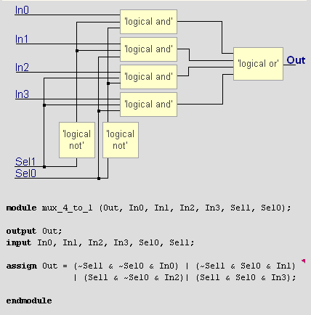
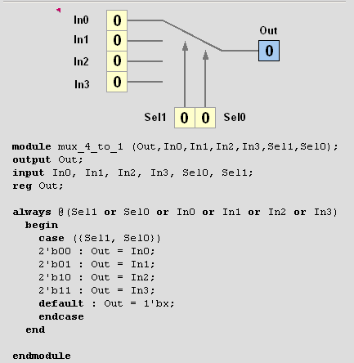
One language, many coding style
Structural
Dataflow
Behavioral

Slide 26
Model styles
Three Modeling Styles in Verilog
  Structural modeling (Gate-level)
  Dataflow modeling
  Behavioral modeling

Slide 27
Gate level
Describes the circuit in terms of interconnections of elementary logic cells (ANDs, ORs, ...).
Similar to schematic netlist

Slide 28

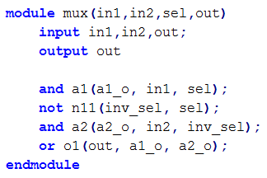
in1
a1_0
a1
out
o1
in2
a2
inv
A2_o
sel

Slide 29

Dataflow
Dataflow modeling provides the means of describing combinational circuits by their function rather than by their gate structure.
Dataflow modeling uses a number of operators that act on operands to produce the desired results: &, |, ? , ~, >; ^ ….
Use continuous assignment : assign
Example :

Slide 30
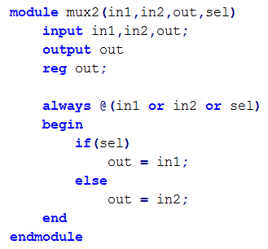
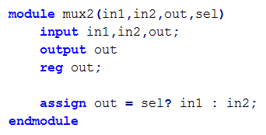
Behavior
Behavioral modeling represents digital circuits at a functional and algorithmic level. It is used mostly to describe sequential circuits but can be used to describe combinational circuits.
sequential
combinational

Slide 31
Basics syntax

Slide 32
Comments
; is the statement terminator
/* */ for multi-line comments
// single line comments

Slide 33
Identifiers
Formed from {[A-Z], [a-z], [0-9], _, $},
can’t begin with $ or [0-9]
  myidentifier 
  m_y_identifier 
  3my_identifier 
  $my_identifier 
  _myidentifier$ 
Case sensitivity
  var ≠ Var

Slide 34
Value set (datatypes)
4 values logic: 0, 1 , x, z
  0 , 1 : binary symbol
  Z : high impedenace value: this is what tri-state buffers drive when they are off
  X : unknow state
At simulation start, all signals have x in every bit

Slide 35
Numbers format
<size>’<radix> <value>
  8’h ax = 1010xxxx
  12’o 3zx7 = 011zzzxxx111
No of
bits
Binary → b or B
Octal → o or O
Decimal → d or D
Hexadecimal → h or H
Consecutive chars
0-f, x, z

Slide 36
You can insert “_” for readability
  12’b 000_111_010_100
  12’b 000111010100
  12’o 07_24
Bit extension
  MS bit = 0, x or z ⇒ extend this
    4’b x1 = 4’b xx_x1
  MS bit = 1 ⇒ zero extension
    4’b 1x = 4’b 00_1x
Represent the same number

Slide 37
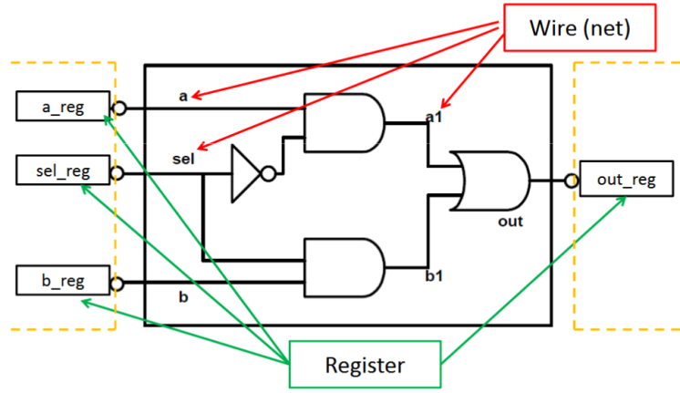
Register & Wire
Wire (net)
  Physical connection between components
  A wire does not store its value, it must be driven
  use “wire” in continuous assignment
  Default value is z
Register
  Register represent abstract storage elements
  Holds value until an new value is assigned to it (remain unchanged): event driven
  Used in procedural block
  Default value is x

Slide 38
Vectors
Represent buses
  wire [3:0] busA; reg [1:4] busB; reg [1:0] busC;
Left number is MostSignifiant bit
Slice management
  busC[1] = busA[2];
  busC[0] = busA[1];
Vector assignment (by position!!)
  busB[1] = busA[3];
  busB[2] = busA[2];
  busB[3] = busA[1];
  busB[4] = busA[0];

Slide 39
Integer & Real Data Types
Declaration
  integer i, k;
  real r;
3.1415926 - decimal notation
9.3e-3 - scientific notation
Integers are not initialized!!
Reals are initialized to 0.0

Slide 40
Arrays
Syntax
  integer count[1:5]; // 5 integers
  reg var[-15:16]; // 32 1-bit regs
  reg [7:0] mem[0:1023]; // 1024 8-bit regs
Accessing array elements
  Entire element: mem[10] = 8’b 10101010;
  Element subfield (needs temp storage):
    reg [7:0] temp;
    ..
    temp = mem[10];
    var[6] = temp[2];

Slide 41
Arrays limitations
Limitation: Cannot access array subfield or entire array at once
  var[2:9] = ???; // WRONG!!
  var = ???; // WRONG!!
No multi-dimentional arrays
  reg var[1:10] [1:100]; // WRONG!!
Arrays don’t work for the Real data type
  real r[1:10]; // WRONG !!

Slide 42
Strings
Implemented with regs:
  reg [8*13:1] string_val; // can hold up to 13 chars
  ..
  string_val = “Hello Verilog”;
  string_val = “hello”; // MS Bytes are filled with 0
  string_val = “I am overflowed”; // “I ” is truncated
Escaped chars:
  \n newline
  \t tab
  %% %
  \\ \
  \“ “

Slide 43
Logicals operators
&& → logical AND
|| → logical OR
! → logical NOT
Operands evaluated to ONE bit value: 0, 1 or x
Result is ONE bit value: 0, 1 or x
  A = 6; A && B → 1 && 0 → 0
  B = 0; A || !B → 1 || 1 → 1
  C = x; C || B → x || 0 → x

Slide 44
Bitwise operators
& → bitwise AND
| → bitwise OR
~ → bitwise NOT
^ → bitwise XOR
~^ or ^~ → bitwise XNOR
Operation on bit by bit basis

Slide 45
Reduction Operators
& → AND
| → OR
^ → XOR
~& → NAND
~| → NOR
~^ or ^~ → XNOR
One multi-bit operand → One single-bit result
  a = 4’b1001;
  ..
  c = |a; // c = 1|0|0|1 = 1

Slide 46
Shift operators
>> → shift right
<< → shift left
Result is same size as first operand, always zero filled
a = 4’b1010;
...
d = a >> 2; // d = 0010
c = a << 1; // c = 0100

Slide 47
Concatenation Operator
{op1, op2, ..} → concatenates op1, op2, .. to single number
Operands must be sized !!
  reg a;
  reg [2:0] b, c;
  ..
  a = 1’b 1;
  b = 3’b 010;
  c = 3’b 101;
  catx = {a, b, c}; // catx = 1_010_101
  caty = {b, 2’b11, a}; // caty = 010_11_1
  catz = {b, 1}; // WRONG !!
Replication ..
  catr = {4{a}, b, 2{c}}; // catr = 1111_010_101101

Slide 48
Relational operators
> → greater than
< → less than
>= → greater or equal than
<= → less or equal than
Result is one bit value: 0, 1 or x
  1 > 0 → 1
  ’b1x1 <= 0 → x
  10 < z → x

Slide 49
Equality operator
Return 0, 1 or x
== → logical equality
!= → logical inequality
=== → case equality
!== → case inequality
  4’b 1z0x == 4’b 1z0x → x
  4’b 1z0x != 4’b 1z0x → x
  4’b 1z0x === 4’b 1z0x → 1
  4’b 1z0x !== 4’b 1z0x → 0
Return 0 or 1

Slide 50
Conditional operator
cond_expr ? true_expr : false_expr
Like a 2-to-1 mux ..
A
1
Y
Y = (sel)? A : B;
B
0
sel

Slide 51
Parameters
A parameter is a constant with a name.
Increase ability to reuse module

Slide 52
Procedural statements

Slide 53
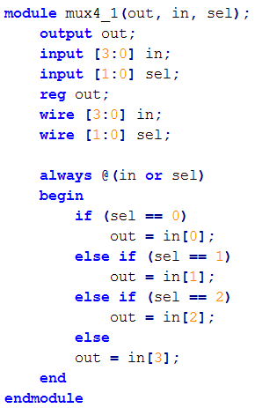
If
if (expr1)
true_stmt1;
else if (expr2)
true_stmt2;
..
else
def_stmt;

Slide 54
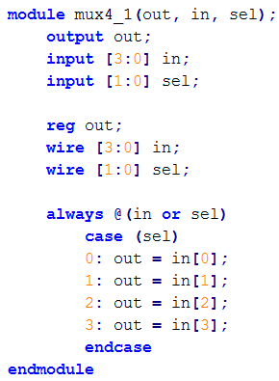
Case
case (expr)
item_1, .., item_n: stmt1;
item_n+1, .., item_m: stmt2;
..
default: def_stmt;
endcase

Slide 55
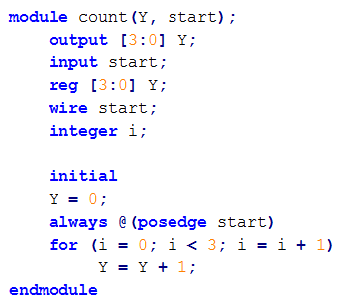
FOR
for (init_assignment; cond;step_assignment)
stmt;

Slide 56
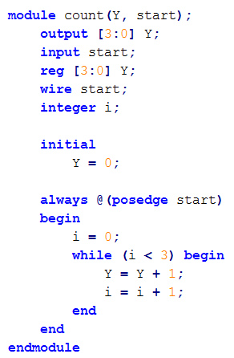
While
while (expr) stmt;

Slide 57
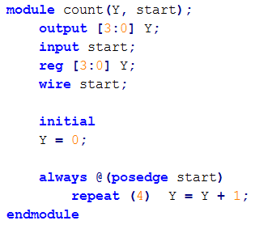
Repeat
repeat (times) stmt;
Can be either an
integer or a variable

Slide 58
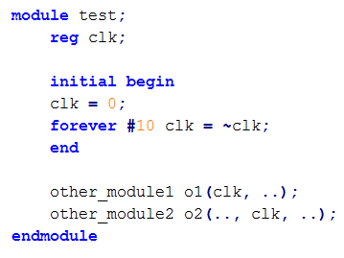
Forever
forever stmt;
Executes until sim
finishes

Slide 59
Delay & event control
Delay Statements
- Represented with a # sign
- Delays the execution of the statement immediately after
- Inertial delay model (ignores glitches)
- Additive with blocking statements
Event Control Statements
- Edge sensitive, represented with a @ sign
- Delays the execution until expression transitions
Ex. always @(clock)
always @(posedge clock)
always @(a or b)
- Level sensitive, represented with wait statement
Ex. always wait (enable) #20 cnt = cnt + 1;

Slide 60
MODULE

Slide 61
Module : basic unit
Verilog provides the concept of module
A circuit is a module (fonctionnality)
Module:
  Created by “declaration”
  Used by “instanciation”
Interface is defined by ports
May contain instances of other modules
All modules run concurrently
Design block
inputs
outputs

Slide 62
Module organization
Everything you write in Verilog must be inside a module
Module organize the design in hierarchy
Allow reuse of the design
Instantiation concept

Slide 63
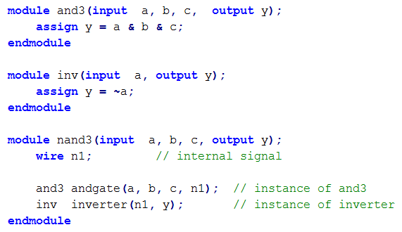
Hierarchical Design
Top Level
Module
Sub-Module
1
Sub-Module
2
Basic Module
1
Basic Module
2
Basic Module
3

Slide 64
Defining a module
A module is the main block in verilog
We first need to declare:
  name of the module
  types of its connections
  names of its connections
a
Verilog module
b
y
c

Slide 65
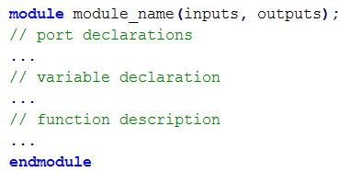
Module example:

Slide 66
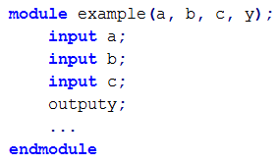

Port declaration
Verilog keyword
  input, output,inout
We can also define busses :
  [range_start:range_end]
Size = 32 bits

Slide 67
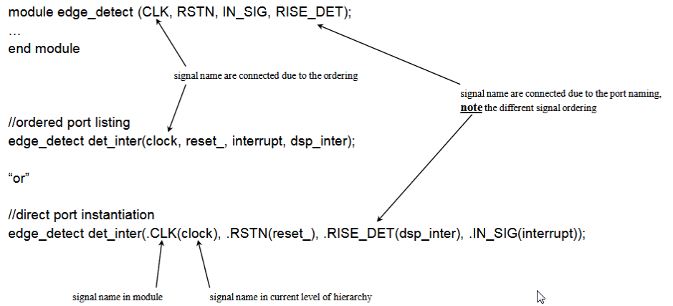
Instanciate a module
Port mapping can be done in two different ways
  by order
  by name
Connecting ports by name yields clearer and less buggy code

Slide 68
Assignment

Slide 69
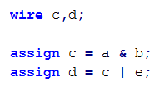
Structural
Think like a circuit (hardware)
  Describe explicit connections between logic gates instantiated and connected to one others
  Similar to schematic
Changing a,b or e any time may immediately change c, d
Reversing statement order does nothing
Concurrent process
a
c
b
e
d

Slide 70
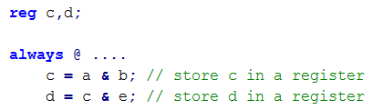
Procedural
Describe circuit as algorithm, many possible circuit could have same behavior but different implementation
Think like C code
Describe how a function works but not how to build it (what the component does)
Order of statement is important
Let the syntheziser do the logic

Slide 71
Two types of modules:
  Behavioral: describe what a module does
  Structural: describe how a module is built from elementary gates

Slide 72
Designs that combine dataflow and algorithmic constructs are called RTL

Slide 73
Blocking assignement
Procedural (blocking) assignments (=) are done sequentially in the order of the statements are written.
Evaluated and assigned in a single step
Execution flow within the procedure is blocked until the assignment is completed
A second assignment is not started until the preceding one is complete
x = a | b Evaluate a |b and assign result to x

Slide 74
Non blocking assignment
Evaluted and assigned in two steps:
1 . The right hand side is evaluated immediately
2. The hand side is delayed until other evaluations in the current time step are completed
x <= a | b Evaluate a |b but defer assignment to x

Slide 75
Non-blocking versus blocking
Non blocking Blocking
Value are assigned at the end of the block
All assignments are made in parallel, process flow is not blocked
Value is assigned immediately
Process waits until the first assignement is complete, it blocks progress

Slide 76
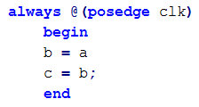
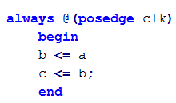
Blocking (=) versus Non-blocking (<=)
Sequential
Parallel
Executed simultaneously
At each rising clock edge, b = a
After that c = b = a -> c = a
At each rising clock edge, b and c simultaneously
receive the old values of a, b and c
a = b and b = c (previous value)
a
D
Q
b
c
a
D
Q
b
D
Q
c
CLK
CLK
CLK
shift register

Slide 77
Continous assignment: only drive wire
Procedural assignment: only drive reg , integer
To ensure correct synthesis and simulation results:
  use blocking (=) assignment for combinational logic
  use non-blocking (<=) assignment for sequential logic
Do not mix both assignments in one procedure

Slide 78
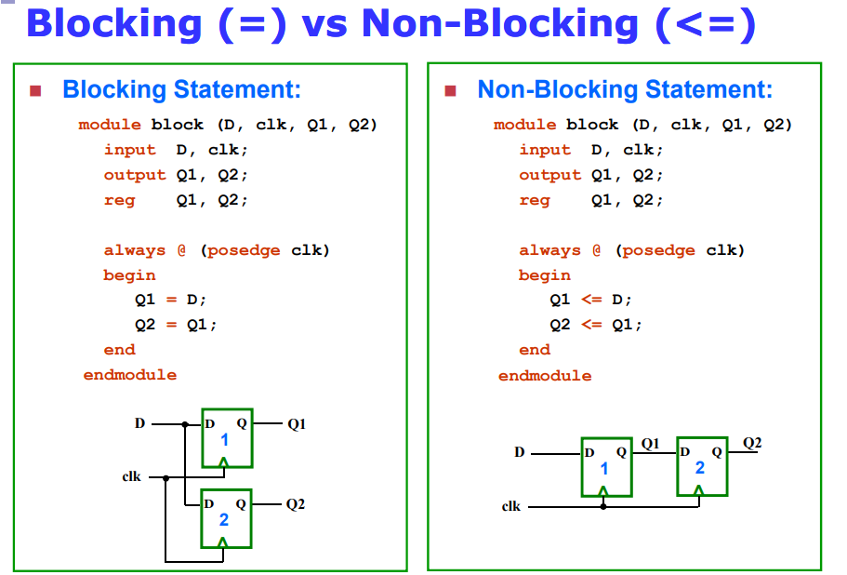
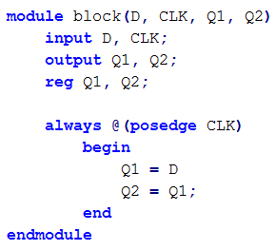

Blocking (=) versus Non-blocking (<=)
D
D
Q
Q1
CLK
D
Q
Q2
D
D
Q
Q1
D
Q
Q2
optional
CLK
CLK
CLK

Slide 79
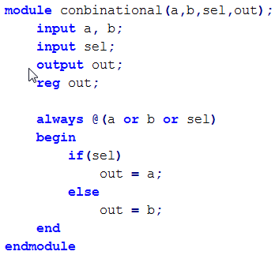
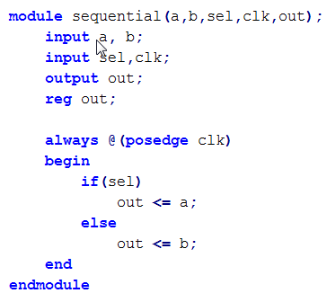
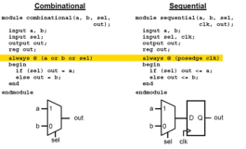
Combinational
Sequential
a
1
a
1
0
out
0
D
Q
out
b
b
sel
sel
clk

Slide 80
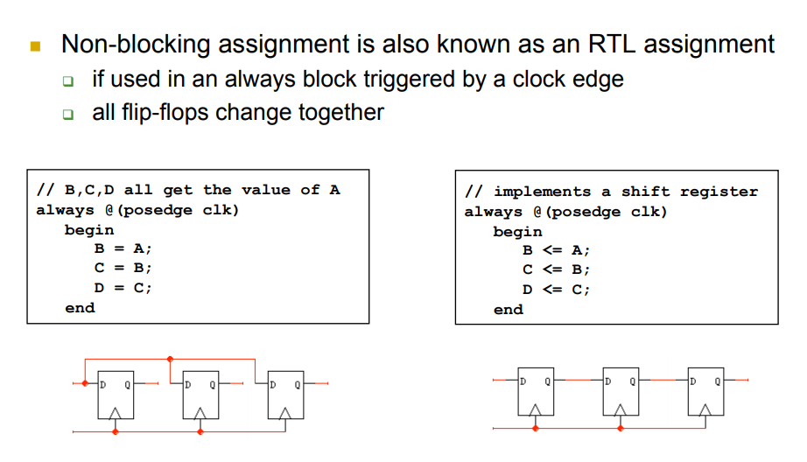

Slide 81
Concurrent Statements
Concurrent means that the operations described in each line take place in parallel. The commonly used concurrent constructs are gate instantiation and the continuous assignment statement.

Slide 82
Sequential statements
Sequential statements are similar to statements in a normal programming language. A sequence of statements is regarded as describing operations that take place one after the other instead of at the same time.
All sequential Verilog statements must be inside a procedural block.
Sequential statements are placed inside a begin/end block and executed in sequential order within the block. However, the blocks themselves are executed concurrently.
Verilog statements outside any process block are interpreted as concurrent statements and different procedural blocks execute concurrently.

Slide 83
Simulation

Slide 84
How to build and test a module
Create a « test bench» for your design
  Develop your hierarchical system within a module that has input and output ports (called “design” here)
  Develop a separate module to generate tests for the module (“test”)
  Connect these together within another module (“testbench”)

Slide 85
Simulation
Circuit Description
Test vectors
Verilog Simulator
Simulation Result

Slide 86
Testbench
Testbench
Generating inputs
Module
Generating inputs
Stimulus block

Slide 87
Testbench Template
module test;
// declare signals
// instantiate module
// apply stimulus
// monitor signals
endmodule
Testbench declares no ports because it is a top-level module that no other module will
instantiate.

Slide 88
Testbench example
Inputs to device under test
module test;
reg a, b, sel;
mux instance(y, a, b, sel);
initial begin
$monitor($time,, “a = %b b=%b sel=%b y=%b”, a, b, sel, y);
a = 0; b= 0; sel = 0;
#10 a = 1;
#10 sel = 1;
#10 b = 1;
end
Device under test (instantiation)
$monitor is a built-in event driven like“printf”
Stimulus

Slide 90
Procedural blocks
The simulator starts executing all procedure blocks at time 0
The simulator executes all procedural blocks concurrently
The simulator executes initial blocks once and always blocks continually
initial
begin
•
•
•
end
always
begin
•
•
•
end

Slide 91
http://www.ece.eng.wayne.edu/~sjiang/ECE2610-winter-11/Verilog%20tutorial.pdf

