Slide 1
Digital Flow
Practice Verilog
Patrice Delpy 2017

Slide 2
HDL Introduction
Hardware description language (HDL): allows designer to specify logic function .
Computer-aided design (CAD) tool produces or synthesizes the optimized gates.

Slide 3
HDL to gates
Simulation
Input values are applied to the circuit
Outputs checked for correctness
Millions of dollars saved by debugging in simulation instead of hardware
Synthesis
Transforms HDL code into a netlist describing the hardware (a list of gates and the wires connecting them)
IMPORTANT:
When describing circuits using an HDL, it’s critical to think of the hardware the code should produce.

Slide 4
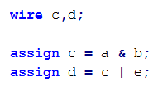
Structural
Think like a circuit (hardware)
Describe explicit connections between logic gates instantiated and connected to one others
Similar to schematic
Changing a,b or e any time may immediately change c, d
Reversing statement order does nothing
Concurrent process
a
c
b
e
d

Slide 5
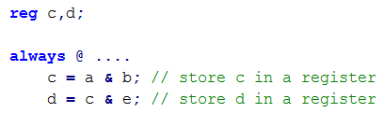
Procedural
Describe circuit as algorithm, many possible circuit could have same behavior but different implementation
Think like C code
Describe how a function works but not how to build it (what the component does)
Order of statement is important
Let the syntheziser do the logic

Slide 6
Designs that combine dataflow and algorithmic constructs are called RTL

Slide 7
Blocking assignement
Procedural (blocking) assignments (=) are done sequentially in the order of the statements are written.
Evaluated and assigned in a single step
Execution flow within the procedure is blocked until the assignment is completed
A second assignment is not started until the preceding one is complete
x = a | b Evaluate a |b and assign result to x

Slide 8
Non blocking assignment
Evaluted and assigned in two steps:
1 . The right hand side is evaluated immediately
2. The hand side is delayed until other evaluations in the current time step are completed
x <= a | b Evaluate a |b but defer assignment to x

Slide 9
Non-blocking versus blocking
Non blocking Blocking
Value are assigned at the end of the block
All assignments are made in parallel, process flow is not blocked
Value is assigned immediately
Process waits until the first assignement is complete, it blocks progress

Slide 10
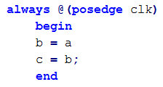
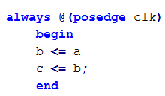
Blocking (=) versus Non-blocking (<=)
Sequential
Parallel
Executed simultaneously
At each rising clock edge, b = a
After that c = b = a -> c = a
At each rising clock edge, b and c simultaneously
receive the old values of a, b and c
a = b and b = c (previous value)
a
D
Q
b
c
a
D
Q
b
D
Q
c
CLK
CLK
CLK
shift register

Slide 11
Continous assignment: only drive wire
Procedural assignment: only drive reg , integer

Slide 12
To ensure correct synthesis and simulation results:
use blocking (=) assignment for combinational logic
use non-blocking (<=) assignment for sequential logic
Do not mix both assignments in one procedure

Slide 13
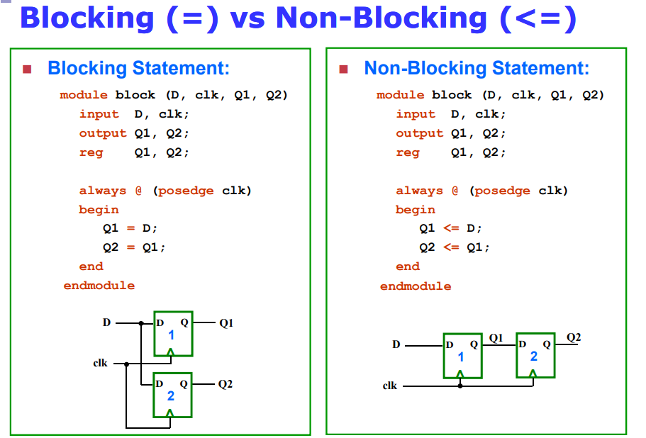
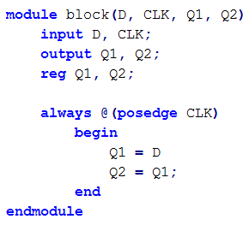

Blocking (=) versus Non-blocking (<=)
D
D
Q
Q1
CLK
D
Q
Q2
D
D
Q
Q1
D
Q
Q2
optional
CLK
CLK
CLK

Slide 14
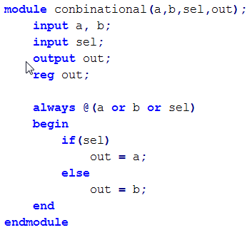
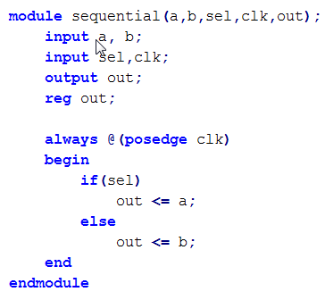
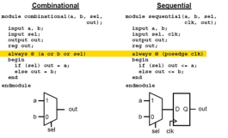
Combinational
Sequential
a
1
a
1
0
out
0
D
Q
out
b
b
sel
sel
clk

Slide 15
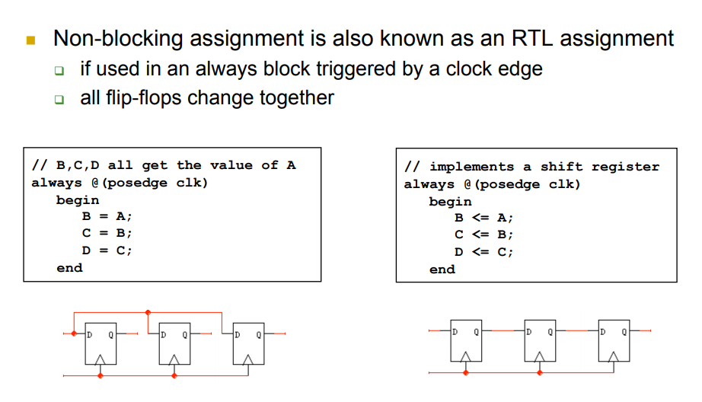

Slide 16
http://www.syssec.ethz.ch/content/dam/ethz/special-interest/infk/inst-infsec/system-security-group-dam/education/Digitaltechnik_14/09_Verilog_Sequential.pdf
sequential code and combinational code in verilog

Slide 17
Difference entre procedural et sequential
http://jatinganhotra.com/blog/2013/02/24/concurrent-and-sequential-statements-in-verilog/

Slide 18
Concurrent Statements
Concurrent means that the operations described in each line take place in parallel. The commonly used concurrent constructs are gate instantiation and the continuous assignment statement.

Slide 19
Sequential statements
Sequential statements are similar to statements in a normal programming language. A sequence of statements is regarded as describing operations that take place one after the other instead of at the same time.
All sequential Verilog statements must be inside a procedural block.
Sequential statements are placed inside a begin/end block and executed in sequential order within the block. However, the blocks themselves are executed concurrently.
Verilog statements outside any process block are interpreted as concurrent statements and different procedural blocks execute concurrently.

Slide 20
Page vide

Slide 21
HDL
What is the need for Hardware Description Language?
Modeling, Represent, And Simulate Digital Hardware
Hardware Concurrency
Parallel Activity Flow
Semantics for Signal Value And Time
Special Constructs And Semantics
Edge Transitions
Propagation Delays
Timing Checks

Slide 22
Design block : basic unit
Verilog provides the concept of module
Describes the functionality of the design
Two types of modules:
Behavioral: describe what a module does
Structural: describe how a module is built from elementary gates
Design block
inputs
outputs

Slide 23
Defining a module
A module is the main block in verilog
We first need to declare:
name of the module
types of its connections
names of its connections
a
Verilog module
b
y
c

Slide 24
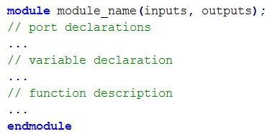
Module example:

Slide 25
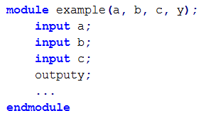

Port declaration
Verilog keyword
input, output,inout
We can also define busses :
[range_start:range_end]
Size = 32 bits

Slide 26
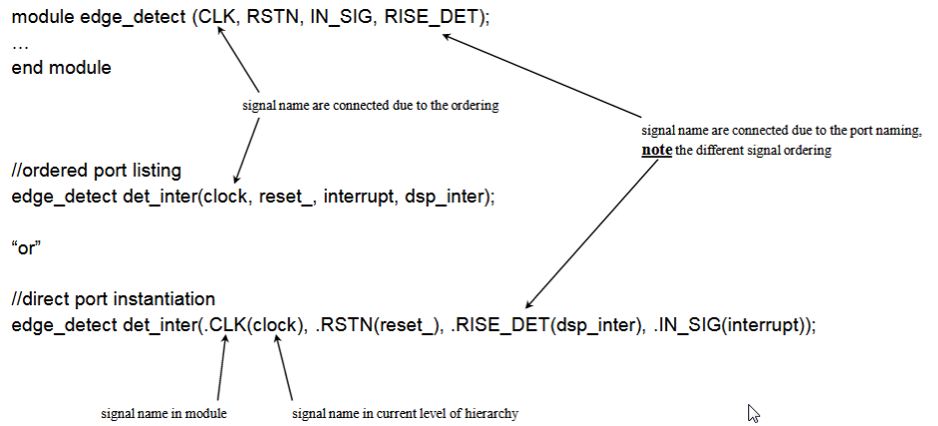
instance
There a two techniques:
Ordered port listing
Direct port instantiation

Slide 27
Modeling approches

Slide 28
Testbench
Testbench
Generating inputs
Module
Generating inputs
Stimulus block

Slide 29
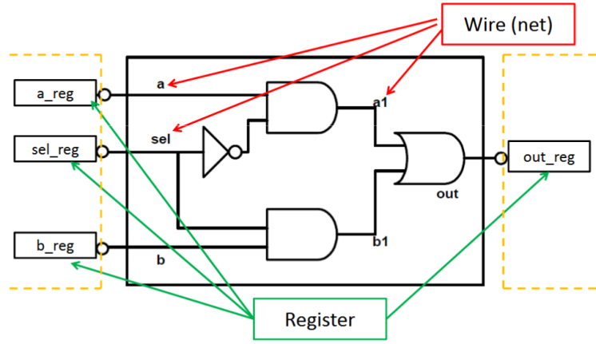
Register & Wire
Wire (net)
Physical connection between components
A wire does not store its value, it must be driven
use “wire” in continuous assignment
Default value is z
Register
Register represent abstract storage elements
Holds value until an new value is assigned to it (remain unchanged): event driven
Used in procedural block
Default value is x

