Slide 1
Design for Testability
Test & reliability

Slide 2
Murphy’s laws
“If you don’t test it, it won’t work!” (Guaranteed)

Slide 3
The purpose of this document is to give an overview of the test pattern generation
General concept
Implementation

Slide 4
Test concept
The fabrication process is imperfect and introduce manufacturing defects
cause malfunction of the device
Improve yield and reject undesirable parts
2 types of yield loss : random effects or process variations

Slide 5
Defect
A defect is the unintended difference between the implemented hardware and its intended design 
Defects occur either during manufacture or during the use of devices

Slide 6
Defects in fabrication
Decreasing feature size increases probability of defects during manufacturing process
Technology scale
These defects come from many sources :
Defects in the base silicon.
Oxide breakdown (crystal defects)
Optical deformation (photolithography)
Dust or contamination in the fab or on wafer.
Dust on mask.
Misalignment. Over-etch or under-etch.
…….

Slide 7
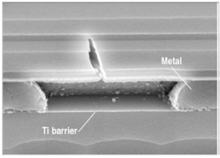
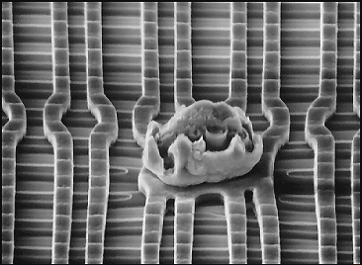
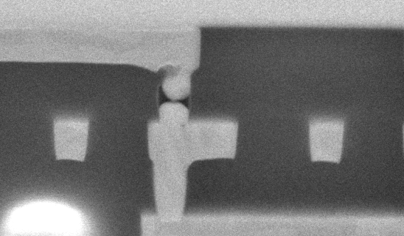
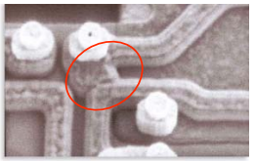
Defects examples

Slide 8
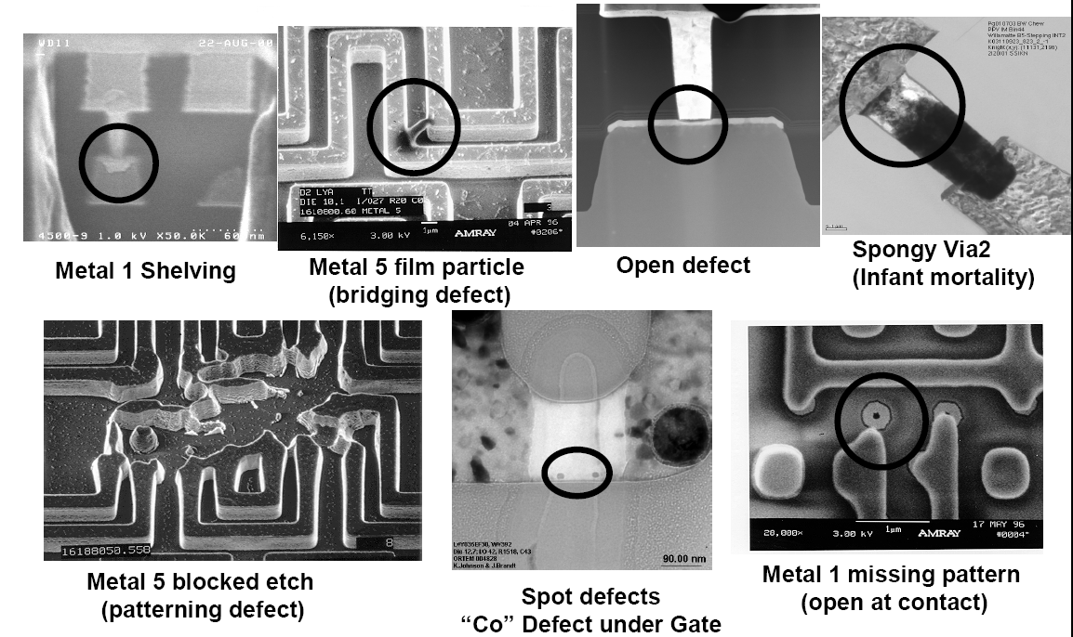

Slide 9
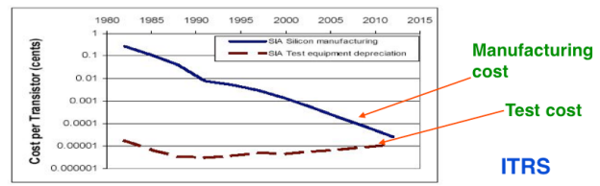
Importance of the test
Yield of any chip is < 100% Perfection does not perfect !
The role of testing is to detect whether something went wrong
Effectiveness of testing is most important for quality products
Today, test cost as more 60% of the total manufacturing cost

Slide 10
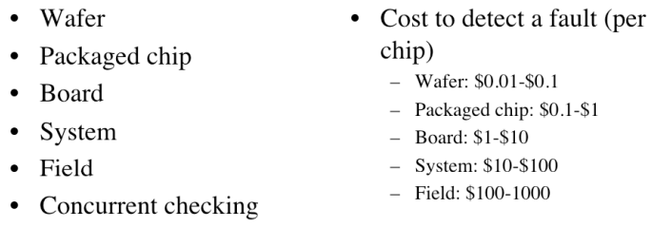
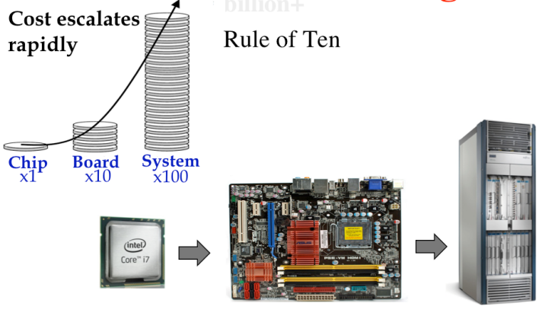
Motivation of testing
Intel bug (1994): 1M units shipped, recall cost $450M

Slide 11
Benefits of testing
Quality and economy are two major benefits of testing, these two attributes are greatly dependent and can not be defined without the other 
Quality means satisfying the user’s needs at a minimum cost 
Needto weed out all bad products before delevery to customers 
Understanding the principles of manufacturing and test is essential for design a quality product

Slide 12
Manufacturing
Testers (ATE) are very expensive
Time is money
Minimize time on tester
Careful selection of test

Slide 13
Exhaustive test is impossible or unpractical

Slide 14
How to test digital blocks ?
Input Patterns
Output Response
-1011
11-00
-0-1-
01--0
0-101
Circuit under
Test
(CUT)
1-001
0011-
-1101
1001-
01-11
Stored
Correct
Response
Comparator
Test result
The stimuli are called test patterns or test vectors

Slide 15
Testability
Two important concept are higlhy associated woth testability:
• Controllability : ease of observing a node by watching external output pins of the chip
• Observability : ease of forcing a node to 0 or 1 by driving input pins of the chip

Slide 16
Focus to digital test
Aim: observe and control logic stucture
Combinational logic is usually easy to observe and control
It’s difficult to test sequential circuit behave
Idea: Modify sequential circuitery of the design
This technique is called scan design and is a part of the DFT methodology

Slide 17
Design for test (DFT)
Design the circuit to increase observability and controllability
If each register could be observed and controlled, test problem reduces to testing combinational logic between registers.
Better yet, logic blocks could enter test mode where they generate test patterns and report the results automatically.

Slide 18
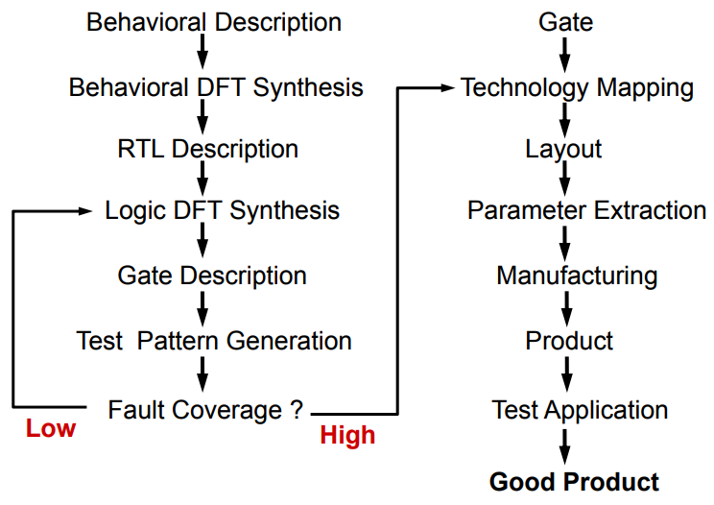
DFT implementation

Slide 19
Simulate faults :
Apply

Slide 20
Test pattern generation
• Manufacturing test ideally would check every node in the circuit to prove it is not stuck.
• Apply the smallest sequence of test vectors necessary to prove each node is not stuck.
• Good observability and controllability reduces number of test vectors required for manufacturing test.
– Reduces the cost of testing
– Motivates design-for-test

Slide 21
http://people.ee.duke.edu/~krish/teaching/Lectures/

Slide 22
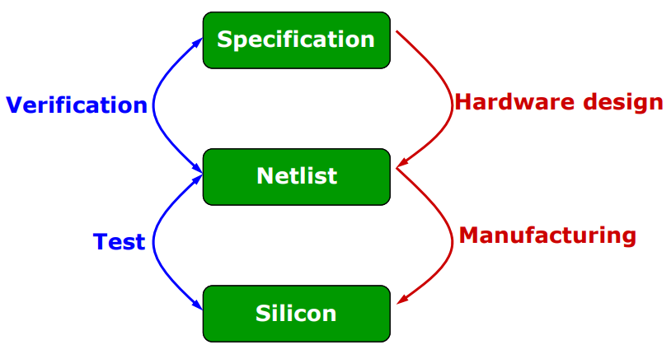
Test vs verification

Slide 23

Defect, Fault, and Error
Defect : 
- A defect is the unintended difference between the implemented hardware and its intended design 
Fault :
- A representation of a defect at the abstracted function level 
Error : 
- A wrong output signal produced by a defective system 
An error is caused by a Fault or a design error
Defect --> Fault ---> Error ---> Failure

Slide 24
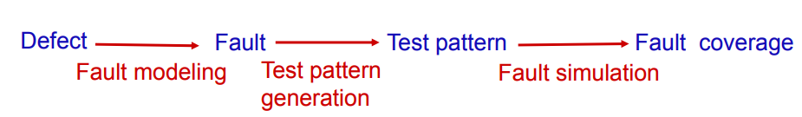

Slide 25
Faults models
Defects are too many and too difficult to explicitly enumerate
• Abstraction (technology independence): presence of physical defect is modeled by changing the logic function (or delay)
• Reduced complexity: distinct physical defects may be represented by the same logical fault
• Generality: tests derived for logical faults may detect vaguely-understood or hard-to-analyze physical defects
• A test pattern detects a fault from the fault model

Slide 26
Fault models
A fault model is an abstraction of a type of defect behavior

Slide 27
Reducing Number of Test Vectors
Two features can be exploited to reduce the number of test vectors
Redundancy - a single fault in the circuit is usually covered by several input patterns; detection of the fault requires only one
Reduced fault coverage - relax the requirement that all faults be detected (95% to 99% fault coverage is typical)

Slide 28
Main faults models
Stuck at faults : one signal stuck to VDD or GND
Transistor stuck short: conduction cause increased quiescent current IDDQ
Transistorstuck open : cause output floating
Bridging: represents a short beetween a group of nets
Delay transistion: increase the input to output delay of one logic gate (slow to rie or to fall)
Delay path : propagation delay of the path exceeds the clock interval
(timing violation)

Slide 29
Stuck at faults
How does a chip fail?
Usually failures are shorts between two conductors or opens in a conductor
This can cause very complicated behavior
• A simpler model: Stuck-At
- Assume all failures cause nodes to be stuck-at” 0 or 1 (shorted to GND or VDD)
– Not quite true, but works well in practice

Slide 30
Concept
IC design techniques that add testability features to a hardware product design.
Design techniques that make test generation, test application and test evaluation cost-effective.
The added features make it easier to develop and apply manufacturing tests to the designed hardware. The purpose of manufacturing tests is to validate that the product hardware contains no manufacturing defects that could adversely affect the product's correct functioning

Slide 31
Helps to provide good controllability and observability of internal state variables for testing.
– Converts the sequential test generation problem into a combinational one

Slide 32
Ideal test & real tests
Ideal tests detect all defects produced in the manufacturing process 
It is difficult to generate tests that detect every possible fault in the chip due to high design complexity
Very large numbers and varieties of possible defects need to be tested 
Difficult to generate tests for some real defects

Slide 33
Main idea:
Obtain controllability & observability of FFs
Add a test mode to the circuits
- All FFs functionally form one or more shift registers
- Inputs and output of these registers are made into
PIs & POs
- All FFs can be set to any desired state (by shifting in)
- All states of FFs can be observed (by shifting out)
- All FFs can be set/observed in “#FFs longest register
” *CLK

Slide 34
Scan path design
Basic Problem
– Test generation for sequential circuits is difficult.
Objective
– Make all the flip flops directly controllable and observable.
What do we gain?
– Combinational circuit test generation can be used.
– A few additional tests to test the flip-flops (shift register).

Slide 35
Scan is the most popular DFT technique:
- Rule-based design
- Automated DFT hardware insertion
- Combinational ATPG
Advantages:
Design automation
High fault coverage; helpful in diagnosis
Hierarchical – scan-testable modules are easily
combined into large scan-testable systems
Moderate area (~10%) and speed (~5%) overheads
Disadvantages:
Large test data volume and long test time
Basically a slow speed

Slide 36
Assure the detection of all faults in a circuit
Reduce the cost and time associated with test development
Reduce the execution time of performing test on fabricated chips
In test mode , all FF are configured as a shift register
Once initialised, normal mode is used to apply a pattern and the results are latched in the FF

Slide 37
Shift test
Shift toggle 00110011
DFT is a technique, which facilitates a design to become testable after production
Its the extra logic which we put in the normal design, during the design process, which
helps its post-production testing. Post-production testing is necessary because, the process of
manufacturing is not 100% error free. There are defects in silicon which contribute towards the
errors introduced in the physical device.

Slide 38
Of course a chip will not work as per the specifications
if there are any errors introduced in the production process. But the question is how to detect
that.
http://www.vlsiip.com/pdf/dft.pdf

Slide 39
Faults models
Stuck-at fault (saf) permanent
a short is formed by connecting points not intended to be connected;
an open results from the breaking of a connection.
Bridging faults
A short circuit between two signal lines (proximity)
Transistor faults slow to rise
Delay faults
http://www.eecg.toronto.edu/~ece1767/notes/lect2.pdf

Slide 40
Fault coverage = percentage of faults detected by set of test vectors
For a given set of input test pattens
At least one mismatch -> fault is detected
No mismatches -> fault is not detected
http://www.eng.auburn.edu/~strouce/class/elec6970/BISTc2.pdf

Slide 41
Fault detecion
Requires
Observation to catch an error (from the fault)
Control to apply stimuli that creates an error as a result of fault

Slide 42
Fault coverage
D = detected faults
U = undetected faults
T=Total faults = D + U
Fault coverage = D / T

Slide 43
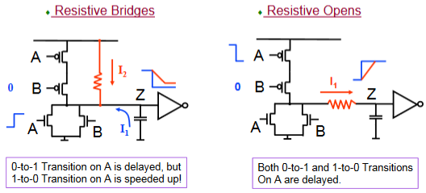
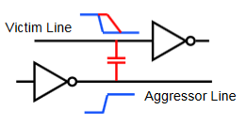
Delay faults
Certain manufacturing defects do not change the logic function of the chip, but can cause timing violations
Path delay fault
- Too much delay along a path
Transition fault (or Gate delay fault)
– Too much delay across a particular gate
http://nptel.ac.in/courses/117105137/Digital%20VLSI%20Testing%20Assignment%20Solutions.pdf

Slide 44
Fault models considered in this document:
Stuck-at fault (gate level)
Bridging fault
Transition fault
Path-delay fault
A delay or transition fault alters the signal propagation delay
along the faulty line As a result, signals can arrive at the outputs of
the circuit before or after the time expected.

Slide 46
Wrapper ?
Interface between digital block and rest of chip
Make access to cell and isolate it from rest of the circuit
Test wrapper is the logic added around topdig to provide test access to the embedded core
Normal mode :
Test mode

Slide 47
Functional vs Structural testing
Functional testing verifies that a circuit fulfils the desired spec.
Functional testing not feasible for exhaustive tests.
Example: 32-bit adder requires 2⁶⁵ ≈ 3.7*10¹⁹ test vectors
Structural test focuses rather on the circuit structure and can cover manufacturing defects that otherwise may not have been detected by functional testing.
Power or ground shorts
Open interconnect on the die (caused by dust particles)
Short circuited source or drain on the transistor, (caused by metal spike through)
Exhaustive test is impossible or unpractical

Slide 48
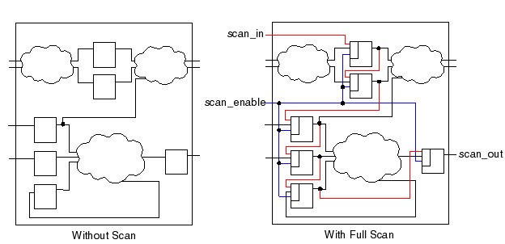
Scan chain principle

Slide 49
Digital Testing Framework
Stimulus and response are calculated by ATPG tool based on fault models
0110
1000
1011
0001
:
compare
fail flags
Device
Under Test
(DUT)
stimuli
0001
0111
1010
0001
:
response

Slide 50
Test architecture
Dig
source
TAM
TAM
k
wrapper

Slide 51
Wrapper isolation
Wrapper
bypass
bypass
Wrapper cells providing function access and test controllability + observability
TestRail inputs
TestRail outputs
IP
function inputs
function
outputs
Wrapper Control Block

Slide 52
Scan design overview
Internal scan (or scan design) is the internal modification of your design’s circuitry to increase its testability.
Goal of scan : make a difficult to test sequential circuit behave (during the testing process) like an easier to test combinational circuit
Replacing sequential cells (FF) with scannable scan cells and then stitching the scan cells together into scan registers, or scan chains. You can then use these serially-connected scan cells to shift data in and out when the design is in scan mode.
https://documentation.mentor.com/en/docs/201805047/atpg_gd/pdf?dest=M8.newlink.manualtitle

Slide 53


Slide 54
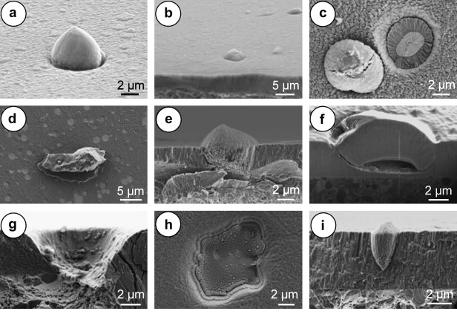
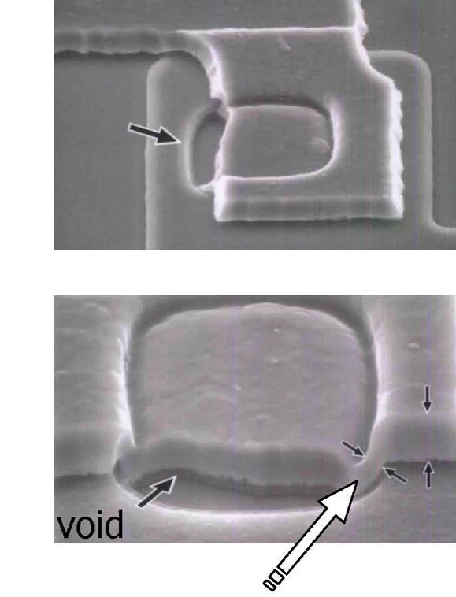
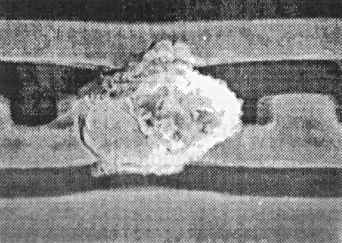
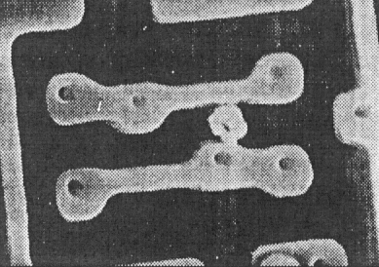
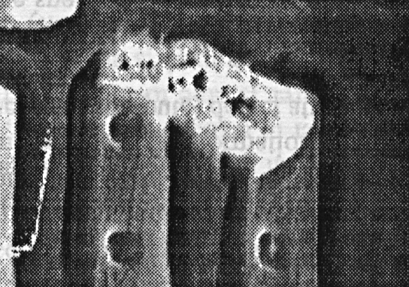
Short
Short
Short

Slide 55
Sequential -> combinational
Problem: ATPG works for combinational logic while most ICs are sequential
Solution: Provide a test mode in which flip flops can be
accessed directly
Replace flip flop (FF) with scan flip flop (SFF): extra multiplexer
on data input
▪
Connect SFFs to form one or more scan chains
▪
Connect multiplexer control signal to scan enab

Slide 56
FlipFlop to scan
Flip-flop
Data in
0
Flip-flop
D
Q
Q
Scan in
1
clk
clk
Scan Mode

Slide 57
All the flops are connected in form of a chain, as a shift register
Combinational logic
D
0
FF
D
0
FF
D
0
FF
Q
Q
Q
SI
1
SI
1
SI
1
clk
clk
clk
SE
SE
SE
Normal mode SE = 0

Slide 58
²
Combinational logic
D
0
FF
D
0
FF
D
0
FF
Q
Q
D
Q
SI
1
SI
1
SI
1
clk
clk
clk
SE
SE
SE
Scan mode SE = 1

Slide 59
Comb.
logic
Scan Mode
Clock
D1
Q
FF
Comb.
logic
Scan-in
1
D2
Q
CK
0
Flip-flop
Data-in
Comb.
logic
Q
D1
D2
FF
Comb.
logic
CK

Slide 60
Scan Mode
Flip-flop
Scan in
1
Flip-flop
D
Q
Q
Data in
0
clk
clk

Slide 61
Scan design methodology
Replace all

Slide 65
Convert each flip-flop to a scan register
Normal mode: flip-flops behave as usual 
Scan mode: flip-flops behave as shift register

Slide 67
Design for test
Design the chip to increase observability and controllabilit y

Slide 68
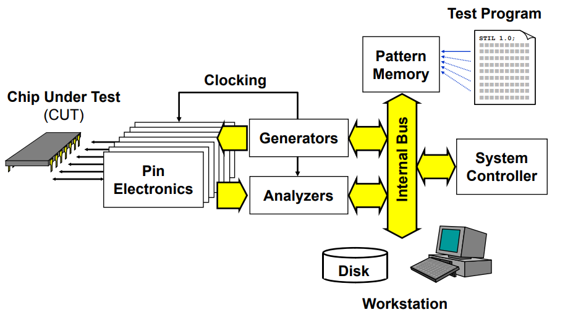
Internal structure of ATE

Slide 69
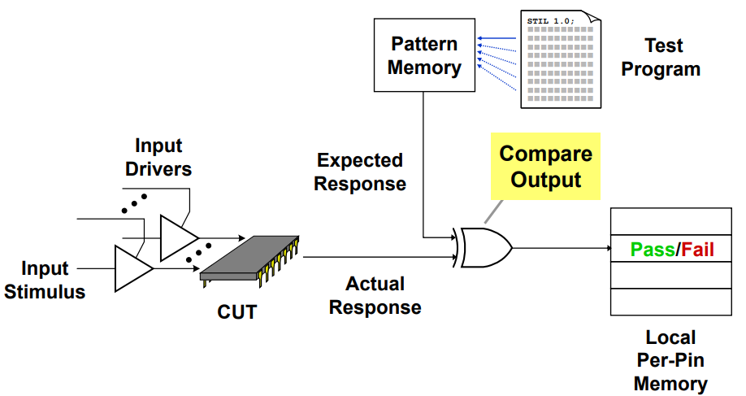
ATE Test operation

Slide 70
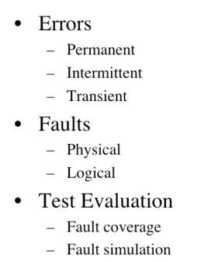
Summarry
Think about testing from the beginning
Good tests require ingenuity

Slide 71
Test the first chips back from fabrication
– If you are lucky, they work the first time
– If not…

Slide 72
M. Abramovici, M.A. Breuer, and A.D. Friedman. Digital Systems Testing and Testable Design. Wiley-IEEE Press, 1994.

Slide 73
Test pattern generation
Automated tool that consists of creating test sequences (stimuli ) to verify the proper functioning of a digital circuit.
Detection of defects introduced by the manufacturing
The test sequence generators verify that each of the nodes of the circuit will be observable to develop a sequence of tests whose routing through the circuit activates all its nodes and makes it possible to propagate the faults up to the output pins of the component.

Slide 74
for given fault, determine excitation vector (called test vector) that will propagate error to primary observable output

Slide 75
Design for test
Design the chip to increase observability and controllability
If each register could be observed and controlled, test problem reduces to testing combinational logic between registers.
Adding multiplexers

Slide 76
ATPG essentials
Netlist
ATPG algorithms use fault models to
generate patterns and to give a fault
coverage result & fault classes list
A fault model is a digital representation of a
real manufacturing/silicon defect
- Fault model matches with one category of
silicon defect only
- It is the abstract of reality (not 100%)
Defects not covered by a fault model could
escape to test
Fault coverage 100 % ≠ 0 ppm
ATPG
Algorithms
User
ATPG
engine
Fault
models
ATPG Tool
Patterns

Slide 77
ATPG overview
Sets of 1 and 0 placed in each inputs pins during the manufacturing test process to determine if the chip is functioning properly
When the test pattern is applied, the tester determines if the circuit is free from manufacturing defects by comparing the fault-free output—which is also contained in the test pattern—with the actual output measured by the ATE
If no test vectorexists for a fault, the fault is said untestable

Slide 78
ATPG process
2 Main steps:
Generating patterns
Performing fault simulation to determine which faults the patterns detect

Slide 79
What is STIL ?
Standard Test Interface Language

Slide 80
ITC = Interconnect Test coverage
Also know as loopback
Cells testplaced inside analog cells (xor)

Slide 81
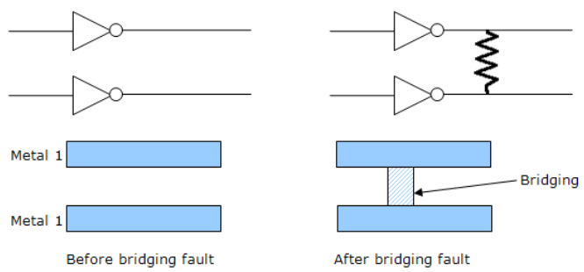
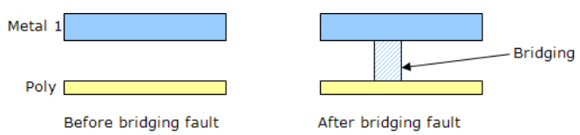
Bridging fault model
The bridging fault model tests for resistive shorts between two normally unconnected in wires, which could be caused by a piece of metal from the sputtering process
Bridging faults can be intra-layer and inter-layer c

Slide 82
Tool analysis
The probability of bridged net pairs

Slide 83
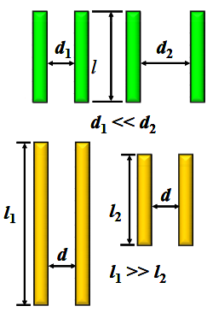
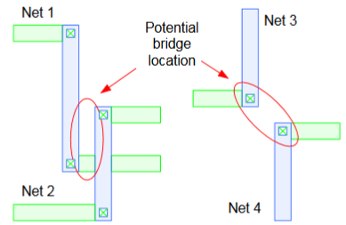
Detect bridging faults : interconnect defects
Two or more adjacent wire are shorter together
EDA tool extract capacitive coupling based bridge pairs from physical design (frindge capacitance)
Higher capacitance indicating the higher probability of bridge occurence
Onsemi script analyze output database to identifiy the potential bridge
The designer can filter the results to select or ignore nodes that are suceptible to create a bridge.
The new netlist is given to ATPG tool to generate the
bridge detection patterns used by ATE
High probability
of bridging faults

Slide 84
Detects bridging pair nets:
examining the physical database for parallel or close proximity wires

Slide 85
IDDQ testing
Measure supply current in quiescent state (not switching and inputs are statics)
Leakage and bias current value expected is less than 10uA
Advantage:
- IDDQ test can detect (catch) bridge that are not detectable or other
faults that are not found by saf vectors
Inconvenience :
- Compared to scan chain test, Iddq test is time consuming (slow)
- Leakage current closer to quiescent current for deep submicron

Slide 86
applies a set of patterns to the design, lets the current settle, then measures for excessive current draw. Devices that draw excessive current may have internal manufacturing defects.
Ideal IDDQ test vectors produce a nearly zero quiescent power
supply current

Slide 87
Normal IDDQ: 1nA
Abnormal : > 10µA
VDD
IDD
inputs
outputs
circuit
VSS

Slide 88
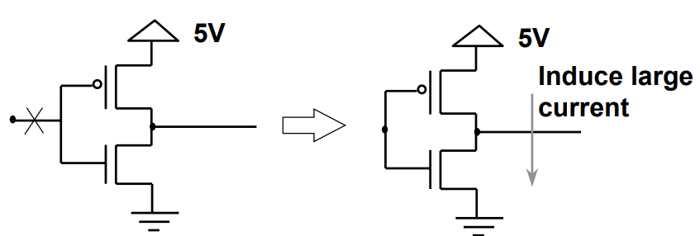
Floating node: nmos and pmos are ON
V
DD
defect
I
DD
PMOS
in
out
NMOS

Slide 89
V
DD
DUT
G
’
I
DD
ND
-
Pass/Fail
Sensing element
+
Vref
BICM
G
ND
Figure 2 On-chip supply current testing

Slide 90
References
Essential of electronic test for digital : Bushnell, Agrawal
Digital Systems Testing and Testable Design Wiley-IEEE Press, 1994
M. Abramovici, M.A. Breuer, and A.D.
VLSI Test principles and architectures
The Morgan Kaufmann Series in Systems on Silicon

Slide 91
Tessent tool
Fault models supported:
Logical faults, change the logic function in the circuit
struck-at
Bridging
Parametric faults alter physical properties
Delay
Transistion
IDDQ

Slide 92
Typical flow:
Implement DFT
Generate test patterns (ATPG)
Verify fault coverage of patterns trought fault simulation

Slide 93
Gate level netlist
SDC (optional)
Output:
Patterns in STIL or verilog format

Slide 94
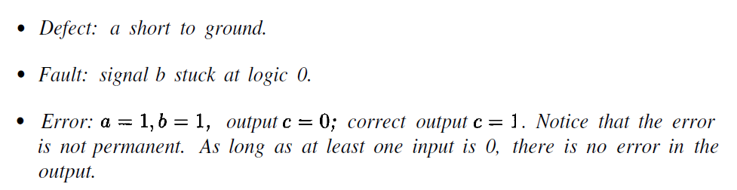
The term faukt is used to refer to electrical

Slide 95
wrapper: surrounding hardware with test logic block
A normal mode where the core terminal is driven by the host chip.
An external test mode where the wrapper element observes the core input terminal for interconnect test.
An internal test mode where the wrapper element controls the state of the core input terminal for testing the logic inside the core.

Slide 96
Testing scan register
Scan register must be tested prior to application of scan test sequences
Shift sequence 00110011…

Slide 97
https://anysilicon.com/overview-and-dynamics-of-scan-testing/
All the flops are connected in form of a chain = shift register.
The first flop of the scan chain is connected to the scan-in port and the last flop is connected to the scan-out port
Scan testing are performed to detect any manufacturing fault in the combinatorial logic block.
ATPG tool try to excite each and every node within the combinatorial logic block by applying input vectors at the flops of the chain.

Slide 98
toggling …
Scan chain operation involves 3 stages: Scan-in, Scan-capture and Scan-out
Shifting in and loading all the flip-flops with an input vector. During scan-in, the data flows from the output of one flop to the scan-input of the next flop not unlike a shift register
Once the pattern is loaded, one clock pulse (capture) is applied to excite the combinatorial logic block (evaluation) and the output is captured .
The data is then shifted out and the signature is compared with the expected signature

Slide 99
Scan testing
During response shift-out, next pattern can be
concurrently shifted in.
Shift-In
Capture
Shift-Out
time

Slide 100
Terminology
Design-for-test (DFT): Modifications to the circuit for facilitating test. e.g. scan flip-flop insertion
Automatic Test Pattern Generation (ATPG): Process of automatically generating test patterns that can be applied to the chip
Pattern generation happens on the gate-level netlist of the circuit assuming a certain set of eventual defects/faults
Fault Models: Abstraction of potential defects to ease the task of ATPG
E.g., stuck-at faults, transition faults
Compression: Technology for reduced test data volume/test application time. Compressed patterns are stored on the tester, while on-chip de-compression logic ensures that uncompressed patterns can be applied.

Slide 101
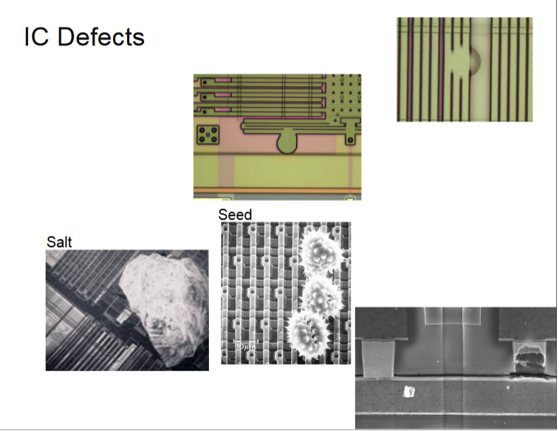

Slide 102
Invoke the tessent shell environment in order to utilize Tessent Scan, Tessent FastScan, and Tessent TestKompress.
Setup and analyze designs to prepare for ATPG
Perform ATPG to achieve high test coverage with a minimal number of patterns
Troubleshoot DRC violations
Troubleshoot areas of low test coverage
Troubleshoot simulation mismatches

Slide 103
Accessing documentation and getting help
Using the scan and ATPG tool flow
Reading and analyzing messages
Troubleshooting a DRC error in DFTVisualizer
Using common methodologies to attain a quick estimate of test coverage
Troubleshooting areas of low test coverage
Determining the cause of undetected faults
Creating and saving patterns in different formats
Verifying patterns using ModelSim
Reading ASCII files into Tessent FastScan
Modifying timeplates
Creating fault models and performing fault grading

Slide 104
What is Tessent ?
Tessent Shell is a design-for-test environment within which you can perform all the tasks required to insert DFT hardware, generate manufacturing test patterns, and post-silicon tasks such as diagnosis and yield analysis
Tessent Shell provides a graphical user interface, DFTVisualizer, that allows you to edit and introspect designs, and adjust object attributes
open_visualizer -display flat_schematic hierarchical_schematic data
http://www.eng.auburn.edu/~strouce/class/elec6970/NelsonBIST.pdf

Slide 105
DFTVisualizer to visally investigate the ccauses of DRC violations
Data rules checking
Ensures the proper transfer of data within the scan chain
The Debug window of DFTVisualizer is especially useful for analyzing and debugging certain rules violations (see Tessent User’s Mabual)
https://documentation.mentor.com/en/docs/201805047/tshell_user/pdf?dest=M8.newlink.manualtitle
DFTVisualizer graphically displays the source of the mismatches for easy identification
DFTVisualizer displays and highlights overlapping design, simulation, and test pattern
data for the selected simulation mismatch
ANALYSIS> open_visualizer
Tools > Analyze Mismatch

Slide 106
Find undetected fault targets to improve tests ?
100% fault coverage may be impossible due to undetectable faults
Debugging low test coverage
The combination of scan and ATPG tools has been shown to successfully detect the vast majority of manufacturing defects. When you use an ATPG tool, your goal should be to achieve the highest coverage of defects as possible. Because high test coverage directly correlates to the quality of the parts shipped, many companies demand that the coverage for single stuck-at faults be at least 99% and transition delay faults be at least 90%.
https://www.electronicdesign.com/products/debugging-low-test-coverage-situations
https://www.youtube.com/watch?v=HsmNwoGff18

Slide 107
VLSI Test principles and architectures
The Morgan Kaufmann Series in Systems on Silicon
Digital Systems Testing and Testable Design IEEE press
An Introduction to logic circuit Testing Parag K.Lala
Morgan & Claypol
ftp://ftp.borg.moe/yarr/Gentoomen%20Library/Digital%20Design/Digital%20Design%20and%20Fabrication.pdf
http://ece-research.unm.edu/jimp/vlsi_test/slides/faults1.pdf

Slide 108
http://www.ee.ncu.edu.tw/~jfli/memtest/lecture/ch01.pdf
http://courses.ece.ubc.ca/578/notes4.pdf

Slide 109
ATPG – digital blocks

Slide 110
ATPG digital flow features
For each project, a set of patterns must be generated.
In digital environment a set of scripts stored in templates allows to:
Generate vectors in STIL format compatible with tester
Generate testbench and vectors in Verilog format
Simulate Verilog vectors with timings back annotation
Provide cadence cells with auto-check embedded vectors for top cell simulation
Estimate realistic stuck-at fault test coverage

Slide 111
Directory structures & files templates
Several files (do file, lib files, contraints sdf, parameters) are needed to perform pattern generation and for testbenchs simulations
mkblock.csh script creates a dedicated directory under DIG_BLOCKS/<digital_block name>/tool_data/tessent
Symbolink :

Slide 112
Directory template
/tessent
tessent_patt_saf.do : tessent dofile to generate stuck at fault vectors
tessent_patt_sbf.do : tessent dofile to generate static bridge fault vectors
tessent_patt_tft.do : tessent dofile to generate transient fault vectors
tessent_patt_iddq.do : tessent dofile to generate IDDQ vectors
tessent_cov.do : tessent dofile to estimate coverage
tessent_testproc.do : tessent procedures file used by dofiles
param_file : tessent options for .stil format
run_patt.sh : tessent command for pattern generation
run_cov.sh : tessent command for coverage estimation
atpg_wrapper.v : wrapper around digital block= netlist for vectors generation
generate_patterns.sh : script to generate patterns and create files for top cell simulation
simulate_patterns.sh : script simulating all generated patterns in worst & best conditions
/vectors : directory to store vectors and re-simulate them
scan_map.txt : text file template for scan pins mapping
header.txt : text file template for .stil header compatible with eagle tester
/reports : directory containing tessent reports
/top_cell_sim : directory to store deliverables for top cell simulation
To be completed by Designer

Slide 113
Wrapper

Slide 114
ATPG Patterns generation 1
In tessent directory, use generate_patterns.sh script that includes several sub command:
Launch tessent trought run_patt.sh to generate vectors and test benchs
Call gen_stil_4_eagle.pl to make STIL vectors compatible with eagle tester
Call generate_top_vectors.pl to write cadence test benches for top cell simulations.
Usage: sh generate_patterns.sh cellname block1 block2 …. blockN
Example: sh generate_patterns.sh DigTop scv78565_dig switcher_dig

Slide 115
Faults models
tessent -shell \
-dofile tessent_patt_saf.do \
-logfile tessent_patt_saf.log -replace
# Transition fault
tessent -shell \
-dofile tessent_patt_tft.do \
-logfile tessent_patt_tft.log -replace
# Static bridging fault
tessent -shell \
-dofile tessent_patt_sbf.do \
-logfile tessen_pattt_sbf.log -replace
# IDDQ
tessent -shell \
-dofile tessent_patt_iddq.do \
-logfile tessent_patt_iddq.log -replace
./run_patt.sh

Slide 116
ATPG Patterns generation 2
Here is the list of files outputted by Tessent through run_patt.sh script:
under tessent/
tessent_patt.log -> drc rules report
under reports/
<block_name>_scan_chains.rpt -> lists registers in chains from output to input
<block_name>_drc_C6.rpt -> report of C6 violations, flops to be masked
<block_name>_wrapper_faults_au.rpt -> provides list of untestable faults
<block_name>_wrapper_coverage.rpt -> provides coverage information
Note: use run_cov.sh to get real coverage

Slide 117
ATPG Patterns generation 3
under vectors/
<block_name>_chain.v
<block_name>_chain.v.0.vec -> set of Verilog data + auto check testbench
<block_name>_chain.v.cfg for shift in / shift out vector (scan check integrity)
<block_name>_chain.v.po_name
<block_name>_serial.v
<block_name>_serial.v.0.vec -> set of Verilog data + auto check testbench
<block_name>_serial.v.cfg for first 10 vectors (shift and capture)
<block_name>_serial.v.po.name
<block_name>_serial_full.v
<block_name>_serial_full.v.0.vec -> set of Verilog data + auto check testbench
<block_name>_serial.v.cfg for all vectors (shift and capture)
<block_name>_serial_full.v.po.name
<block_name>_parallel.v
<block_name>_parallel.v.0.vec -> set of Verilog data + auto check testbench
<block_name>_parallel.v.cfg for all vectors (capture only) for debug purpose
<block_name>_parallel.v.po.name
<block_name>_parallel.v.chain.name
<block_name>.stil -> all vectors in stil format

Slide 118
ATPG Patterns generation 4 : STIL post processing
To be fully compatible with eagle test program, the header of stil file generated by Tessent must be modified.
Inputs must be masked and outputs receive hi-Z during the first tester cycle.
scan_map.txt (in vectors/ directory) must be manually updated with top cell scan pin names and number of chains in the design:
Example scv78565: nb_chain =1
scan_clk = scan_clk
scan_rstb = scan_rstb
scan_en = scan_en
scan_in1 = scan_in
scan_out1 = scan_out
header.txt (in vectors/ directory):
Must be changed only if multiple scan chains to add other scan_in/scan_out pins.
Scan pins will be replaced by their top cell names by gen_stil_4_eagle.pl script.

Slide 119
ATPG Patterns generation 5
The generate_patterns.sh script calling generate_top_vectors.pl inside top_cell_sim/ directory to modify the testbench files generated by Tessent in vectors/ directory :
usage: perl $TOOLS_SCRIPT/scan/generate_top_vectors.pl
-vec <block_name>_chain.v | serial.v | parallel.v
-map scan_map.txt
-delay < in us>
-block b1 –block b2 …. block N
What the script does:
Modify Tessent testbench file :
- Remove atpg_wrapper instantiation and create scan pins inputs and outputs
- Change relative to absolute paths for called files, insert delay scan process execution from <delay> us
- Replace atpg_wrapper_inst by digital hierarchical path in top cell test bench
- Rename modules in atpg_shift_vectors atpg_capture_vectors or atpg_parallel_vectors according to type
- Copy other files from vectors/ directory
- Create testbenches in top_cell_sim/ for re-simulation including .trn logging

Slide 120
ATPG Patterns generation 6
Here are the files generated:
under vectors/
<block_name>_chain.v
<block_name>_chain.v.0.vec
<block_name>_chain.v.cfg
<block_name>_chain.v.po_name
<block_name>_serial.v
<block_name>_serial.v.0.vec
<block_name>_serial.v.cfg
<block_name>_serial.v.po.name
<block_name>_parallel.v
<block_name>_parallel.v.0.vec
<block_name>_parallel.v.cfg
<block_name>_parallel.v.po.name
<block_name>_parallel.v.chain.name
under topcell_sim/
atpg_ <block_name>_ shift_vectors.v
<block_name>_chain.v.0.vec
<block_name>_chain.v.cfg
<block_name>_chain.v.po_name
tb_scan_shift.v
atpg_ <block_name>_ capture_vectors.v
<block_name>_serial.v.0.vec
<block_name>_serial.v.cfg
<block_name>_serial.v.po.name
tb_scan_capture.v
atpg_ <block_name>_ parallel_vectors.v
<block_name>_parallel.v.0.vec
<block_name>_parallel.v.cfg
<block_name>_parallel.v.po.name
<block_name>_parallel.v.chain.name
tb_scan_parallel.v
New modules atpg_<block_name>_[shift | capture | parallel]_vectors can be imported in cadence as functional views through verilogin.
Other files (.0.vec, .cfg, .po.name , .chain.name) will be directly accessed by people in charge of top cell simulation.

Slide 121
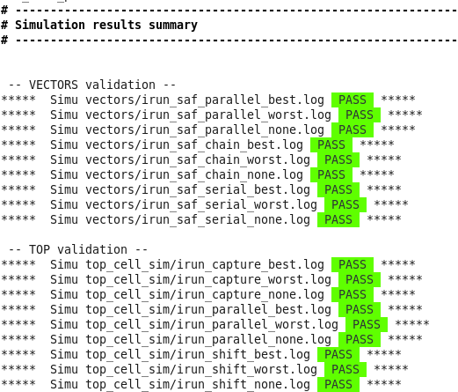

Slide 122
ATPG with ITC loop back

Slide 123
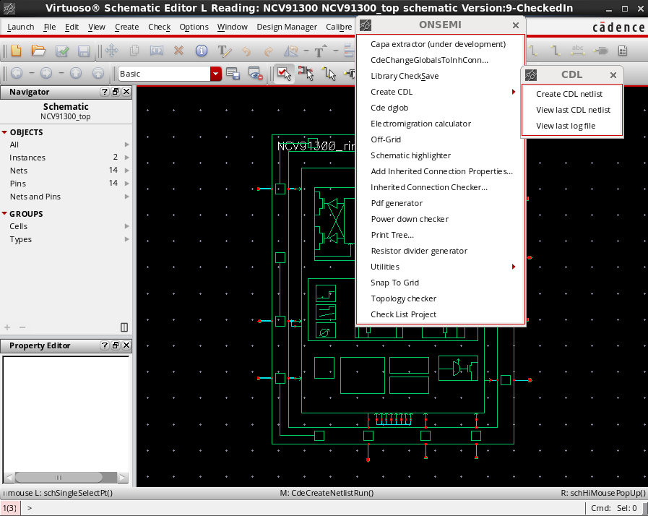
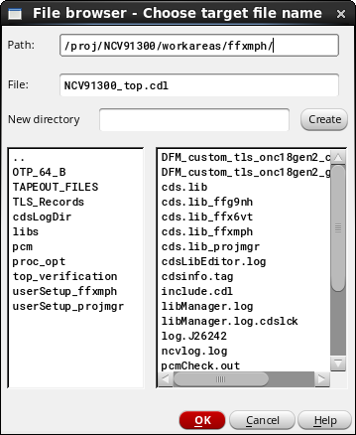
Netlist of the design: step 1
Generate CDL netlist of the Topcell

Slide 124
Apply patch : step 2
In itc directory:
Apply patch.pl to CDL netlist to create a modified netlist.cdl
This script identify digital libraries and cells (TLS works with multiple dig blocks and Brno use only one)

Slide 125
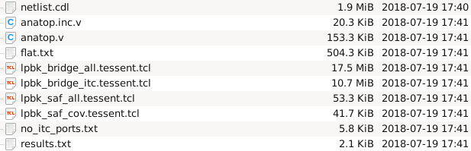
Interconnectes extraction: step3
We need to extract the connectivity (interconnects) between the ITC cells placed inside analogs macro blocks and the topdig cell
./cdl_itc.pl -cmd
Before going to the next step, check the files no_itc_port.txt and results.txt to make sure the consistency of the nets will be tested.
results.txt : List of warning
no_itc_port.txt : List of nets that will not be tested , may be forgottent ?
Output files

Slide 126
lpbk_saf_all_tessent.tcl : faults descriptions
Ipbk_saf_cov_tessent.tcl

Slide 127
Replace instance name: step4
Build excuded_ports.txt file
Grep command contains regular expression to change

Slide 128
Extract cell pins and nets connect to : step

Slide 129
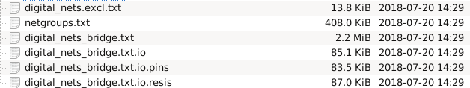
Extract bidge pairs from calibre DB

Slide 130

Tetramax faults list generation

Slide 131
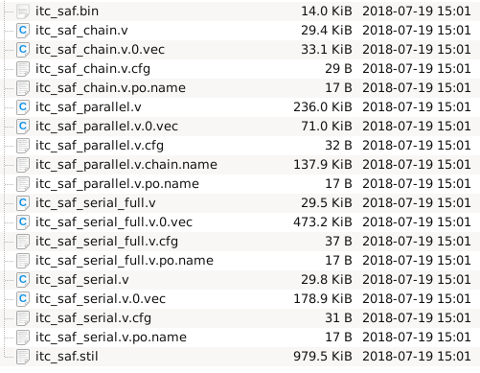
ATPG generation
Step 1:Execute Tessent cmd to launch vectors generation in Tessent directory
Created file inside/vectors

Slide 132
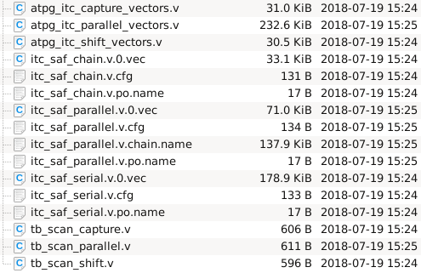
Step 2: Execute generate_top_vectors.pl to modify vectors generated by Tessent and stored in /vectors
/top_cell_sim

Slide 133
Step3 : It’s necessary to simulate generated vectors (to check generation) before to send it to test team.

Slide 134
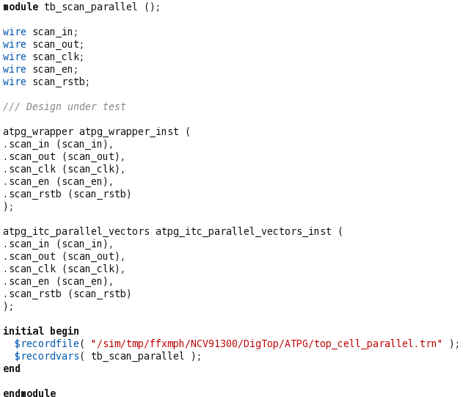
we will create an ATPG box that can be used by the verification team to simulate the behavior of the scan on the topcell.

Slide 136
scan_in
tb_scan_xxx.v
scan_clk
scan_rstb
scan_en
atpg_vectors.v
atpg_wrapper.v
scan_out

Slide 137
ATPG_wrapper from ITC
scan_in
atpg_wrapper.v
scan_clk
scan_rstb
scan_en
Hard coded
Switcher_dig.v
Top_dig.v
Analog_top.v
scan_out

Slide 140
Tessent suite is set of DFT tools from Mentor Graphics

Slide 141
What is ATPG ?
Automatic Test pattern generation tools are used at the end of the design process to generate a set of vectors that will be test the device
It’s to check manufacturing error
Generates efficient scan patterns that can be used to find manufacturing defects in the real silicon. It also produces a fault coverage report that tells you how good your test it, and which nets are and are not covered by the test pattern.

Slide 142
ATPG alogorithms will go trought each net of the design and apply fault model to come up with a test that will « catch » each potential error

Slide 143
The goal of DFT is to define a failure analysis process that will provide efficent and accurate results
Extra hardware are added in design to impove testability
Observability and controlability

Slide 144
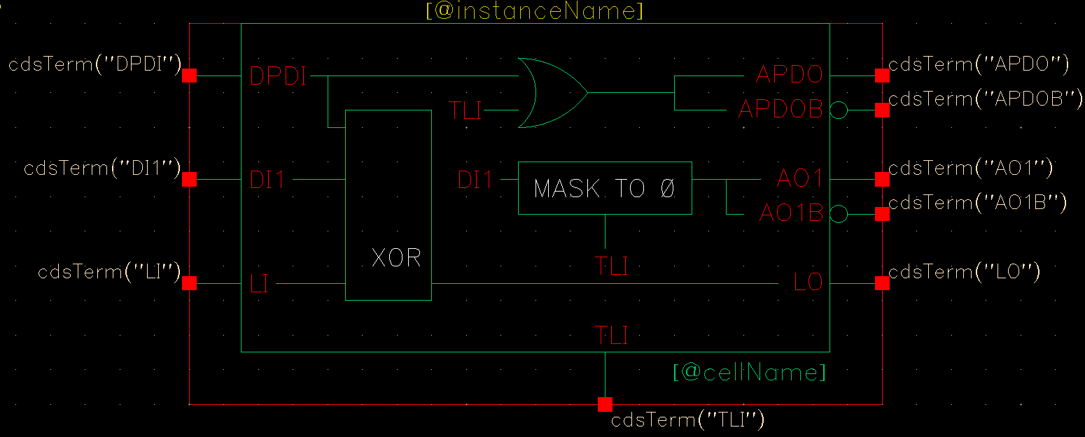
How test wires beetween digital and analog nets ?
ITC cells (interconnect test coverage or loop back )
Required to check stuck at and birdge failures on wire between digital and analog
Koopback cells must be placed inside analof blocks

Slide 145
Digital
cmd
Analog
in
ITC
out

Slide 146
Fault model example
Inputs and outputs can either be “stuck-at” a high (Vdd) or low (Ground)
A
B
Y
Pattern | A | B | Y | Faults Detected
1 | 0 | 0 | 0 | A: SA1 (#2) B: SA1 (#4) Y: SA1 (#6)
2 | 0 | 1 | 0 | A: SA1 (#2) B: SA0 (#3)
3 | 1 | 0 | 0 | A: SA0 (#1) B: SA1 (#4) Y: SA1 (#6)
4 | 1 | 1 | 1 | A: SA0 (#1) B: SA0 (#3) Y: SA0 (#5)
Fault Number | Fault Description
#1 | Input A is (shorted to Gnd): SA0
#2 | Input A is (shorted to Vdd): SA1
#3 | Input B is (shorted to Gnd): SA0
#4 | Input B is shorted to Vdd) : SA1
#5 | Output Y is (shorted to Gnd): SA0
#6 | Output Y is (shorted to Vdd) : SA1

Slide 147
Bridge pair extraction
Bridge and Cell-Aware
Faults
IDDQ
Trans
Stuckat

Slide 148
Scan design is a methodology used for Design For Test (DFT) to add testability features to a hardware design.
Scan design makes Automatic Test Pattern Generation (ATPG) easier to implement as logic depth is constrained.
There is always a trade-off. Full scan design typically adds 10%-15% more area with approximately a 5% speed hit.

Slide 149
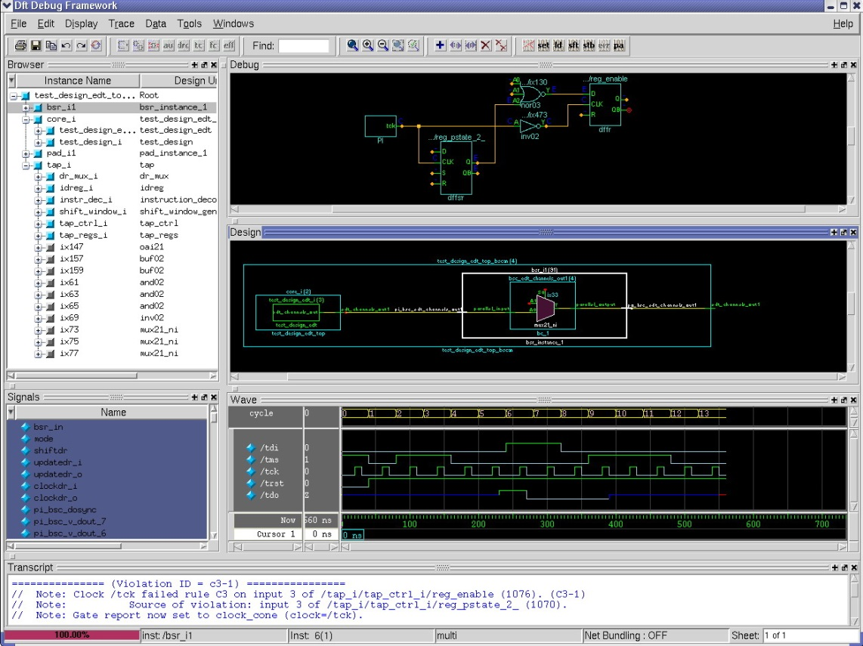
DFT VISUALIZER
DFT debug environment in Tessent
Intuitive and effective GUI to reduce DFT debug effort
Eases design navigation & exploration
Helps to debug DFT related issues
DRC violations
Low coverage
Test procedures

