Slide 1
2012 Performance Appraisal (PA) Cycle
Part One – Appraisal Training
October 2011
Purpose: To help people managers …
Explain PA process to their employees
Complete Part One – write, rate and calibrate

Slide 2
Content
Introduction to Talent Management
PA Cycle Overview
Training for Appraise Steps
Review, Key Messages
Q & A

Slide 3
ON Semiconductor Talent Management Philosophy
Ensure ON Semiconductor has the talent needed to deliver the desired results today and faster, better, more cost effective results tomorrow
We need to aggressively manage our talent to support ON Semiconductor’s growth strategy
Within constraints of running business, we will work with employees to provide opportunities for them to apply and grow their talents
Talent management needs to become a regular part of the business

Slide 4
Talent Management System at ON Semiconductor
Business Strategies
Workforce Planning
Have vs. Need
Continuous Process…
EVP*
Outcomes
Talent & Business
Acquire
Deploy
Develop
Compensation
Get right people
on the bus
In right seats with right goals
Grow in right ways
for business and person
Retain best fit, redirect or manage out poor fit
Get great results
Performance Management
*EVP = Employee Value Proposition
Notes:
5 mins
This graphic shows the elements of talent management at ON Semiconductor.
Recent changes –
we’ve explicitly called out the importance of workforce planning, and we recognize that desired outcomes of this continuous process is great business results, retaining best fit and redirecting poor fit
Note that although performance management doesn’t have it’s own bubble, it encompasses how we as leaders deploy and develop our talent.

Slide 5
Performance Management
Performance management is fundamentally:
  Setting clear goals and expectations; continuing to raise the standards
  Monitoring and providing regular feedback including clear, unambiguous performance messages and development opportunities
  Rewarding and recognizing
Desired outcome of this process is:
  Right business results are produced
  Individuals understand their performance relative to manager expectations and peers, their strengths and areas for development
  Performance of individuals and organization continuously improve
  Retain good-fit employees; redirect or manage out poor-fit employees
Manager/supervisor role in this process:
  Ensure employees understand the process
  Manage the process to achieve the desired results
Annual PA process is culmination of a year-round process

Slide 6
Overall Annual PA Process –
Owners and Outcomes
OWNERS:
All people managers of eligible employees
Eligible employees must own their part
Eligible employees = full or part-time employees, excluding SANYO Semiconductor employees in Asia and Japan
OUTCOMES:
All eligible employees (appraisees) receive accurate and fair (objective, informed) performance message
Appraisees and appraisers (managers) achieve mutual understanding of
  how appraisee performance can be enhanced or improved
  how appraisee’s potential at ON Semiconductor is viewed (required for IDL only)
Appraisees understand PA message, agreement is desired, not required
Variations in performance are identified and acted on
  High performance is recognized and rewarded, below expectations performance is identified and addressed
  At company and group level, rating distributions meet bell-curve

Slide 7
Overall PA Process Tools, Process
TOOLS:
Appraisal templates
Oracle E-Business Suite (EBS)
UPK Training for Oracle EBS
Performance Management
Communication packages
PROCESS:
Oct. 24, 2011 to Jan.16, 2012 - Appraise (write and rate, calibrate )
Jan. 16 to Jan. 30, 2012 - Allocate merit, lump sum, equity
Feb. 20. to March 16, 2012 - Communicate results
Located on Performance Tools home page

Slide 8
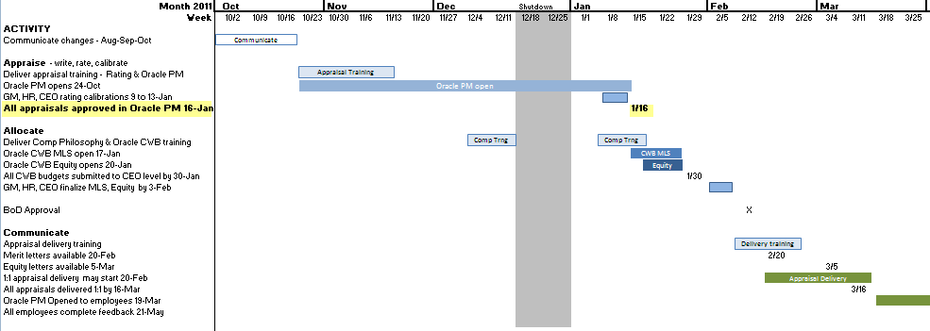
2012 Performance Appraisal (PA) timeline
Process:
  WW43’11 through WW02’12 - Appraise (write, rate, calibrate)
  WW03’12 through WW04’12 - Allocate merit, lump sum, equity
  WW08’12 through WW11’12 - Communicate results
today
Notes:
Note: Financial results for Q4’11 won’t be available by Jan 16, 2012; you will have to estimate attainment of goals on the appraisal and submit them for approval before Jan 16

Slide 9
Annual PA Process Steps
Appraise
Appraiser collects performance data
Appraiser summarizes results
Appraiser writes preliminary appraisal(s)
Appraiser calibrates performance message(s)
Appraiser submits final appraisal(s) in Oracle EBS
Approver dispositions final appraisal(s) in Oracle EBS
Appraiser allocates merit, lump sum and equity in Oracle CWB
Appraiser calibrates and submits in Oracle CWB
Approver dispositions final allocation(s) in Oracle CWB
Appraiser delivers performance and reward message(s) 1:1
Appraisee(s) provide(s) feedback on appraisal(s)
Allocate
Communicate

Slide 10
Part one – Appraise
Outcomes: appraisals are finalized, submitted and approved in Oracle EBS by Jan. 16 such that overall rating distribution guidelines are met

Slide 11
1. Appraiser Collects Performance Data
TOOLS:
  IDL self appraisal
  360 feedback template
  IDL , DL or DL Back End (Assembly/Test) templates
PROCESS:
  Ask IDL appraisee to complete self-appraisal
  Strongly recommend collect 360 feedback for people and program managers, senior individual contributors
  Send out no more than six (6) feedback requests for IDL or DL appraisees
  Can ask appraisee for their inputs on names for 360 but appraiser is the final decider
OUTCOMES:
  Completed inputs
Recommend collect a maximum
of 1+6 inputs
Appraiser
Matrix Mgr
Peer(s)
IDL
Appraisee
Customer(s)
Appraisee
Subordinate(s)

Slide 12
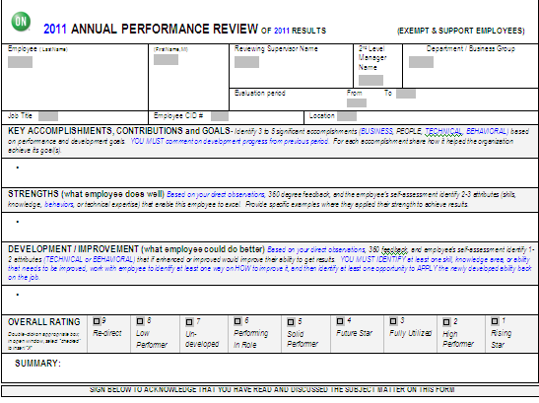
2. Appraiser Summarizes Results
TOOLS:
  Completed inputs
  IDL , DL or DL Back End (Assembly/Test) templates
PROCESS:
  Review completed inputs looking for common themes and trends
  Common themes that support your observations are good candidates for inclusion
  Consider including or following up on common themes that you haven’t observed
OUTCOMES:
  DL or IDL template with key accomplishments completed
  Bullet points in Strength, Development / Improvement areas
  Recommend not assign overall rating or comments just yet
All text areas limited to 2000 or less characters

Slide 13
3. Appraiser Writes Preliminary Appraisal(s)
TOOLS:
  Summary from step 2
  IDL , DL or DL Back End (Assembly/Test) templates
PROCESS:
  Review expected results
  Assess performance (business and people results) vs. expectations
  Assess potential (IDL only)
  Assign rating
  Edit wording in appraisal to give preliminary message
OUTCOMES:
  DL or IDL template with completed text, assigned rating and ready for calibration
  Note: You should save appraisal in Oracle EBS but not submit for approval until after calibration to avoid premature approval
Notes:
Q -

Slide 14
3a. Review Expected Results
TOOLS:
  Guidelines in Career Path and Promotional Guidelines, Technical and Business Ladder level guidelines, Job Descriptions
  Organization-specific goals, management by objectives (MBOs) or Key Performance Indicators (KPI) results
  Individual-specific goals, MBOs or KPIs
  Individual PA, Individual Development Plan (IDP) from previous year
    Link to “old” Oracle 11i where you can view PAs from 2010 and before
PROCESS:
  Review expected results, both general and specific
  Compile expectations (business and people results, changes in knowledge-skills- abilities-behaviors) that were communicated last year
  Note any changes/challenges that occurred during the year
OUTCOMES:
  Set of expected business and people results, expected improvements in knowledge-skills- abilities-behaviors
  Note: Ideally this is captured at the beginning of the appraisal period and kept up-to-date throughout the appraisal period
Notes:
Q - What’s the effective date after which managers hired will not have access to Oracle 11i

Slide 15
3b. Performance Assessment
TOOLS:
  Set of expected results from step 3a
  Individual PA summary from step 2
  DL guidelines for 1-5 rating
  Nine-box performance rating guidelines for IDL
PROCESS:
  Did this person’s key results consistently exceed expected key results? Meet them? Fall below expectations?
  Did this person’s results and impact place them in top 20% of peers for the appraisal period? Middle 60%? Bottom 20%?
  Did this person’s behavior to Values and leadership attributes always exceed your expectations? Meet them? How does their behavior compare to peers?
  Was this person a key contributor to your team? The larger organization?
  Did this person act on last year’s performance feedback? Complete their key IDP items?
  Summarize answers to your questions; compare to definitions of performance for rating 1-5 for DL or top-middle-bottom row for IDL
  Choose appropriate performance rating for DL (or row for IDL)
OUTCOMES:
  Individual performance appraisal with performance level identified

Slide 16
3c. Assess Potential (IDL Only)
TOOLS:
  Career Path and Promotional Guidelines, Technical and Business Ladder level guidelines, Job Descriptions
  Individual performance appraisal from step 3b
  Description of components of potential from Corporate Leadership Council (CLC)
  Nine-box tool potential guidelines
PROCESS:
  Does this person possess (or exhibit the ability to learn) the knowledge, skills, abilities and behaviors they need for next grade level at ON Semiconductor? Next position after that?
  Does this person’s behavior indicate they aspire to take on more responsibility?
  Can you picture this person being successful at one grade level higher within next 2-3 years? Two grade levels higher?
  Has this person demonstrated a willingness to put in extra effort? To do what is necessary to achieve business and people goals? Pursue their career goals?
  Is this person viewed as an advocate for the organization? The company?
  Has this person demonstrated the ability to see a broader perspective outside their own role? Function? Organization?
  Will your group/company have a need for jobs at one-two grade levels higher within 2-3 years?
  Summarize answers to your questions; compare with definitions of potential in nine-box tool; use CLC components of potential to help you identify factors which are present or absent
  Choose appropriate potential column for the individual
OUTCOMES:
  Individual performance appraisal with potential level identified
  Remember: Assessment of potential does not equal promotion; actual promotion depends on business need and employee’s continued performance trajectory

Slide 17
3d. Assign Nine-Box Rating (IDL only)
TOOLS:
  Outputs from 3b and 3c
  Nine-box tool cell descriptions, bottom row guidelines
PROCESS:
  Review nine-box tool cell descriptions, bottom row guidelines
  Review preliminary PA and results from 3b and 3c
  Select box that best represents the employee’s performance for previous period and potential
  Assign rating to preliminary appraisal
OUTCOMES:
  Individual employee preliminary appraisal with nine-box rating

Slide 18
3e. Edit wording (preliminary message)
TOOLS:
  Preliminary individual appraisal (DL or IDL template)
  Results of 3b (DL) and 3c (IDL)
  Definitions of DL rating and IDL ratings
  Oracle E-Business Suite
  UPK Training for Oracle EBS Performance Management
PROCESS:
  Review preliminary appraisal text and rating
  Review appraisal writing guidelines
  For IDL review nine-box action guide
  Revise direction provided in development and improvement areas (IDL) or overall comments (DL)
    What are 1-2 actions this person can do to most positively impact their performance? Their potential? Their value to the company?
  Check for consistency of wording and rating, edit as needed
  Enter preliminary text and rating into Oracle PM and save by end November
  Note: Recommend not submit for approval until after calibration
OUTCOMES:
  Completed preliminary appraisal for the individual employee, saved in Oracle PM

Slide 19
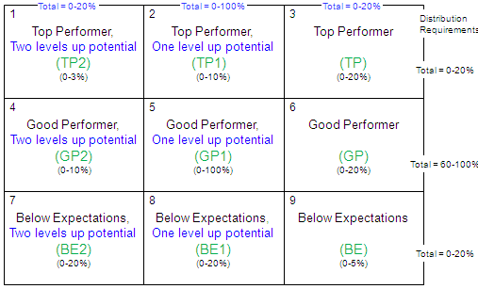
4. Appraiser Calibrates Messages
TOOLS:
  Rating definitions (DL), Nine-box tool (IDL)
  Oracle E-Business Suite
  UPK Training for Oracle EBS Performance Management
  Nine-box calibration template
PROCESS:
  Check performance rating distributions using Appraisal Summary link in Oracle EBS
  Compare performance distributions vs. guidelines
  Identify employees on “low” and “high” sides (edges) of 1-5 (DL) or row (IDL) groupings
  Should any of these employees move to adjacent grouping? Revise as needed
  Repeat steps above for potential (IDL only)
  Check distribution vs. guidelines and box 1 is no more than 3%
  Review results with second-level manager and peer staff; recommend group session*
  Listen to inputs, revise as needed
  Capture key messages for employees, key learnings for appraisers
OUTCOMES:
  Evidence of group performance differentiation
  Revised individual performance appraisals
Performance distributions are more important than potential distributions
Potential Groupings
2
2 grade
levels
1 grade
level
Steady
at grade
1
TP
GP
Performance Groupings
BE
Nine-box calibration template
* Suggested group calibration process and tools will be available; contact your HR rep for assistance
Notes:
Questions…
Reports – send to HR mgrs; Mgrs

Slide 20
5. Appraiser Submits Final Appraisal
TOOLS:
  Preliminary performance appraisals
  Output from calibration sessions
  Oracle E-Business Suite (EBS)
  UPK Training for Oracle EBS Performance Management
PROCESS:
  Appraiser reviews output from calibration sessions
  Appraiser revises preliminary performance appraisals, as needed
  Review UPK training for submitting appraisal in Oracle EBS as needed
  Appraiser logs into Oracle EBS, enters appraisal information from template into Oracle EBS
  Submits to Approver for disposition (Approve, Reject or Return for Correction)
OUTCOMES:
  Appraisal is finalized with results from calibration session
  Appraisal is submitted for approval in Oracle, moves to “Pending Approval” status in Oracle

Slide 21
6. Approver Dispositions Appraisal in Oracle
TOOLS:
  Notification of submitted appraisal
  Notes from calibration session, as appropriate
  Oracle E-Business Suite (EBS)
  UPK Training for Oracle EBS Performance Management
PROCESS:
  Approver receives either Outlook email or Oracle notification
  Logs into Oracle, clicks “Notifications” link
  Views appraisal, verifies text and rating meet expectations, boxes checked
  Dispositions appraisal – Approve, return for correction, or reject
    Return for Correction – clicking link sends back, “Return for correction” status
    Reject – clicking button returns to appraiser, goes to “Ongoing” status
OUTCOMES:
  Appraisal moves from “Pending Approval” to “Pending Appraisee Feedback” assuming feedback box was left checked or
  Returned to appraiser in “Returned for Correction” or “Ongoing” status

Slide 22
Review and Key Messages
APPRAISE STEPS
Appraiser collects performance data
Appraiser summarizes results
Appraiser writes preliminary appraisal(s)
Appraiser calibrates performance message(s)
Appraiser submits final appraisal(s) in Oracle EBS
Approver dispositions final appraisal(s) in Oracle EBS
KEY MESSAGES
Get started now
Ask for employee and 360 inputs, as needed
Look for trends/patterns in feedback
Support your evaluation with examples
Follow guidelines for appraisal writing
Make your text consistent with rating message
Enter preliminary text and rating into Oracle EBS in November*, submit for approval in Oracle after calibration
Calibrate your assessments/messages with your manager, peer managers
Final appraisals must be approved in Oracle by January 16
Watch for future communications and training for “allocate” steps
Questions? Contact your HR rep
* Higher level managers will want to see how distributions are progressing

Slide 23
Additional Q&As

Slide 24
Reference

Slide 25
Performance Rating 1-5 Definitions for DL
Return

Slide 26
Nine-box Rating Tool for IDL - Performance
high
1
2
3
Distribution
Requirements
Consistently exceeds expectations
In top 20% of your performers
Consistently exceeds goals, budget, schedule
Consistently
exceeds
Box 1+2+3= ~0-20%
4
5
6
Meets, sometimes exceeds
Meets, sometimes exceeds expectations
Meets, sometimes exceeds goals, budget, schedule
Performance
Box 4+5+6= ~60-100%
Performance is below expectations
Does not always meet goals, budget, schedule
In bottom 20% of your performers
May be new to role (box 7 only)
7
8
9
Does not always meet
Box 7+8+9= ~0-20%
low
Return

Slide 27
ON Semiconductor Values
Integrity
  We say what we mean and are accountable for delivering our commitments on time.
  We address issues in an objective, fact based and constructive fashion without fear of reprisal.
  When a decision has been made we all execute to support it.
  We comply with all legal requirements and hold ourselves to the highest standards of ethical conduct.
Respect
  We treat each other with dignity and respect.
  We share information and encourage divergent viewpoints in an open and honest environment.
  We draw out the best in each other recognizing that diversity of backgrounds and experience are key strengths.
  We all win when we support each other by placing the success of the Company above individual interests.
Initiative
  We take informed risks while making data based decisions.
  If a problem exists we are individually responsible to see it through to rapid resolution.
  We value people who demonstrate a positive, “can-do” attitude, while collaborating to win.
  We work smart and with a sense of urgency.
Return

Slide 28
What are the attributes of a performing leader?
Eleven leadership attributes used in succession planning process….
Intellectually sharp and agile
Business acumen
Strategic thinking
Self awareness
Ability to influence (especially across organizations)
Risk-taker
Innovative
Decisive
Results-oriented
Rigorously manages talent
Timely, value added communication
Return

Slide 29
Intellectually sharp and agile
A performing leader at ON Semiconductor….
Is bright and intelligent
Deals comfortably with concepts, ambiguity, and complexity
Approaches problems and opportunities in fresh new ways
Quick to catch on; quickly learns from mistakes
Return to attribute list

Slide 30
Business Acumen
A performing leader at ON Semiconductor….
Knows how businesses work
Understands semiconductor business
Understands our value drivers, practices, policies and how they impact his/her business
Understands the customer current needs
Knows the competition
Return to attribute list

Slide 31
Strategic Thinking
A performing leader at ON Semiconductor….
Is aware of customer and marketplace trends
Is knowledgeable of how company value drivers, strategies and tactics will affect his/her future business activities
Can visualize and express with conviction a desired future
Return to attribute list

Slide 32
Self-Awareness
A performing leader at ON Semiconductor….
Is aware of his/her own preferred communication styles and behavioral preferences
Understands other styles and behaviors and how to adapt and build constructive and positive relationships
Understands his/her strengths, weaknesses and limits
Seeks feedback and acts on it
Learns from mistakes
Return to attribute list

Slide 33
Ability to Influence
(especially across organizations)
A performing leader at ON Semiconductor….
Understands when collaboration is needed
Is sensitive to how people and organizations operate and their interests
Is able to identify common goals
Constructively deals with conflict
Is widely trusted and seen as a direct, truthful individual
Is able to energize others to rise to the occasion
Return to attribute list

Slide 34
Risk-Taker
A performing leader at ON Semiconductor….
Questions the status quo
Initiates change
Experiments and is open to different approaches
Has a bias for action
Will act in the face of uncertainty
Learns and adjusts quickly
Return to attribute list

Slide 35
Innovative
A performing leader at ON Semiconductor….
Relentlessly seeks to create more product or process value
Seen as original thinker, value-adding at brainstorm sessions
Has good judgment about which creative ideas/suggestions will work
Return to attribute list

Slide 36
Decisive
A performing leader at ON Semiconductor….
Quickly grasps the essence of a situation even without complete information
Is able to make quick decisions
Makes decisions that mostly turn out to be correct over time
Is sought out by others for advice and solutions
Return to attribute list

Slide 37
Results-Oriented
A performing leader at ON Semiconductor….
Can be counted on to exceed/meet goals
Is bottom-line oriented
Consistently pushes self and others to achieve
Clearly communicates what success looks like
Holds his/herself and others accountable
Return to attribute list

Slide 38
Rigorously Manages Talent
A performing leader at ON Semiconductor….
Hires the best people available, inside or outside
Is not afraid of selecting strong people or waiting to hire the right person
Creates opportunities for people to contribute their best for the team
Sets clear performance expectations and provides actionable feedback
Faces up to performance problems quickly and directly; is not afraid to act
Develops his/her workforce and successors
Return to attribute list

Slide 39
Timely Value-Added Communication
A performing leader at ON Semiconductor….
Provides information his/her people need to do their job and feel committed to the business and the company
Passes along information in a timely manner adding his/her perspective on what it means to the business and the company
Can discuss multiple aspects and impacts of relevant business issues
Return to attribute list

Slide 40
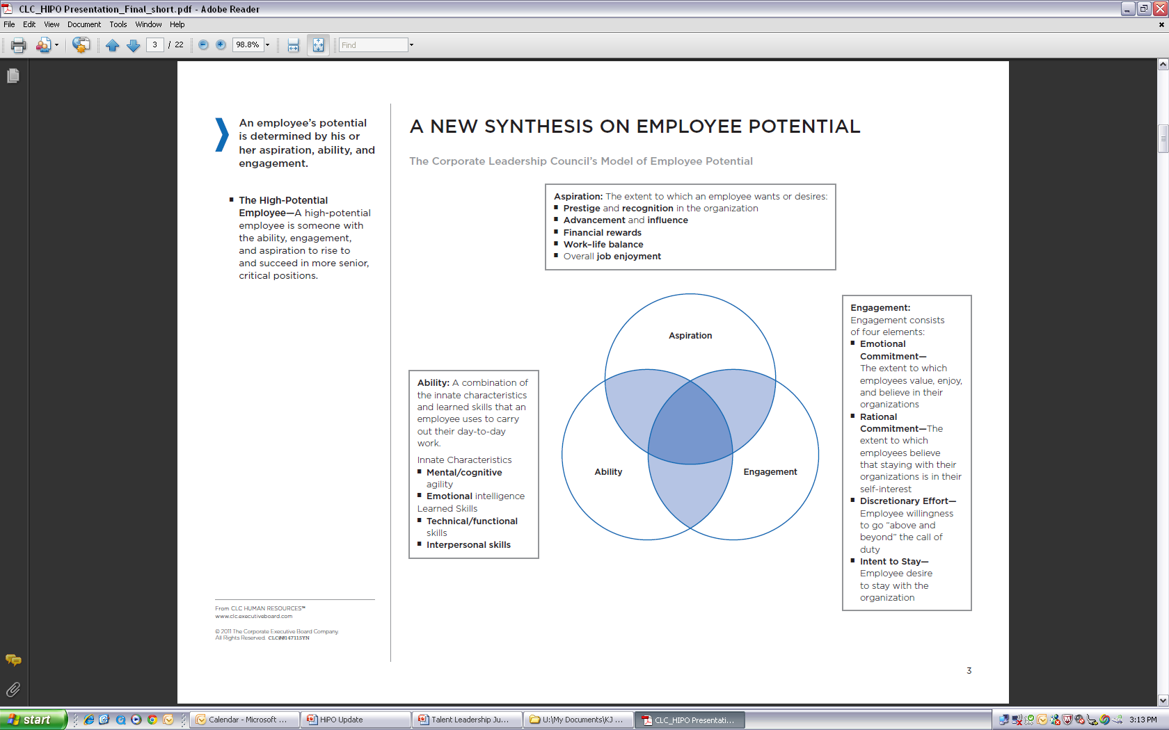
Elements of Potential
Source: CLC
Return

Slide 41
Nine-box Rating Tool for IDL - Potential
1
1+4+7= 0-20%
2
2+5+8= 0-100%
3
3+6+9= 0-20%
0-3%
0-10%
0-20%
4
5
6
0-10%
0-100%
0-20%
7
8
9
0-20%
0-20%
0-5%
high
Two or more grade levels
One grade level
Steady at current grade
low
Potential
Potential defined as realistic* probability that employee could advance up company career ladder within next 2-3 years
  High potential = two grade levels or more
  Medium potential = one grade level
  Low potential = steady or zero grade levels
* As assessed by two or more members of employee’s leadership team
Return

Slide 42
Nine-box Rating Descriptions
1
TP2
2
TP1
3
TP
Consistently exceeds expectations
In top 20% of your performers
Consistently exceeds goals, budget, schedule
Realistic chance employee could advance two grade levels in 2-3 years
Consistently exceeds expectations
In top 20% of your performers
Consistently exceeds goals, budget, schedule
Realistic chance employee could advance one grade level in 2-3 years
Consistently exceeds expectations
In top 20% of your performers
Consistently exceeds goals, budget, schedule
Likely employee will stay at current grade level over next 2-3 years
4
GP2
5
GP1
6
GP
Meets, sometimes exceeds expectations
Meets, sometimes exceeds goals, budget, schedule
Realistic chance employee could advance two grade levels in 2-3 years
Meets, sometimes exceeds expectations
Meets, sometimes exceeds goals, budget, schedule
Realistic chance employee could advance one grade level in 2-3 years
Meets, sometimes exceeds expectations
Meets, sometimes exceeds goals, budget, schedule
Likely employee will stay at current grade level over next 2-3 years
Performance
7
BE2
8
BE1
9
BE
In bottom 20% of your performers
New to role (box 7)
Does not always meet goals, budget, schedule
Realistic chance employee could advance two grade levels in 2-3 years
In bottom 20% of your performers
Does not always meet goals, budget, schedule
Realistic chance employee could advance one grade level in 2-3 years
In bottom 20% of your performers
Does not always meet goals, budget, schedule
Likely employee will stay at current grade level over next 2-3 years
Advancement Potential within 2-3 years
Return

Slide 43
Nine-box Rating Phrases, Abbreviations
high
1
Total = 0-20%
Total = 0-100%
Total = 0-20%
Top Performer,
Two levels up potential
(TP2)
(0-3%)
2
Top Performer,
One level up potential
(TP1)
(0-10%)
3
Top Performer
(TP)
(0-20%)
Distribution
Requirements
Top Performer
Total = 0-20%
4
Good Performer,
Two levels up potential
(GP2)
(0-10%)
5
Good Performer,
One level up potential
(GP1)
(0-100%)
Good Performer
(GP)
(0-20%)
6
Good Performer
Performance
Total = 60-100%
7
Below Expectations,
Two levels up potential
(BE2)
(0-20%)
Below Expectations,
One level up potential
(BE1)
(0-20%)
8
Below Expectations
(BE)
(0-5%)
9
Below
Expectations
Total = 0-20%
low
high
Two or more grade levels
One grade level
Steady at current grade
low
Advancement Potential within 2-3 years
Return

Slide 44
Below Expectations Guidelines
high
1
TP2
2
TP1
3
TP
4
GP2
5
GP1
GP
6
Performance
7
BE2
BE1
8
BE
9
Redirect
low
high
Advancement potential within 2-3 years
low
Box 7 is for employees new to role; limited to one year or less in box 7
Box 8 employees require a focused effort by manager and employee
  Do not require Performance Improvement Plan (PIP)
  If performance doesn’t improve employee rating goes to box 9
Box 9 employees have two choices
  Go on a (PIP) or
  Discuss separation option with their manager
Overall, employees are limited to two consecutive years in “Below Expectations” row
Return
Notes:
The following is an example of negligent management that is not acceptable…
Mgr goes to HR or senior management and say I need to “get rid of” someone….
And that person has never received a low performance message before…

Slide 45
Guidelines for Appraisal Writing
DON’T
Over-focus on development areas
Frame development feedback around personality
Assume employee understands feedback and how to maintain or improve
DO
Balance positive and development feedback
Frame development feedback around skills and behaviors
Provide examples and suggestions for improvement
Return to step 3e
Return to Key Messages

Slide 46
Nine-box Action Guide
1
TP2
2
TP1
3
TP
IDP required – create and track
Involve in corporate hiPO activities
Find opportunities to have box 1s teach/coach others
IDP recommended – create and track
Involve in group or department level hiPO activities
Find opportunities to have box 2s teach/coach others
IDP recommended – create and track
Find opportunities to have box 3s teach/coach others
4
GP2
5
GP1
6
GP
IDP recommended – create and track
Involve in group or department level hiPO activities
Leverage capable box 4s to teach/coach others
IDP recommended – create and track
Leverage capable box 5s to teach/coach others
IDP recommended – create and track
Leverage capable box 6s to teach/coach others
Performance
7
BE2
8
BE1
9
BE
IDP recommended – create and track
Disposition within one year
IDP required – create and track
Disposition within one year
Performance Improvement Plan (PIP) required or
Discuss separation option
Redirect
Advancement potential within 2-3 years
Common to all: regular performance management that includes
goal-setting, monitoring, evaluating, and providing feedback (coaching, recognition, correction)
Return

Slide 47
Nine-box Calibration Tool
2
Potential Groupings
Names..
Names..
Names..
Names..
Names..
Names..
Names..
Names..
Names..
Names..
Names..
Names..
Names..
Names..
Names..
high
1
Performance Groupings
1 – TP2
Name ..
2 – TP1
Name ..
Name ..
3 - TP
Name ..
TP
Names..
Names..
Names..
Names..
4 – GP2
GP
Names..
Names..
Names..
Names..
Names..
Names..
Names..
Names..
Name ..
5 – GP1
Name ..
Name ..
Name ..
Name ..
Name ..
Name ..
Name ..
6 - GP
Performance
7 – BE2
Name ..
Name ..
8 – BE1
Name ..
9 - BE
BE
Names..
Names..
Names..
low
Redirect
high
Advancement potential within 2-3 years
low
Return

