Slide 1
Kick-off of 2012 Performance Appraisal (PA) Cycle
October 2011
Purpose: Share what is and is not changing, why we are changing, overall timeline, expectations

Slide 2
Content
What is not changing for 2012 Performance Appraisal (PA) Cycle
What is changing for 2012 PA Cycle
Why we are changing
Overall 2012 PA Cycle timeline
Key Messages
Expectations
Q & A

Slide 3
What is not changing for 2012 PA Cycle
Appraisal period is still Jan. 1 to Dec. 31
Eligibility - full-time or part-time employees hired on or before Sept. 30, 2011
Direct Labor (DL) rating scale of 1-to-5; same DL templates
Appraisee’s performance will be assessed relative to
Appraiser’s expectations
Appraisee’s peers
Performance rating distribution for large groups should meet normal (bell-shaped curve) guidelines
Our compensation philosophy – pay for performance
Most managers and employees will again use online tools
Oracle Performance Management (PM) to enter appraisals
Compensation Workbench (CWB) to do merit and equity planning
Final approval of cycle results done at February Board meeting

Slide 4
2012 PA Cycle for SANYO Semiconductor
SANYO Semiconductor adoption of ON Semiconductor appraisal process and tools will be done in phases
Current phasing plans are shown below
Final adoption dates for SANYO Asia (non-Japan) and Japan dependent on outcomes of union negotiations
Appraisal Period | PA Cycle | SANYO US and EUR | SANYO Asia (not Japan) | SANYO Japan
2011 | 2012 | PA Tools
2012 | 2013 |  | PA Tools
2013 | 2014 |  |  | PA Tools
Notes:
Q – Will performance management corrective actions taken with SANYO employees count against our performance distributions? A – No, but you should still be managing performance regardless of which system you are using.

Slide 5
What is changing for 2012 PA Cycle
Adopting nine-box rating scale for Indirect labor (IDL)
Based on the familiar nine-box tool with minor changes
Training will be provided on using the tool and delivering messages
Must meet normal distribution guidelines by grade bands 18-16, 15-13, 12-10, 9-7
Clear definition of split (division) between DL and IDL jobs
Moving PA entry, merit and equity processes to Oracle e-Business Suite (EBS)
Oracle PM application has tangible improvements
Oracle CWB changes are minor
Appraisal tools available earlier so appraisers can start earlier
ALL written appraisals must be submitted and approved by Jan. 16
Employees with no approved appraisal => no merit, lump sum, or equity
Only merit/lump sum and equity changes may be entered in Oracle CWB; no rating changes

Slide 6
Why we are adopting nine-box for IDL rating
Simplify rating process by moving from two metrics to one
Increase transparency and openness
Scores for potential have been assigned to IDLs in the past
Communication practices were inconsistent
Improved quality of development feedback and discussion

Slide 7
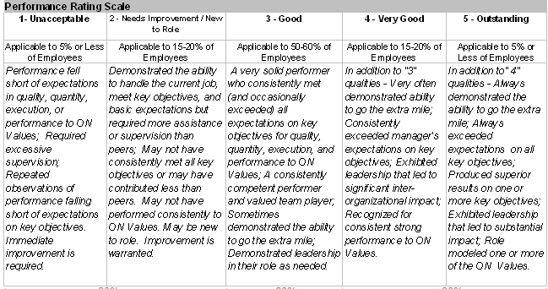
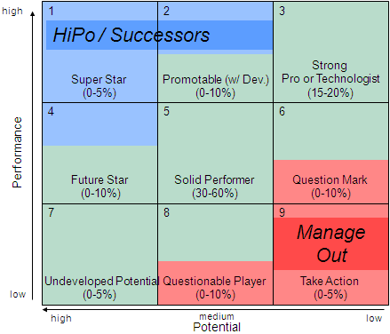
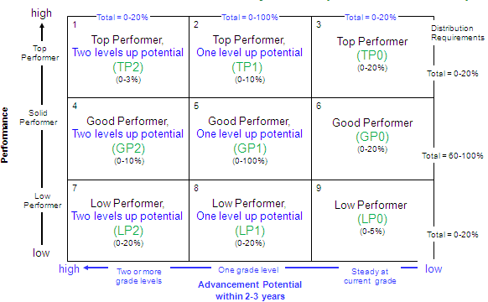
Rating changes for IDL
IDL process was two steps…
Assign a rating of 1 (Unacceptable) to 5 (Outstanding) and
Assign a potential score of 9 (Redirect) to 1 (HiPO or Super Star)
Potential score was sometimes communicated
Now IDL process is one step…
Assign a rating of 9 (Low) to 1 (High)
Performance and potential are reflected in one number
Communicated and discussed with all IDLs
Rating definitions1-5
Nine-box for potential
1 - high
Performance and
Potential together
9 - Low

Slide 8
Nine-box rating tool - performance
high
1
2
3
Distribution
Requirements
Consistently exceeds expectations
In top 20% of your performers
Consistently exceeds goals, budget, schedule
Consistently
exceeds
Box 1+2+3= ~0-20%
4
5
6
Meets, sometimes exceeds
Meets, sometimes exceeds expectations
Meets, sometimes exceeds goals, budget, schedule
Performance
Box 4+5+6= ~60-100%
Performance is below expectations
Does not always meet goals, budget, schedule
In bottom 20% of your performers
May be new to role (box 7 only)
7
8
9
Does not always meet
Box 7+8+9= ~0-20%
low

Slide 9
Nine-box rating tool - potential
1
2
3
4
5
6
7
8
9
high
Two or more grade levels
One grade level
Steady at current grade
low
Potential
Potential defined as realistic* probability that employee could advance up company career ladder within next 2-3 years
High potential = two grade levels or more
Medium potential = one grade level
Low potential = steady or zero grade levels
* As assessed by two or more members of employee’s leadership team

Slide 10
Nine-box rating tool – potential distributions
1
1+4+7= 0-20%
2
2+5+8= 0-100%
3
3+6+9= 0-20%
0-3%
0-10%
0-20%
4
5
6
0-10%
0-100%
0-20%
7
8
9
0-20%
0-20%
0-5%
high
Two or more grade levels
One grade level
Steady at current grade
low
Advancement potential within 2-3 years
Notes:
Not planning to enforce cumulative potential distribution guidelines as hard as distribution guideline with exception of Box 1 is capped at 3%; Why 3% cap? A – Because we want to ensure our limited corporate HiPO program resources are concentrated on our highest performing, highest potential employees and not “peanut-buttered” over a larger group
A dynamic that might not be obvious at first – As you go higher in grade level and position in the organization, it is increasingly difficult to be a hiPO. Why? – The higher you go in the organization, there are fewer and fewer positions with higher and higher expectations. And at some level there aren’t any more positions two grades higher. Not everyone is going to be a CEO.

Slide 11
Nine-box ratings and abbreviations
high
1
Total = 0-20%
Total = 0-100%
Total = 0-20%
Top Performer,
Two levels up potential
(TP2)
(0-3%)
2
Top Performer,
One level up potential
(TP1)
(0-10%)
3
Top Performer
(TP)
(0-20%)
Distribution
Requirements
Top Performer
Total = 0-20%
4
Good Performer,
Two levels up potential
(GP2)
(0-10%)
5
Good Performer,
One level up potential
(GP1)
(0-100%)
Good Performer
(GP)
(0-20%)
6
Good Performer
Performance
Total = 60-100%
7
Below Expectations,
Two levels up potential
(BE2)
(0-20%)
Below Expectations,
One level up potential
(BE1)
(0-20%)
8
Below Expectations
(BE)
(0-5%)
9
Below
Expectations
Total = 0-20%
low
high
Two or more grade levels
One grade level
Steady at current grade
low
Advancement Potential within 2-3 years

Slide 12
Nine-box rating descriptions
1
TP2
2
TP1
3
TP
Consistently exceeds expectations
In top 20% of your performers
Consistently exceeds goals, budget, schedule
Realistic chance employee could advance two grade levels in 2-3 years
Consistently exceeds expectations
In top 20% of your performers
Consistently exceeds goals, budget, schedule
Realistic chance employee could advance one grade level in 2-3 years
Consistently exceeds expectations
In top 20% of your performers
Consistently exceeds goals, budget, schedule
Likely employee will stay at current grade level over next 2-3 years
4
GP2
5
GP1
6
GP
Meets, sometimes exceeds expectations
Meets, sometimes exceeds goals, budget, schedule
Realistic chance employee could advance two grade levels in 2-3 years
Meets, sometimes exceeds expectations
Meets, sometimes exceeds goals, budget, schedule
Realistic chance employee could advance one grade level in 2-3 years
Meets, sometimes exceeds expectations
Meets, sometimes exceeds goals, budget, schedule
Likely employee will stay at current grade level over next 2-3 years
Performance
7
BE2
8
BE1
9
BE
In bottom 20% of your performers
New to role (box 7)
Does not always meet goals, budget, schedule
Realistic chance employee could advance two grade levels in 2-3 years
In bottom 20% of your performers
Does not always meet goals, budget, schedule
Realistic chance employee could advance one grade level in 2-3 years
In bottom 20% of your performers
Does not always meet goals, budget, schedule
Likely employee will stay at current grade level over next 2-3 years
Advancement Potential within 2-3 years

Slide 13
Below Expectations row guidelines
high
1
TP2
2
TP1
3
TP
4
GP2
5
GP1
GP
6
Performance
7
BE2
BE1
8
BE
9
Redirect
low
high
Advancement potential within 2-3 years
low
Box 7 is for employees new to role; limited to one year or less in box 7
Box 8 employees require a focused effort by manager and employee
Do not require Performance Improvement Plan (PIP)
If performance doesn’t improve employee rating goes to box 9
Box 9 employees have two choices
Go on a (PIP) or
Discuss separation option with their manager
Overall, employees are limited to two consecutive years in “Below Expectations” row
Notes:
The following is an example of negligent management that is not acceptable…
Mgr goes to HR or senior management and say I need to “get rid of” someone….
And that person has never received a low performance message before…

Slide 14
Nine-box rating action guide
1
TP2
2
TP1
3
TP
IDP required – create and track
Involve in corporate hiPO activities
Find opportunities to have box 1s teach/coach others
IDP recommended – create and track
Involve in group or department level hiPO activities
Find opportunities to have box 2s teach/coach others
IDP recommended – create and track
Find opportunities to have box 3s teach/coach others
4
GP2
5
GP1
6
GP
IDP recommended – create and track
Involve in group or department level hiPO activities
Leverage capable box 4s to teach/coach others
IDP recommended – create and track
Leverage capable box 5s to teach/coach others
IDP recommended – create and track
Leverage capable box 6s to teach/coach others
Performance
7
BE2
8
BE1
9
BE
IDP recommended – create and track
Disposition within one year
IDP required – create and track
Disposition within one year
Performance Improvement Plan (PIP) required or
Discuss separation option
Redirect
Advancement potential within 2-3 years
Common to all: regular performance management that includes goal-setting, monitoring, evaluating, and providing feedback (coaching, recognition, correction)
Notes:
Box 1 – a very strong mutual commitment between org and hipo’s; company commits to invest resources, time and effort; individual is expected to be committed in kind to the organization (i.e. be available for assignments, etc.)

Slide 15
PA Process Steps – Training will be available
Appraise
Appraiser collects performance data
Appraiser summarizes results
Appraiser writes preliminary appraisal(s)
Appraiser calibrates performance message(s)
Appraiser submits final appraisal(s) in Oracle PM
Approver dispositions final appraisal(s) in Oracle PM
Appraiser allocates merit, lump sum and equity in Oracle CWB
Appraiser calibrates and submits in Oracle CWB
Approver dispositions final allocation(s) in Oracle CWB
Appraiser delivers performance and reward message(s) 1:1
Appraisee(s) provide(s) feedback on appraisal(s)
Allocate
Communicate

Slide 16
Criteria for Assigning DL and IDL Templates
2011 PA Cycle:
Verbal directions given
“DL” = “operators”
“IDL” = “everyone else”
Ultimately template chosen by appraiser
Ratings scale same for both
But in Oracle DL and IDL had financial meanings
“DL” = salaries tied to COGS*
“IDL” = everyone else
2012 PA Cycle:
Designation now drives rating scale
“DL” = rating 1-5
“IDL” = rating 9-1
Need repeatable decision criteria; propose following
Criteria 1 = Job classification
Criteria 2 = location (for DL)
Will use criteria to auto-assign templates
“DL” = front-end or back-end DL template
“IDL” = IDL template
* COGS = Cost of Goods Sold
Notes:
Job classification = Equal Employment Opportunity job classifications

Slide 17
DL employees, rated 1-5 using DL templates
Job Classification | Job Titles (examples) | Locations | Appraisal Template | Forms
Administrative Support Workers Laborers and Helpers Operatives Service Workers | ACCOUNTING CLERKS ADMINISTRATIVE ASSISTANTS CASHIER/FOOD SERVICE WORKERS CHEFS DOCUMENT CONTROL SUPPORTS DRIVER/CHAFFEURS EXPEDITERS INSPECTORS INTERPRETERS JANITOR/CUSTODIANS LABOR LIASONS MATERIAL HANDLERS OPERATORS PAYROLL CLERKS PLANNING ASSISTANTS RECEPTIONISTS SECURITY OFFICERS SHIPPING & RECEIVING CLERKS PROJECT SPECIALISTS MANUFACTURING SPECIALISTS MANUFACTURING TRAINERS | MYSE01 SBN MFG MY4 MYSE03 SCG MALAYSIA HLDGS MYSE04 PENANG SALES MY4 MYSE05 SBN TECH PHCA01 CARMONA MFG PH2 PHCA02 CARMONA D/C PHCL01 CALAMBA PHE THBA01 THAILAND MAIN THZ | DL Backend Template – Business Results Integrity Respect Initiative Quality Performance Driven Overall comments, direction
 |  | All other locations | DL Front End Template – Knowledge Quality Productivity Attendance Initiative & Flexibility Working with others Summary and Development

Slide 18
IDL employees, rated 9-1 using IDL template
Job Classification | Job Titles (examples) | Locations | Appraisal Template | Form
Professionals Executive/Senior Level Officials and Managers First/Mid Level Officials and Managers Sales Workers Technicians Administrative Worker* | Accountants Administrators, Contract and Systems Analysts Attorneys Buyers Controllers Designers Directors Engineers Executives Executive Assistants LEGAL SECRETARIES* Managers Nurses PARALEGALS* Planners Recruiters Representatives Scientists Section Heads Specialists Supervisors Technical Fellows Technical Writers Technicians** Trainers | All | Indirect Labor template Accomplishments Strengths Areas for Development Overall Comments, Summary
* Admin Support Worker exceptions
** Excludes small group that are classified as DL due to local laws

Slide 19
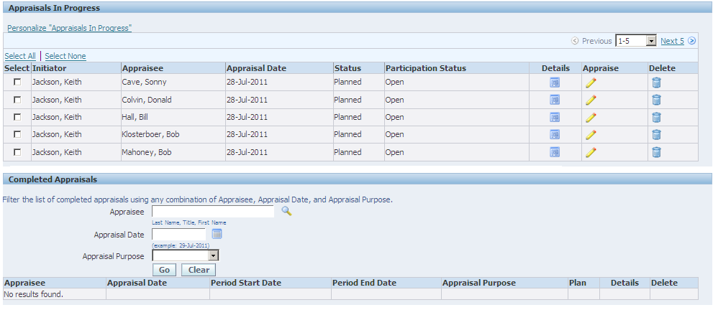
Oracle EBS PM differences
All appraisees will have PA templates automatically assigned
Appraiser will just need to open up Oracle PM, complete and submit for approval

Slide 20
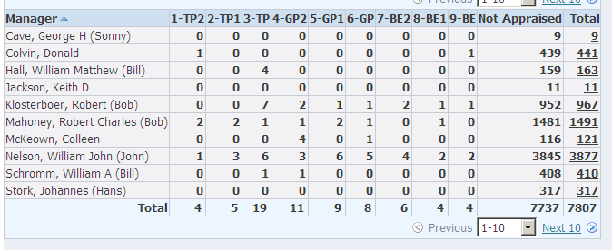
Oracle EBS PM differences
Oracle PM now has appraisal rating summary capability
Example IDL summary shown below
Rating distribution data provided graphically
Summary and graphics will be updated daily
Managers can download all employee data into Excel
Notes:
Note:
HR will provide separate reports that incorporate 2011 DL and IDL terminations; IDL ratings will be converted to new IDL performance rating
Q – Will 2010 appraisals be available in Oracle R12 (EBS)? Rating will be in Oracle R12; to view text will need to go to Oracle 11i

Slide 21
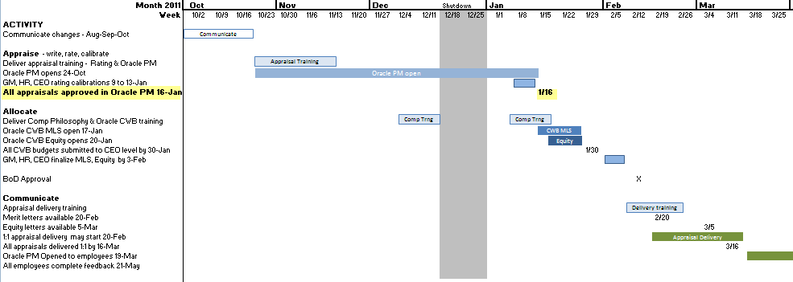
2012 Performance Appraisal Cycle timeline
Key Changes
Earlier kick-off, plan to open Oracle PM Oct. 24 to give appraisers head start
Appraisals must be completed, submitted and approved in Oracle by Jan. 16
Employees whose appraisals are not approved will not be eligible for merit, lump sum, or equity
Notes:
Note: Financial results for Q4’11 won’t be available by Jan 16, 2012; you will have to estimate attainment of goals on the appraisal and submit them for approval before Jan 16

Slide 22
Key Messages
There are some significant changes to our PA process
Adopting nine-box rating scale for Indirect labor (IDL)
Structured criteria for choosing DL and IDL appraisal templates
Moving PA entry, merit and equity processes to Oracle EBS
ALL written appraisals must be submitted and approved by Jan. 16
No rating changes made after Jan. 16
Check for local variations in process and deadlines with your HR representative or manager
Corporate communications and training sessions will be available at start of each phase

Slide 23
Expectations
Appraisers…
Suggest view two e-learning modules this week (only 10 minutes each)
Preparing for Performance Reviews - http://ceburl.com/1f47
Delivering Performance Reviews - http://ceburl.com/1f48
Watch for global appraisal training sessions, attend as available
Request appraisees complete self-appraisals
Collect 360 feedback, as appropriate
Plan ahead to ensure your appraisals are approved in Oracle EBS by end of day Jan. 16
Approvers (managers of appraisers )…
Plan for calibration meetings to be done in December
Work with appraisers to ensure final appraisals are approved by end of day Jan. 16
For all managers of people …
Be aware of any local variations in process and deadlines
Watch for Outlook invitations to tutorials, future communication meetings
Questions? Contact your local HR representative or Jerry Crawford

Slide 24
Q and As

Slide 25
Reference

Slide 26
Performance rating 1-5 definitions
Return

