Slide 1
All Hands Communication Meeting
May 2012
Donald Colvin
EVP and CFO

Slide 2
Agenda
Q1 Recap
Questions and Answers

Slide 3
Q1 Financial Highlights
The company continues to post strong revenue and strengthen its Balance Sheet:
  For the first quarter of 2012, highlights include:
    Total revenues of approximately $744.4 million which includes:
      Historical ON Semiconductor revenue of approximately $538.4 million
      SANYO Semiconductor revenue of approximately $206 million
    GAAP and non-GAAP gross margin of 32.9%
    GAAP net income per fully diluted share of $0.06
    Non-GAAP net income per fully diluted share of $0.12
* Based on 4Q11 earnings release provided on February 8, 2012. For non-GAAP measures and reconciliation please refer to our website.

Slide 4
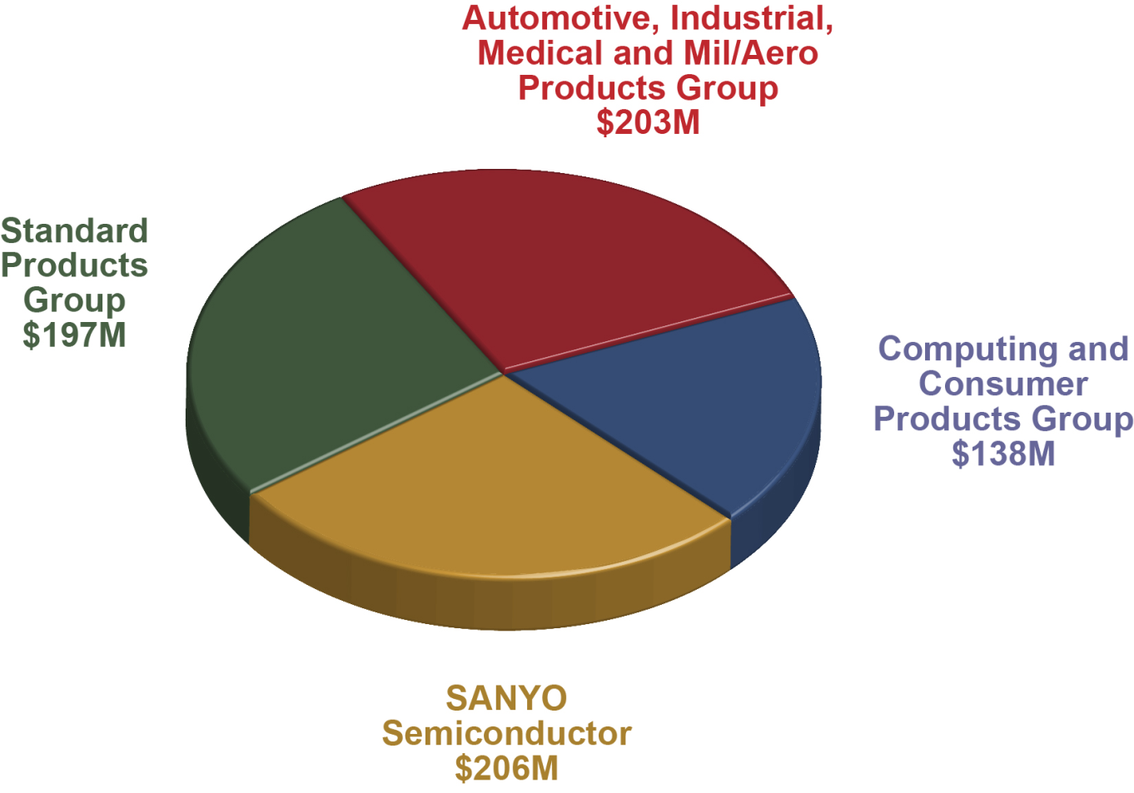
1Q12 Revenues: $744 Million

Slide 5
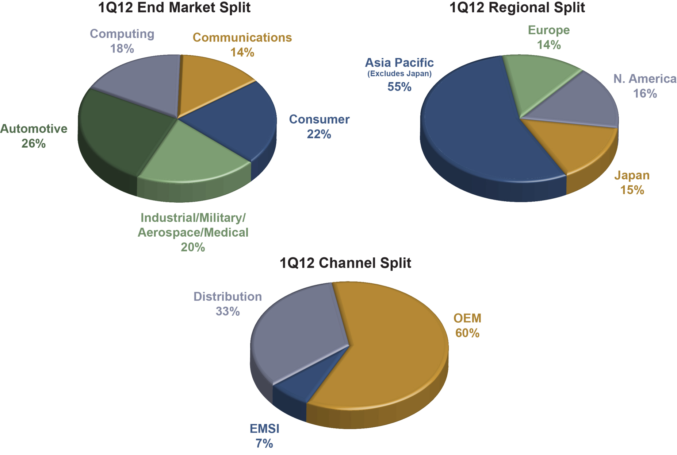
Diverse Segment and Regional Profile

Slide 6
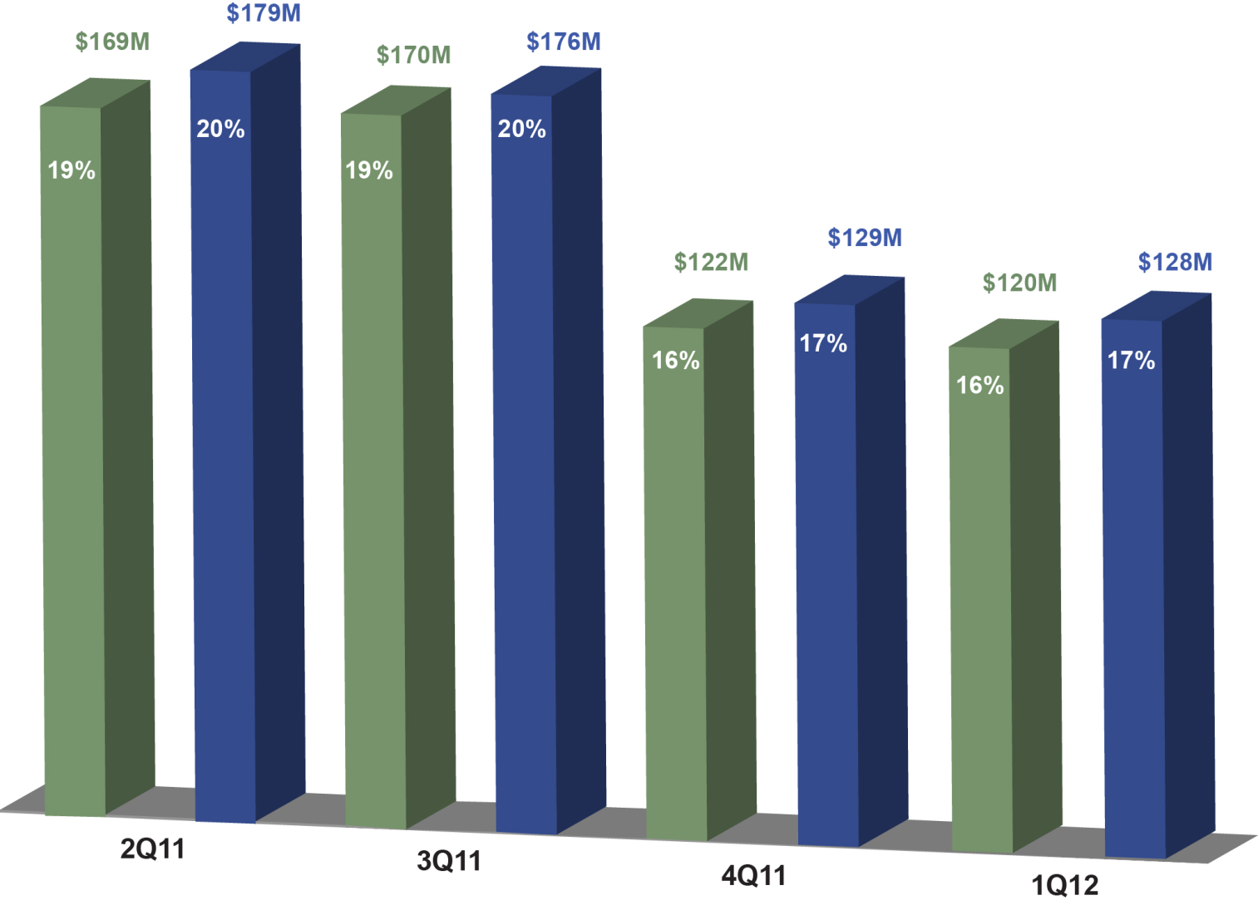
Adjusted EBITDA Position
(Green – Includes Stock-Based Compensation Expense)
(Blue – Excludes Stock-Based Compensation Expense)
TTM EBITDA
$581M – incl SBC
$612M – excl SBC
*Percentages listed in the above graph display EBITDA as a percent of Revenue

Slide 7
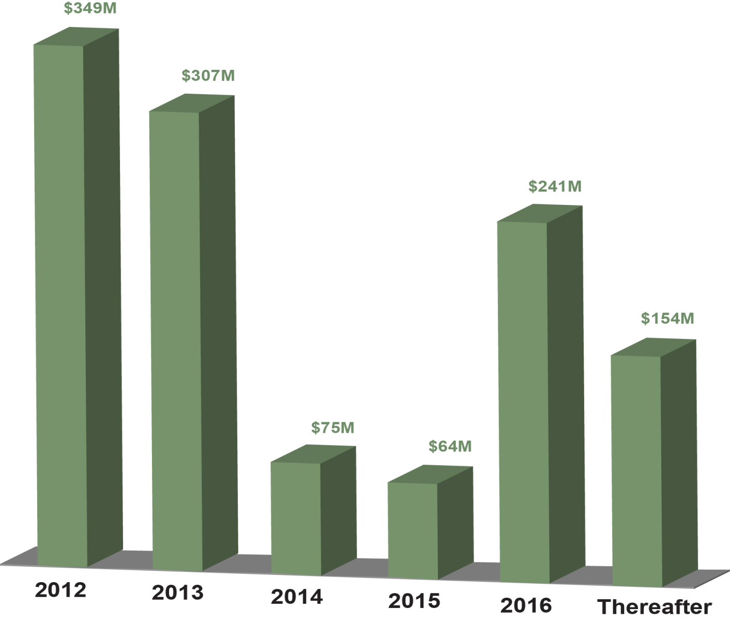
Current GAAP Debt Amortization Schedule
(Convertible Notes Net of Discount (FSP APB 14-1) )
Exited 1Q12 with approximately $892M of cash, cash equivalents and short-term investments and a net debt position of approximately $297M
    4Q11 – Extended debt maturity of approximately $199 million of 2.625% convertible senior subordinated notes from December 2013 to December 2016 via a notes exchange and executed a $325M revolving credit facility

Slide 8
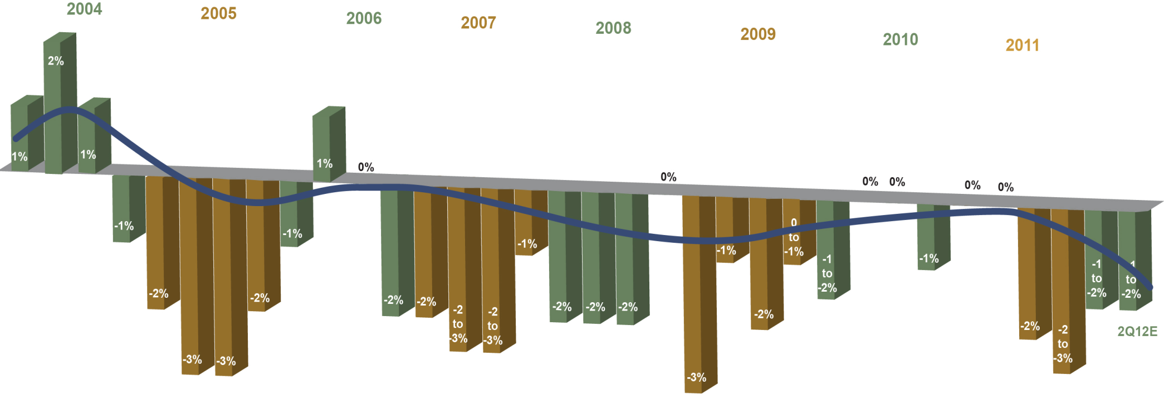
Historical ASP Trends

Slide 9
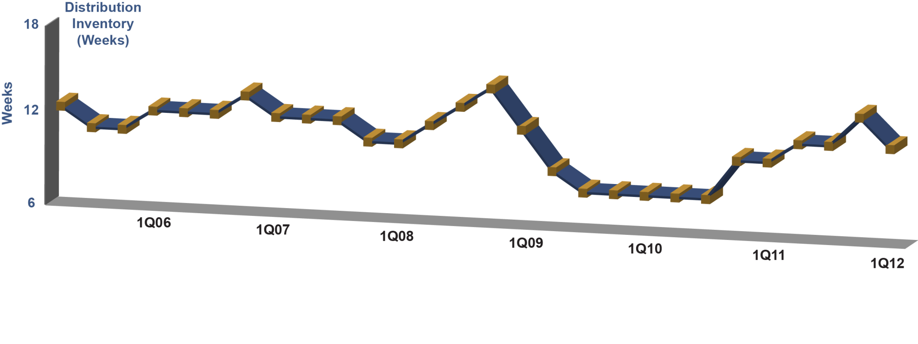
1Q12 Inventory Levels
Internal inventories were approximately 116 days.
Included in our total internal inventory is approximately $69 million of bridge inventory or approximately 13 days, primarily related to the consolidation of certain factories.
Distribution inventories were down approximately 14 percent on a dollar basis and were at approximately 11 weeks exiting 1Q12.

Slide 10
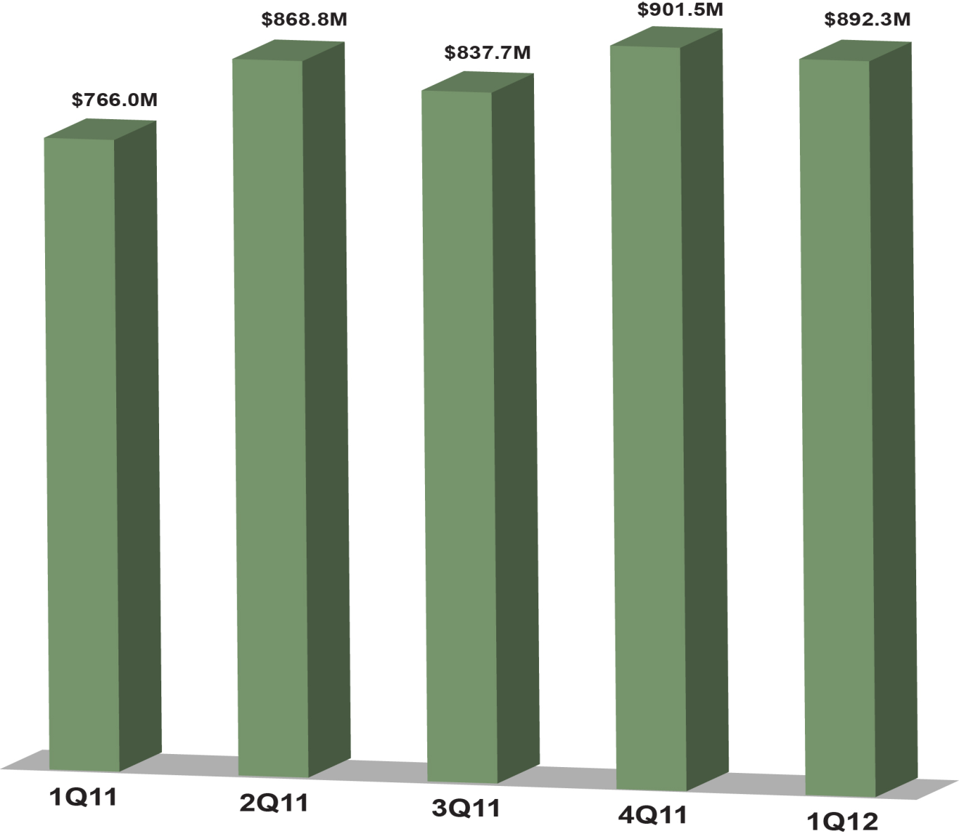
Strong Cash Position*
*Cash, cash equivalents and short-term investments

Slide 11
Zero Coupon Convertible Notes
In M$
Borrowed $260M
at 0% interest for 8 years
Repaid $242M ($18M gain)
Extended put and call dates to 2012 from 2010 at no cost
Apr-04
Savings/ Gains $133M $12M $6M
cost avoidance
12% vs. 0%

Slide 12
Q212 Outlook - Revenue
ON Core
Total ON Semiconductor minus SANYO

Slide 13

Where Are We Going?

Slide 14
Key Takeaways
Global GDP growth projected to be 3.5% in 2012
  Risk is biased to the downside due to slower growth in China and continuing European economic uncertainty
  Potential positive impact of select China economic growth initiatives
Expect 1Q’12 was the bottom of the current industry cycle
System sales are outpacing semiconductor sales resulting in chip inventory drain

Slide 15

Questions and Answers

