Slide 1
Interface & Power Business Plan 2011 – 2014
Thibault Kassir
September 2011

Slide 2
Executive Summary
2011 Progress
Projecting 2011 revenue of $74M, EBIDTA > 18%
First Power IP wins starting to materialize at key customers. Positioned for growth in 2012.
Gaining market share in Supervisory ICs. Ranked #5 WW in 2010.
Objectives for 2012 and beyond
Exceed $80M in 2012, GM > 45% and EBIDTA >22%. Position BU to exceed $100M by 2014.
Achieve 3 year CAGR (2010-2013) > 10% with blend of GP, ASSP and MSI SAM expansion
Position the BU to lead the Power Interface socket for smart phones in 2013 and beyond.
Strategies
Focus on Power: Power Interface, Power Protection and Supervisory ICs.
Drive 3-5% CAGR by revitalizing our foundation business: Supervisory and Power Protection
Lead value innovation solutions targeting Power Interface socket in wireless enabling 10%+ CAGR
Build on current wins / standalone IP (Samsung, HTC, Qualcomm)
Leverage new standards (USB3.0, MHL) as entry point.
Investigate potential partnerships to accelerate our roadmaps.
Hinge Factors
Market growth for Supervisory ICs
Rate of integration in cell phones
Sony-Ericsson survival

Slide 3
VISION IMPLEMENTATION
Interface & Power Vision
Revenues: $74M
Gross Margin: 44%
GP/ASSP Mix: 40%/60%
Business Transformation
Market re-targeting. Leverage investment in Power IP for wins.
Focus on Interface Power solutions for cell phones.
Revitalize Supervisory portfolio. Gain share.
Revenues: $100M
Gross Margin: 49%
GP/ASSP Mix: 30%/70%
Strong Market Presence
Leader in Power Interface solutions for mobile applications
Top 3 player in Supervisory ICs
Financially Strong (> 30% EBIDTA)
2009
2010
2011*
2012
2013
2014
Notes:
Warna…

Slide 4
VISION IMPLEMENTATION
Supervisory ICs (Multi)
Grow share in existing markets
Expand product line target high runners
Leverage distribution
Power Protection
Focus on Computing
Second source to TI
Leverage ON anchor sockets (VRx)
Power Interface
First mover. Leverage emerging standards
Build on existing standalone IC wins
Focus on market makers
EXPAND SAM
Technology Focus / Re-use
Jet City OTP 2.5V/5V cell
OTP cell 64 , 128 bits
Integrated EEPROM solution
Thick copper for low Rdson / high efficiency buck
Packaging Capability
CSP , Copper plated CSP
Low-cost RDL solution
UQFN internal capacity
BGA cost effective sourcing strategy
TECHNOLOGY /
SUPPLY
Smart Phones Phones and Tablets - Value Innovation
Focus on Apple, Samsung and HTC.
Lead value innovation solutions targeting Power Interface socket
Build on current wins / standalone IP (Samsung, HTC, Qualcomm)
Leverage new standards (USB3.0, MHL) as entry point
Team with PQ for complete power offering
Notebooks
Challenger to TI
Fill a second source need
Leverage anchor sockets in Computing
PENERATE
KEY APPS
Sourcing Strategy
Aizu transfer to Gresham
UQFN internal capacity (30% difference with UTL)
CSP , Copper plated CSP & cost effective RDL
Alternative to FCI => Evaluate JCAP / DECA
Develop BGA cost effective sourcing strategy
Yield Improvement
Process control improvement
Re-design / transfer where appropriate
$
COST
REDUCTIONS
Notes:
Warna…

Slide 5
I&P Revenue 2011 - 2012
Opportunity
50% to 85% Confidence
Revenue de-rated 80%, (20% hit rate)
Risk abatement for design loss, cancellations, poor ramp etc…
High Confidence
85% confidence that we win socket
Revenue de-rated 50%, (50% hit rate)
Risk abatement for design loss, cancellations, poor ramp etc…
Confirmed Design Win
We have the socket, just needs to ramp
Revenue de-rated 30%, (70% hit rate)
Risk abatement for cancellations, poor ramp etc…
Base Business
Revenue from 2010 sockets in 2011
8% ASP Decline

Slide 6
I&P Revenue 2011 - 2012
Major Design Win
$4.0M NCN1154/NCN1188 at HTC/MOT
$1.3M NCP391 at Qualcomm
$1.3M NCP373 at Sony Ericsson
$1.2M NCN7200 at Lenovo
$1.0M NCP6334 at Apple
$0.7M NCP380 at Sony Blu-Ray
$0.7M NCP6334 at Seagate
$0.4M NCP1521 at Samsung
Major High Confidence
$1.7M NCP6914 at Samsung
$2.5M NCP1851 at Samsung
$0.7M NCP6338 at Motorola
$0.5M NCP380 at Panasonic
$0.5M NCP382 at Foxconn
Opportunity
$2.0M NCP382 at Compal/Dell
$1.4M NCP383 at Apple
$0.8M NCP380 at Sharp

Slide 7
Product Line Strategy
EXPAND SAM
MAJOR RISK
POWER INTERFACE
POWER INTERFACE INV. ~ $4M
POWER
PROTECTION
■
New to Market
■
POWER
PROTECTION INV. ~ $2M
DISINTEGRATE
INVESTMENT / ROI
■
STANDALONE
POWER
SUPERVISORY
■
GAIN SHARE
SUPERVISORY INV. ~ $2M
New to ON
Analog Switches
HS
Switches
FOCUS INVESTMENT ON POWER INTERFACE PRODUCTS FOR 10%+ CAGR
BUILD ON FOUNDATION TO MINIMIZE RISKS AND ACHIEVE SUSTAINABLE GROWTH
Audio Amplifiers

Slide 8
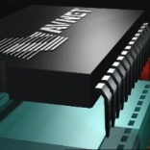
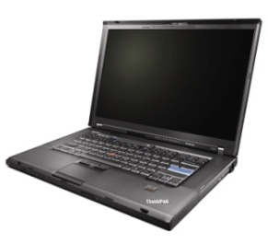
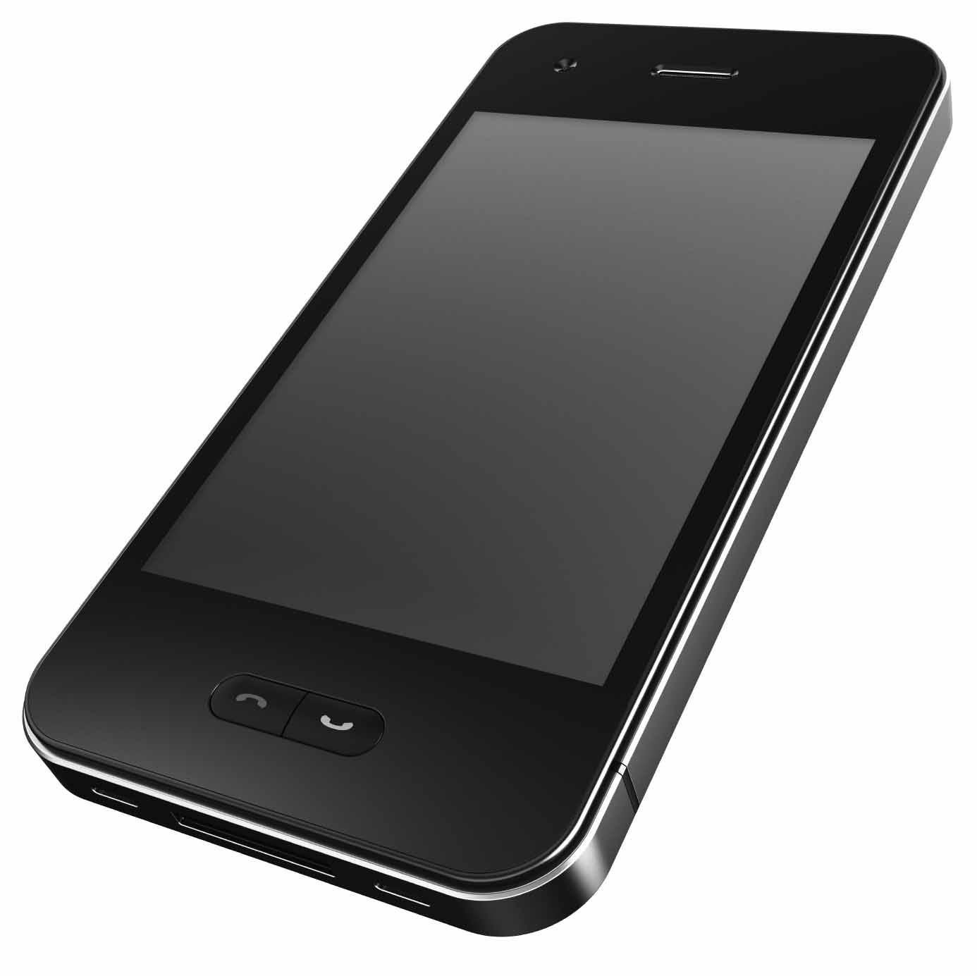
Growth Strategy
Supervisory ICs
TAM: $600M
CAGR 11-14: 5.0%
Power Protection
TAM: $198M
CAGR 11-14: 7%
Power Interface
TAM: $568M
CAGR 11-14: 19.3%
Strategic Objectives | Top 3 Supplier Share Gain > 5.5% | Challenger / Fast Follower TI | Leadership Position in USB Power Interface Solutions
Tactics | Product Line Expansion Cost Reductions | Product Line Expansion | First Mover Value Innovation
Why we win | Value Alternatives to Maxim and Linear Tech | Second Source Strategy Leverage Computing Position | First Enabler
Products | Top 5 high Runners for Maxim and Linear Tech | OVP/OCP Smart Power Protection | Building Block Subsystem and System Level Solutions
Target Markets | Distribution Channel | Computing | Smart Phones
3 Years Revenue ON CAGR 12-14 | $9.1M 9.5% | $20M 31% | $45M 187%

Slide 9
I&P – New Product Plan
 | Q1'12 | Q2'12 | Q3'12 | Q4'12 | TOTAL 2H2011 | TOTAL 2012
Power Interface |  | 1 | 1 | 1 |  | 3
Power Protection | 1 | 1 | 1 | 1 |  | 4
Supervisory |  | 1 | 1 | 1 |  | 3
Other | 1 |  | 1 |  |  | 2
Total Projects Planned |  |  |  |  |  | 12
Notes:
Updated

Slide 10
Financial Performance

Slide 11
Conclusion/Takeaways
Proven that we can deliver additional value
Poised with product that demonstrates value innovation
Korea focus has shown improvement in engagement
Solid plan for “simple” product adoption

