Slide 1

14-NM TECHNOLOGY
& FinFET in MICROWIND
Etienne.sicard@insa-toulouse.fr

Slide 2
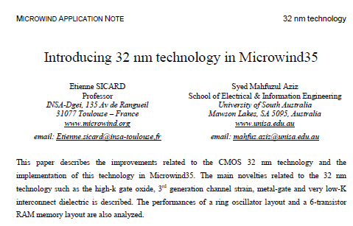
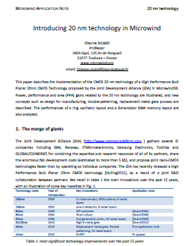
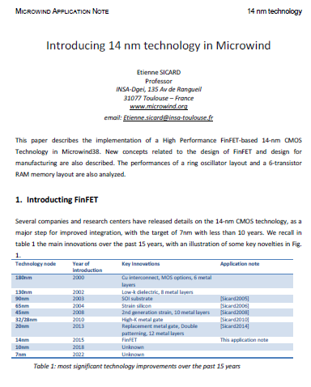
MICROWIND APPLICATION NOTES
Technology node | Year of introduction | Key Innovations
90nm | 2003 | SOI substrate
65nm | 2004 | Strain silicon
45nm | 2008 | 2nd generation strain, 10 metal layers
32/28nm | 2010 | High-K metal gate
20nm | 2013 | Replacement metal gate, Double patterning, 12 metal layers
14nm | 2015 | FinFET
www.microwind.org > Application Notes

Slide 3
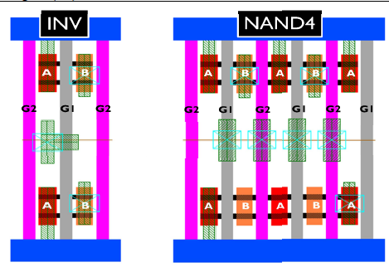
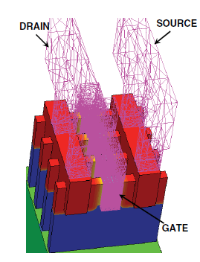
14-NM APPLICATION NOTE
Microwind’s 14-nm rule file has been tuned to the 14-nm technology information based on available publications
The FinFET has been introduced in Microwind
Layout, size and performances inspired from 14-nm FinFET proposed by IMEC, Belgium, Princeton University, USA,
Standard cell level parasitics assessment in 20nm BPL and 14nm BFF
P. Schuddinck, IEDM 2012
3-D-TCAD-Based Parasitic Capacitance Extraction
for Emerging Multigate Devices and Circuits
Ajay N. Bhoj, IEEE VLSI, Vol 21, N°11, 2013

Slide 4

















This application note
Technology
130nm
90nm
45nm
28nm
14nm
5nm
Complexity
100M
250M
500M
2G
7G
150 G
Packaging
Mobile generation
4G
4G+
5G
3G
3G+
2004
2007
2010
2013
2016
2020
Core+ DSP
1 Mb Mem
Core DSPs
10 Mb Mem
Dual core
Dual DSP
RF
Graphic Process.
100 Mb Mem
Sensors
Quad Core
Quad DSP
3D Image Proc
Crypto processor
Reconf FPGA,
Multi RF
1 Gb Memories
Multi-sensors
?
Embedded blocks

Slide 5
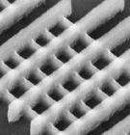
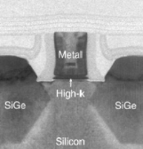
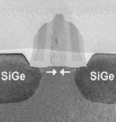
MOS CURRENT DRIVE
FinFET for increasing drive current and reducing leakage
High K Metal Gate to increase field effect
This application note
MOS
Current drive (mA/µm)
Strain to increase mobility
High performance
2.0
General Purpose
1.5
Ioff: 100nA/µm
Low power
1.0
10nA
1 nA
0.5
0.0
130 nm
90 nm
65 nm
45 nm
32 nm
20 nm
14 nm
10 nm
Intrinsic performances
Gate material
Technology node
Strain

Slide 6
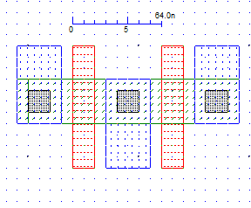
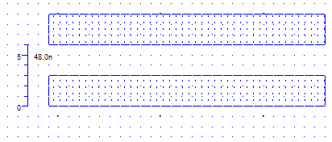
14-NM TECHNOLOGY IN MICROWIND
Gate pitch
Microwind works in lambda units (λ)
Not optimum but independant of technology
Design rules have remained nearly the same for 20 years
λ =8nm in 14-nm technology (nearly half)
Channel length is 2 λ
Minimum gate pitch is 8 λ (2+6)
Minimum metal pitch is 6 λ (3+3)
Channel length
Metal
pitch

Slide 7
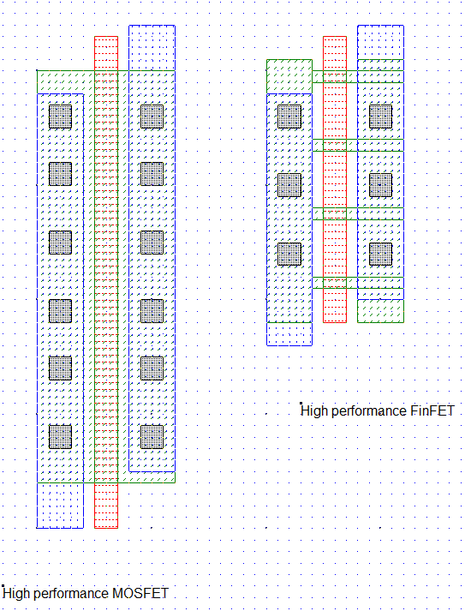
FROM MOSFET TO FINFET
The FinFET device has a different layout style than the MOS device
Instead of a continuous channel, the FinFET uses fins
FinFET provides the same Ion current at a smaller size
FinFET provides lower leakage current Ioff at the same Ion
fins

Slide 8
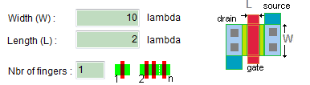
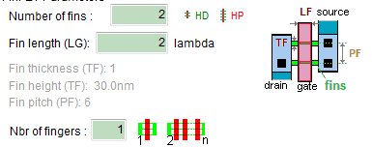
INTRODUCING THE FINFET
MOS Parameter | Typical value
Width (W) | 6 - 12 λ
Length (L) | 2 λ
FinFET Parameter | Typical value
Number of fins (NF) | 2 - 5
Fin pitch (PF) | 6 λ
Fin thickness (TF) | 1 λ
Fin length or gate length (LG) | 2 λ
New screen in Microwind

Slide 9
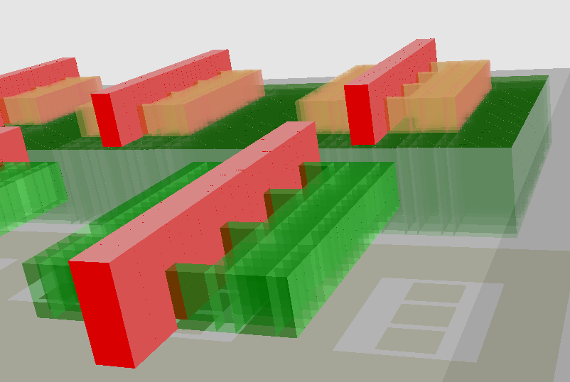
3D OF FINFET USING MICROWIND
Microwind enables a 3D view of the FinFET
P-FinFET
Fin 4
Drain
Fin 3
Fin length
(LG)
Fin 2
Fin thickness
(TF)
Source
Fin 1
Fin height (HF)
Gate
N-FinFET

Slide 10
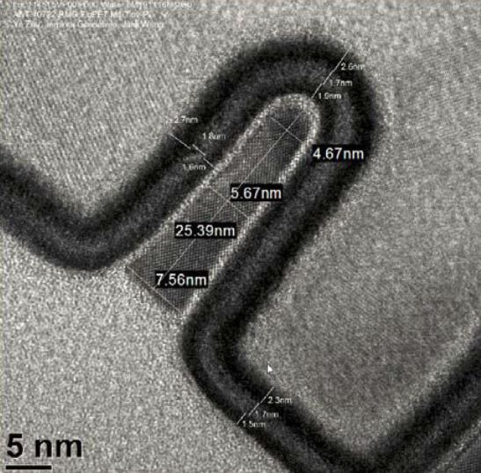
FIN BENEFITS
Fin thickness
(TF)
The total equivalent channel width is higher in FinFET than in MOSFET
Weq = 2*HF+TF
Benefit around 30% in current drive
Gate
Fin height (HF)
FIN from Drain to Source
Total equivalent channel width Weq
MOS
Fin
Ioff
Patton, Evolution and Expansion of SOI in VLSI Technologies: Planar to 3D, IEEE International SOI Conference 2012
Ion

Slide 11
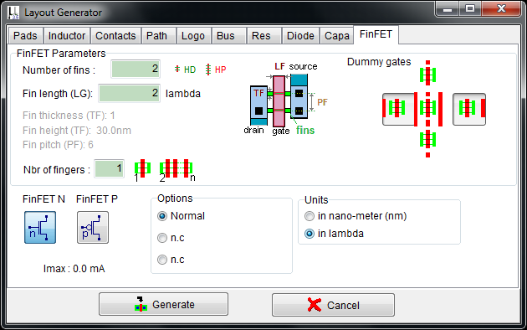
GENERATING A FINFET
Fin Length, equal to gate length, (LG) is 2 lambda (16 nm) by default
Fin thickness (TF) is set to 1 lambda (8 nm)
Fin pitch (PF) is set to 6 lambda (48nm)
FinFET comme with dummy gates for manufacturability

Slide 12
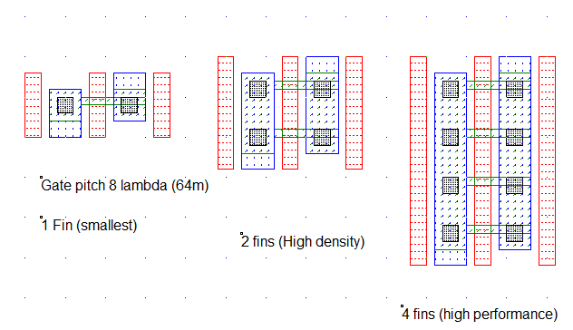
GENERATING A FINFET
HD: High density drawing style : 2 fins
HP : High performance drawing style : 4 fins
1 fin exists in very high density cells such as SRAM
FinFET with more than 4 fins drive string currents

Slide 13
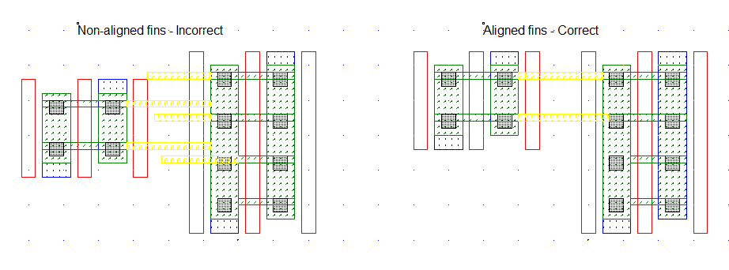
FINFET MANUFACTURABILITY
Fins should be aligned and horizontal, regular pitch 6 λ (1+5)
Non-aligned fins may lead to gate distortion and current performance spread
Ion
Ion
Ioff
Ioff

Slide 14
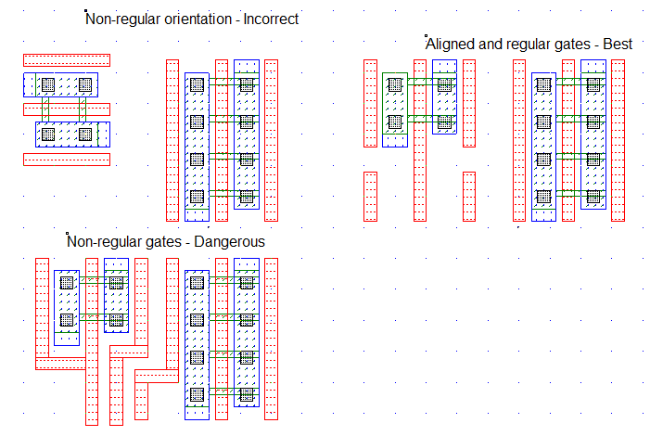
FINFET MANUFACTURABILITY
Gates should be aligned and vertical, regular pitch with 8 λ minimum (2+6)

Slide 15
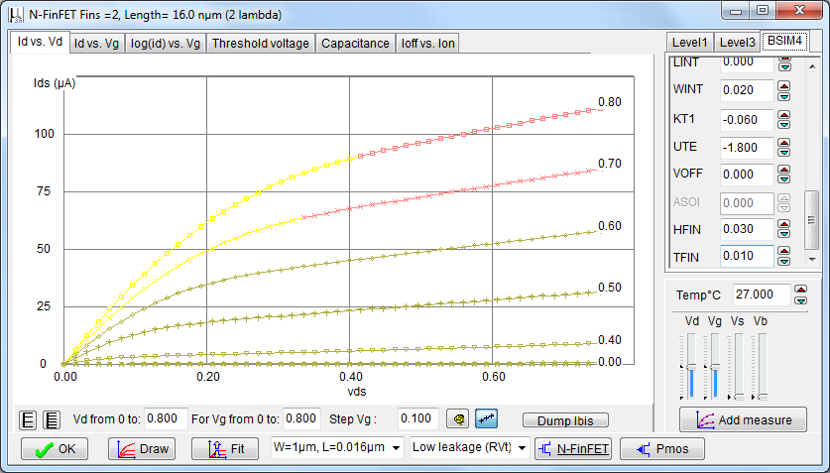
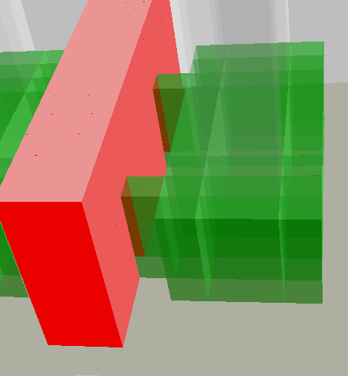
FINFET MODEL
BSIM4 is a good model for MOS devices
BSIM-CMG is targetted to FinFET, but corresponds to a completly new model
The HFIN and TFIN parameters have been added to BSIM4 in Microwind to handle the FinFET
HFIN: Fin Height
TFIN: Fin thickness
Fin thickness
(TF) 10nm
With 2 fins, Weff=140nm
Fin height (HF) 30nm

Slide 16
SUPPLY VOLTAGE SCALE DOWN
VDD is lowered to 800mV in 14-nm technology
14-nm technology
Supply (V)
5.0
0.8 V inside, 1.2V outside
3.3
I/O supply
2.5
Core supply
1.8
1.2
1.0
0.35µ
0.18µ
130n
90n
65n
45n
32n
20n
14n
10n
7n
Technology node

Slide 17
STRAIN
Strain enables outstanding p-FinFET mobility performances, approaching the n-FinFET mobility

Slide 18
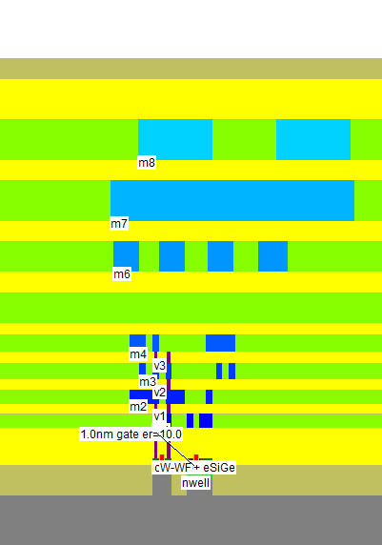
INTERCONNECTS
Metal stack
Main target | Pitch | λ | nm | Used for
M7, M8 | 4 | 24 | 192 | Supply
M5, M6 | 3 | 18 | 144 | Long routing
M3, M4 | 2 | 12 | 96 | Medium routing
M1, M2 | 1.4 | 8 | 64 | Short routing
Gate, Local interc. | 1 | 6 | 48 | Intra-cell routing

Slide 19
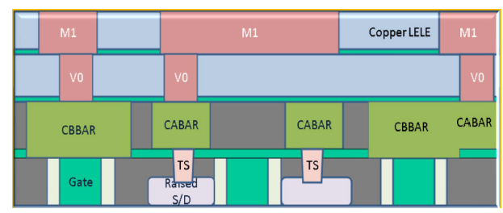
LOCAL INTERCONNECT
Middle of Line (MOL) Local Interconnects
New material « Local Interconnect (LI) » used for very short interconnects
Less capacitance than m1 only
More space for metal 1
10% improved cell density
Contact
Gate
Local interconnect Layer
M. Rashed, ‘Innovations in special constructs for standard cell libraries in sub 28nm technologies," Electron Devices Meeting (IEDM), 2013

Slide 20
TECHNOLOGY INNOVATION & COST
REASONS OF COST EXPLOSION
Performance improvements
  Strain
  eSiGe,
  High-K dielectric
  Metal gate
  Low-K inter dielectrics,
  FinFET
New options
  Local interconnects
New constraints
  double patterning, FinFET

Slide 21
TECHNOLOGY INNOVATION & COST
Main target | Type of innovation | First order effect
Device performance | Strain | Improved n mobility
 | Embedded SiGe (e-SiGe) | Improved p mobility
 | High K gate dielectric | Increased field effect
 | Metal gate | Decreased leakage
 | FinFET | Higher current density
Interconnect performance | Low K inter dielectrics | Reduced crosstalk and delay
 | Local interconnect | Higher density
Manufacturability | Double patterning | Improved yield

Slide 22
DESIGN RULES
Microwind DRC only checks 100 basic design rules
In 14-nm technology, more than 2500 design rules have been listed
130nm
500
design rules
65nm
1000 design rules
14nm
2500
design rules

Slide 23
Thank you for your attention
Etienne.sicard@insa-toulouse.fr

