Slide 1
Interconnect Parasitic Extraction
Speaker: Wenjian Yu
Tsinghua University, Beijing, China
Thanks to J. White, A. Nardi, W. Kao, L. T. Pileggi, Zhenhai Zhu

Slide 2
Outline
Introduction to parasitic extraction
Resistance extraction
Capacitance extraction
Inductance and impedance (RLC) extraction

Slide 3
Introduction to Parasitic Extraction

Slide 4
Introduction
Interconnect: conductive path
Ideally: wire only connects functional elements (devices, gates, blocks, …) and does not affect design performance
This assumption was approximately true for “large” design, it is unacceptable for DSM designs
Slides courtesy A. Nardi, UC Berkeley

Slide 5

Introduction
Real wire has:
  Resistance
  Capacitance
  Inductance
Therefore wiring forms a complex geometry that introduces capacitive, resistive and inductive parasitics. Effects:
  Impact on delay, energy consumption, power distribution
  Introduction of noise sources, which affects reliability
To evaluate the effect of interconnects on design
performance we have to model them
Slides courtesy A. Nardi, UC Berkeley

Slide 6
Conventional Design Flow
Funct. Spec
RTL
Behav. Simul.
Logic Synth.
Stat. Wire Model
Front-end
Gate-level Net.
Gate-Lev. Sim.
Back-end
Floorplanning
Parasitic Extrac.
Place & Route
Layout
Slides courtesy A. Nardi, UC Berkeley

Slide 7
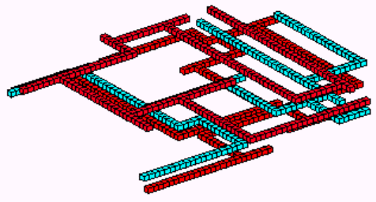
From electro-magnetic analysis to circuit simulation
Parasitic extraction
/ Electromagnetic analysis
Filament with uniform current
Panel with uniform charge
Model order
reduction
Thousands of R, L, C
Reduced circuit

Slide 8
Challenges for parasitic extraction
Parasitic Extraction
  As design get larger, and process geometries smaller than 0.35μm, the impact of wire resistance, capacitance and inductance (aka parasitics) becomes significant
  Give rise to a whole set of signal integrity issues
Challenge
  Large run time involved (trade-off for different levels of accuracy)
  Fast computational methods with desirable accuracy

Slide 9
Resistance Extraction

Slide 10
Outline
Introduction to parasitic extraction
Resistance extraction
  Problem formulation
  Extraction techniques
  Numerical techniques
  Other issues
Capacitance extraction
Inductance and RLC extraction

Slide 11
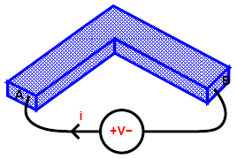
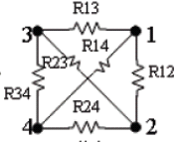
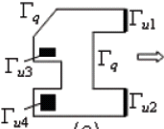
Resistance extraction
Problem formulation
  A simple structure
  Two-terminal structure
  Multi-terminal (port) structure
L
W
i
H
i
A
B
+
-
V
It’s a single R value
NxN R matrix

Slide 12


Resistance extraction
Extraction techniques
  Square counting
  Analytical approximate formula
    For simple corner structure
  2-D or 3-D numerical methods
    For multi-terminal structure; current has irregular distribution
    Solve the steady current field for i under given bias voltages
    Set V₁ = 1, others all zero,
flowing-out current
Repeating it with different settings

Slide 13

Resistance extraction
Extraction techniques – numerical method
  How to calculate the flowing-out current ?
  Field equation and boundary conditions
Field solver
Laplace equation inside conductor:
divergence
E
Boundary conditions:
port surface : u is known
other surface:
Normal component is zero; current can not flow out
The BVP of Laplace equation becomes solvable

Slide 14
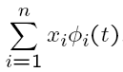
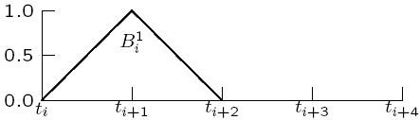
Resistance extraction
Numerical methods for resistance extraction
  Methods for the BVP of elliptical PDE:
  Finite difference method
    Derivative -> finite difference:
    Generate sparse matrix; for ODE and PDE
  Finite element method
    Express solution with local-support basis functions
    construct equation system with
    Collocation or Galerkin method
    Widely used for BVP of ODE and PDE
  Boundary element method
    Only discretize the boundary, calculate boundary value
    Generate dense matrix with fewer unknowns
For elliptical PDE

Slide 15
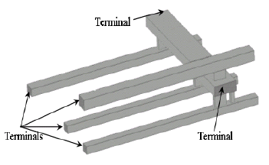
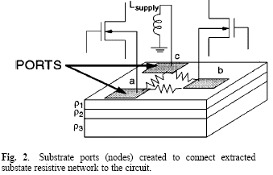
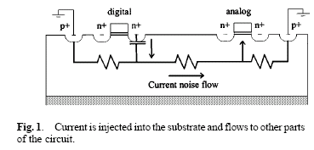
Resistance extraction
Where are expensive numerical methods needed ?
  Complex onchip interconnects:
    Wire resistivity is not constant
    Complex 3D geometry around
    vias
  Substrate coupling resistance
  in mixed-signal IC

Slide 16
Resistance extraction
All these methods calculate DC resistance
  Suitable for local interconnects with small dimensions, or analysis under lower frequency
  R at high frequency: estimated with skin depth for simple geometry; extracted with complex methods along with L
Reference
  W. Kao, C-Y. Lo, M. Basel and R. Singh, “Parasitic extraction: Current state of the art and future trends,” Proceedings of IEEE, vol. 89, pp. 729-739, 2001.
  Xiren Wang, Deyan Liu, Wenjian Yu and Zeyi Wang, "Improved boundary element method for fast 3-D interconnect resistance extraction," IEICE Trans. on Electronics, Vol. E88-C, No.2, pp.232-240, Feb. 2005.

Slide 17
Capacitance Extraction

Slide 18
Outline
Introduction to parasitic extraction
Resistance extraction
Capacitance extraction
  Fundamentals and survey
  Volume discretization method
  Boundary element method
Inductance and RLC extraction

Slide 19
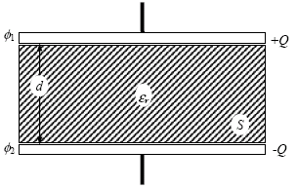


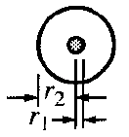
Capacitance extraction
Problem formulation
  A parallel-plate capacitor
    Voltage:
    Q and –Q are induced on both plates; Q is proportional to V
    The ratio is defined as C: C=Q/V
    If the dimension of the plate is large compared with spacing d,
  Other familiar capacitors
coaxial capacitor
interdigital capacitor

Slide 20


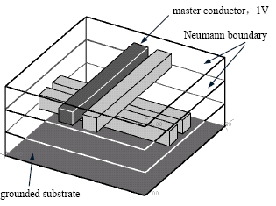


Capacitance extraction
Problem formulation
  Capacitance exists anywhere !
  Single conductor can have capacitance
    Conductor sphere
  N-conductor system, capacitance matrix is defined:
Coupling capacitance
Total capacitance
Electric potential

Slide 21
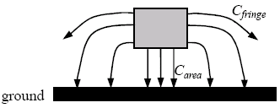

Capacitance extraction
Interconnect capacitance extraction
  Only simple structure has analytical formula with good accuracy
  Different from resistance, capacitance is a function of not only wire’s own geometry, but its environments
  All methods have error except for considering the whole chip; But electrostatic has locality character
  Technique classification:
    analytical and 2-D methods
Shield;
window
Stable model
C /unit length
2-D method ignores 3-D effect, using numerical technique to solve cross section geometry

Slide 22
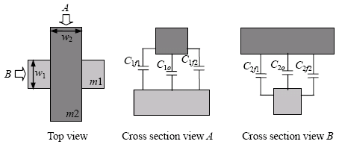

Capacitance extraction
Interconnect capacitance extraction
  analytical and 2-D methods
  2.5-D methods
  Commercial tools
    Task: full-chip, full-path extraction
    Goal: error ≤10%, runtime ~ overnight for given process
lateral
Error > 10%
From “Digital Integrated Circuits”, 2nd Edition, Copyright 2002 J. Rabaey et al.

Slide 23
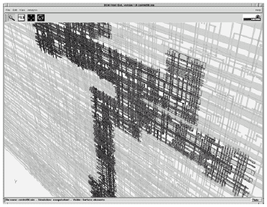
Capacitance extraction
Interconnect capacitance extraction
  Commercial tools(pattern-matching):
  Geometric parameter extraction
    According to given process, generate geometry
    patterns and their parameters
  Build the pattern library
    Field solver to calculate capacitances of pattern
    This procedure may cost one week for a given process
  Calculation of C for real case
    Chop the layout into pieces
    Pattern-matching
    Combine pattern capacitances
  Error: pattern mismatch, layout decomposition
Cadence - Fire & Ice
Synopsys - Star RCXT
Mentor - Calibre xRC

Slide 24
Capacitance extraction
3-D numerical methods
  Model actual geometry accurately; highest precision
  Shortage: capacity, running time
  Current status: widely investigated as research topic;
  used as library-building tool in industry, or for some special structures deserving high accuracy
Motivation
  The only golden value
  Increasing important as technology becomes complicated
  Algorithms for C extraction can be directly applied to R extraction; even extended to handle L extraction

Slide 25
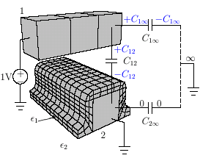
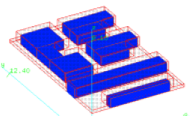
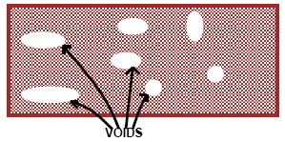
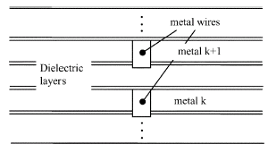
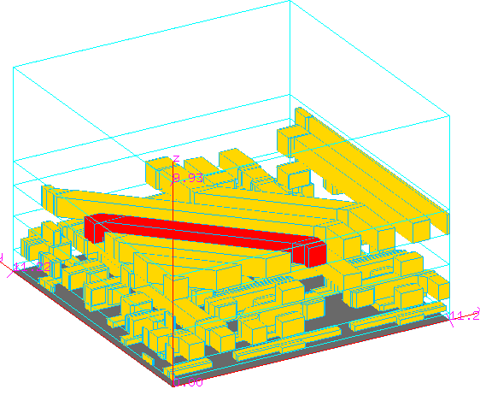
Capacitance extraction
Technology complexity
  Dielectric configuration
    Conformal dielectric
    Air void
    Multi-plane dielectric
  Metal shape and type
    Bevel line
    Trapezoid cross-section
    Floating dummy-fill
They are the challenges, even for 3-D field solver

Slide 26
Capacitance extraction
3-D numerical methods – general approach
  Set voltages on conductor; solve for Q_{i}
  Global method to get the whole matrix
Classification
  Volume discretization: FDM, FEM
  Boundary integral (element) method
  Stochastic method
  Others – semi-analytical approaches
Solve the electrostatic field for u, then
Raphael’s RC3 – Synopsys
Q3D (SpiceLink) – Ansoft
FastCap, HiCap, QBEM
QuickCap - Magma

Slide 27
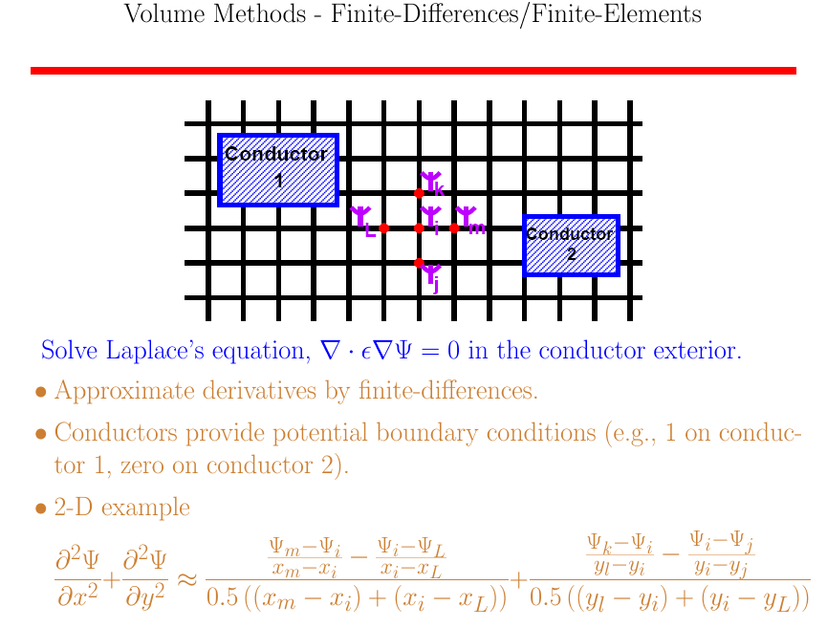
Slides courtesy J. White, MIT
Notes:
I will give some technical details of the 3-D field solvers based on finite difference method, and two kinds of boundary element methods.

Slide 28
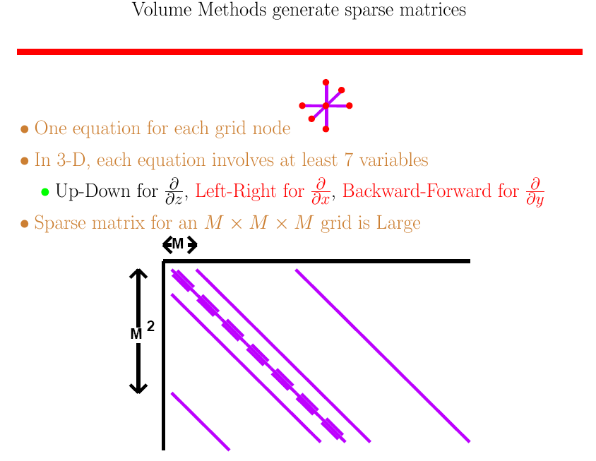
most
Slides courtesy J. White, MIT

Slide 29
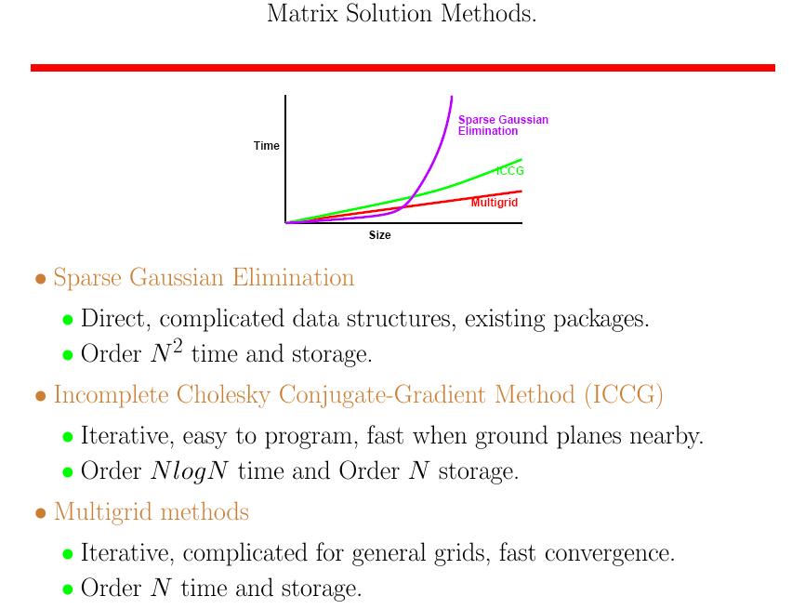
Slides courtesy J. White, MIT

Slide 30
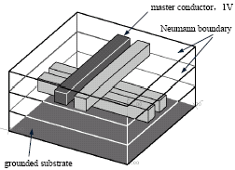
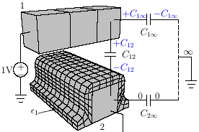
Capacitance extraction
Volume methods
  What’s the size of simulation domain ?
  Two kinds of problem: finite domain and infinite domain
  Which one is correct ?
    3-D extraction is not performed directly on a “real” case
    In the chopping & combination procedure, both models used
    Because of attenuation of electric field, the results from two models can approach to each other
both in most time
Because of its nature, volume methods use finite-domain model

Slide 31
inside alg. of FastCap
c
MoM (method of moment)
Method of virtual charge
Indirect boundary element method
Slides courtesy J. White, MIT

Slide 32
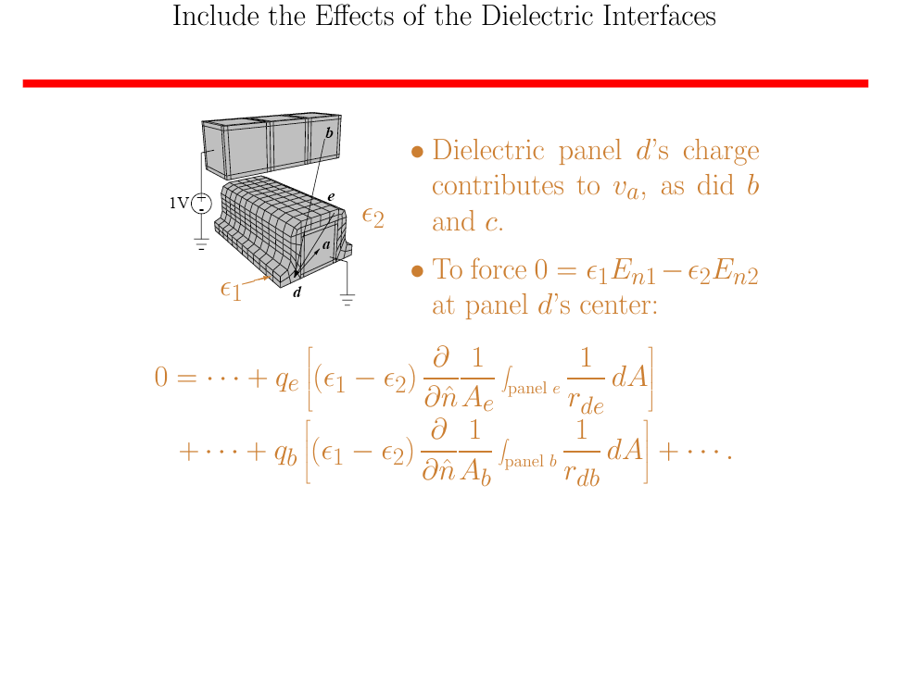
Panel charges contribute to the potential of center of panel d (a dielectric panel)
Slides courtesy J. White, MIT

Slide 33
Slides courtesy J. White, MIT

Slide 34
Slides courtesy J. White, MIT

Slide 35
Slides courtesy J. White, MIT

Slide 36

Multipole expansion with order l
l=0:
Slides courtesy J. White, MIT

Slide 37
Sparse blocked matrix
each block is dense
Slides courtesy J. White, MIT

Slide 38
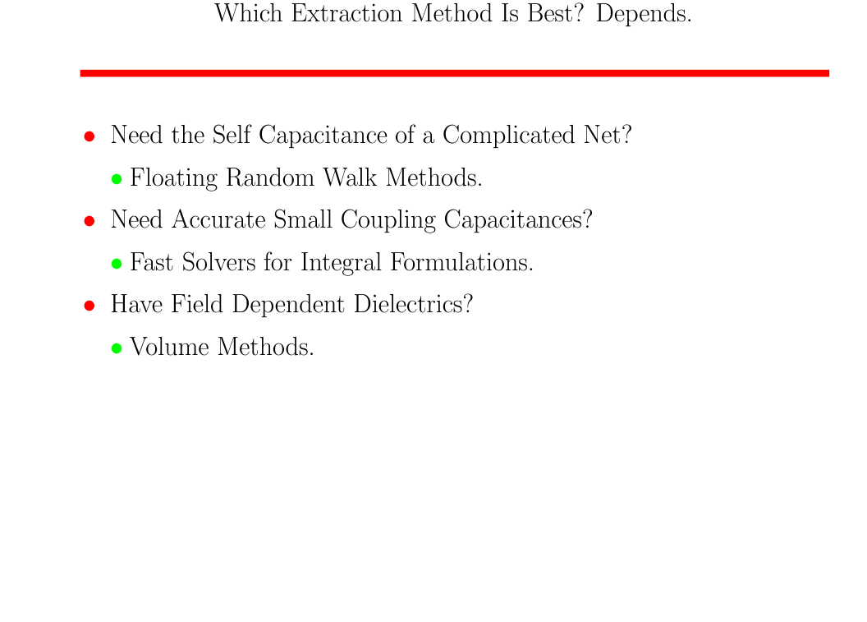
QuickCap
FastCap
HiCap
QBEM
Raphael
Slides courtesy J. White, MIT

Slide 39
Capacitance extraction
Reference
[1] W. Kao, C-Y. Lo, M. Basel and R. Singh, “Parasitic extraction: Current state of the art and future trends,” Proceedings of IEEE, vol. 89, pp. 729-739, 2001.
[2] Wenjian Yu and Zeyi Wang, “Capacitance extraction”, in Encyclopedia of RF and Microwave Engineering , K. Chang [Eds.], John Wiley & Sons Inc., 2005, pp. 565-576.
[3] K. Nabors and J. White, FastCap: A multipole accelerated 3-D capacitance extraction program, IEEE Trans. Computer-Aided Design, 10(11): 1447-1459, 1991.
[4] Y. L. Le Coz and R. B. Iverson, “A stochastic algorithm for high speed capacitance extraction in integrated circuits,” Solid State Electronics, 35(7): 1005-1012, 1992.
[5] J. R. Phillips and J. White, “A precorrected-FFT method for electrostatic analysis of complicated 3-D structures,” IEEE Trans. Computer-Aided Design, 16(10): 1059-1072, 1997
[6] W. Shi, J. Liu, N. Kakani and T. Yu, A fast hierarchical algorithm for three-dimensional capacitance extraction, IEEE Trans. Computer-Aided Design, 21(3): 330-336, 2002.
[7] W. Yu, Z. Wang and J. Gu, Fast capacitance extraction of actual 3-D VLSI interconnects using quasi-multiple medium accelerated BEM, IEEE Trans. Microwave Theory Tech., 51(1): 109-120, 2003.
[8] W. Shi and F. Yu, A divide-and-conquer algorithm for 3-D capacitance extraction, IEEE Trans. Computer-Aided Design, 23(8): 1157-1163, 2004.

Slide 40
Inductance Extraction

Slide 41
Outline
Basic
  Two laws about inductive interaction
  Loop inductance
Interconnect inductance extraction
  Partial inductance & PEEC model
  Frequency-dependent LR extraction - FastHenry

Slide 42


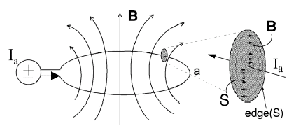

Two inductive laws
Ampere’s Law
Magnetic field created by:
currents in conductor loop,
time-varying electric field
Curl operator
Integral form (derived via Stokes’ Law):
For 1D wire, field direction predicted with right-hand rule
Displacement current density
AC current flowing through capacitor
Notes:
This is the differential expression of the Ampere’s law. B is magnetic induction intensity, j is current density, and E is electric field intensity.
This law reveals that magnetic field is created by current and time-varying electric fields

Slide 43

Two inductive laws
Ampere’s Law (cont’d)
Ohmic current density
Displacement current density
For integrated circuit, the second term is usually neglected
0.13μm technology:
Transistor switching current: 0.3mA
minimal spacing of conductor: 0.13 μm
maximal voltage difference: 2V
minimal signal ramp time: 20ps
0.13×0.26
Decouples inductive and capacitive effects in circuit
Quasi-static assumption:

Slide 44

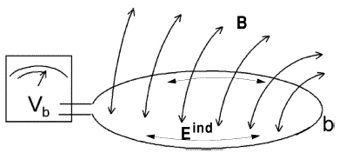

Two inductive laws
Faraday’s Law
Time-varying magnetic field creates induced electric field
This induced electric field exerts force on charges in b
Magnetic flux
E_{ind} is a different field than the capacitive electric field E_{cap}, or electrostatic field:
Both electric fields have force on charge !

Slide 45

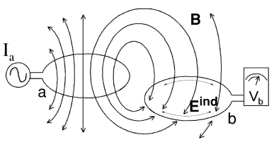
Two inductive laws
Faraday’s Law (cont’d)
Induced voltage along the victim loop:
Orientation of the loop with respect
to the E_{ind} determines the amount
of induced voltage.
Magnetic field effect on the orthogonal loop can be zero !
This is supposed to be the reason why the partial inductive coupling between orthogonal wires is zero

Slide 46

Loop inductance
Three equations
All linear relationships
Relationship between time-derivative of current and the induced voltage is linear as well:
Mutual inductance; self inductance if a=b
There are inductors in IC as components of filter or oscillator circuits;
There are also inductors not deliberately designed into IC, i.e. parasitic inductance

Slide 47
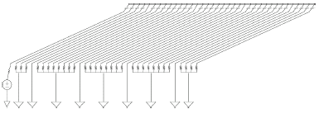
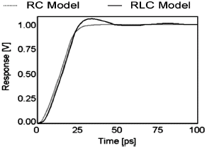
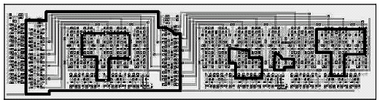
Onchip interconnect inductance
Parasitic inductive effect
  An example
  Ringing behavior
  50% delay difference is 17%
Model magnetic interaction
  “chicken-and-egg” problem
0.18 width, 1 length
Far end of active line
# Possible current loop: O(N²)
Generate L coefficients for all loop pairs is impractical ! O(N⁴)
“Many of these loop couplings is negligible due to little current; but in general we need to solve for them to make an accurate determination”

Slide 48
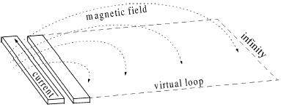
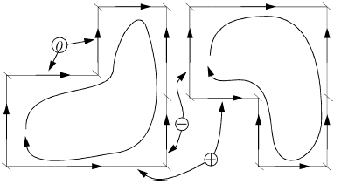

Onchip interconnect inductance
Partial inductance model
  Invented in 1908; introduced to IC modeling in 1972
  Definition: the relationship between the current of aggressor and the virtual loop which victim segment forms with infinity
  Loop L is sums of partial
  L’s of segments forming loop
S_{ij} are -1 if exactly one of the currents in segments i and j is flowing opposite to the direction assumed when computing L_{ij, partial}

Slide 49
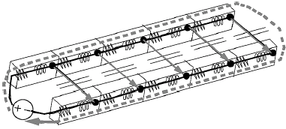
Onchip interconnect inductance
Partial inductance model
  Partial inductance is used to represent the loop interactions without prior knowledge of actual loops
  Contains all information about magnetic coupling
Partial element equivalent circuit (PEEC) model
  Include partial inductance, capacitance, resistance
  Model IC interconnect for circuit simulation
  Has sufficient accuracy up to now
A two-parallel-line example

Slide 50



Onchip inductance extraction
To calculate partial inductance
  Formula for two straight segments:
  Analytical solution is quite involved even for simple geometry
  Numerical solution, such as Gaussian quadrature can be used, but may be time-consuming
  How about high-frequency effects ?
    Skin effect; proximity effect
    Path of least impedance -> least loop L
Assumptions:
current is evenly distributed
Signal line & its return

Slide 51
Inductance extraction
Related research directions
  Design solution to cope with inductive effects
    Limited current loop; inductive effect is reduced, or easy to be analyzed (calculating partial L is costly)
  Use partial inductance (PEEC model)
    Consider issues of circuit simulation
    Partial inductance brings dense matrix to circuit simulation;
    both extraction and simulation is computationally expensive
  Inductance extraction considering high-frequency
    Beyond the on-chip application
    MQS, EMQS, full-wave simulation
Simplify the problem
Has not good locality as C
Approaches of matrix sparsification
No L explicitly; just Z

Slide 52
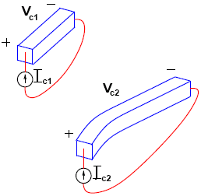


Frequency-dependent LR extraction
High frequency consideration
  nonuniform current distribution affects R
  Extract R and partial L together
  Capacitive effects analyzed separately (MQS)
  Due to the interaction of magnetic field, values of L and R both rely on environments, like capacitance
  Problem formulation:
Terminal pairs:
Impedance extraction:
Mutual resistance becomes visible at ultra-high frequency

Slide 53
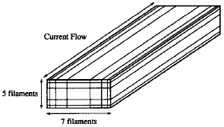
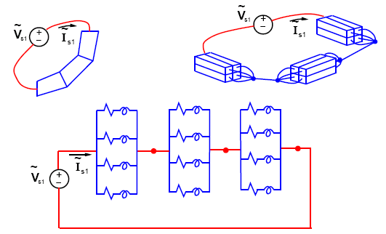
Frequency-dependent LR extraction
FastHenry of MIT
  Two assumptions: MQS; terminal
  pairs with known current direction
  Partitioned into filaments, current distributed evenly
If Vr is set,

Slide 54
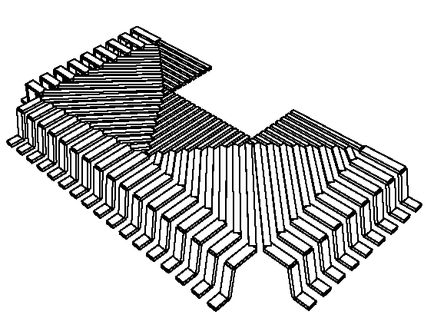
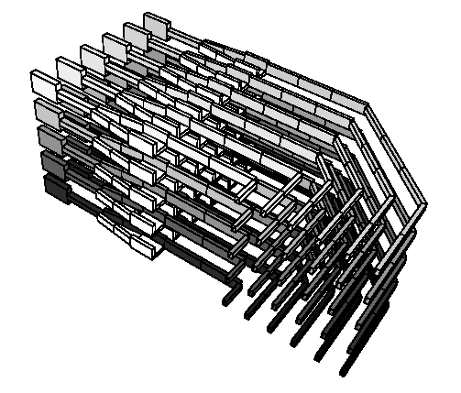
Frequency-dependent LR extraction
FastHenry of MIT
  Solve equation system with multiple right-hand sides
  Multipole acceleration; preconditioned GMRES solver
  Application: package, wide onchip wires (global P/G, clock)
  Shortage: computational speed (#unknown); model inaccuracy; filament partition depends on frequency
35 pins
30 pins

Slide 55
Inductance extraction
Reference
[1] M. W. Beattie and L. T. Pileggi, “Inductance 101: modeling and extraction,” in Proc. Design Automation Conference, pp. 323-328, June 2001.
[2] M. Kamon, M. J. Tsuk, and J. K. White, “Fasthenry: a multipole-accelerated 3-D inductance extraction program,” IEEE Trans. Microwave Theory Tech., pp. 1750 - 1758, Sep 1994.
[3] Z. Zhu, B. Song, and J. White. Algorithms in Fastimp: a fast and wide-band impedance extraction program for complicated 3-D geometries. IEEE Trans. Computer-Aided Design, 24(7): 981-998, July 2005.
[4] W. Kao, C-Y. Lo, M. Basel and R. Singh, “Parasitic extraction: Current state of the art and future trends,” Proceedings of IEEE, vol. 89, pp. 729-739, 2001.
[5] http://www.rle.mit.edu/cpg/research_codes.htm (FastCap, FastHenry, FastImp)

