Slide 1
Self Appraisal Guidelines
Tlse Design Team
Nov - 2019

Slide 2
Goals

Slide 3
Individual Goals
  Project goals
    Ownership & Commitments
    Timely Execution
    Use of Best Practices
    Design for Manufacturing
  IP/Reuse goals
    Reuse & IP alignment
    Innovation & Documentation
    Design Method Improvements
  Behavioral goals
    Business focus
    Breakthrough thinking
    Continuous development
    Accountability
    Collaboration
  These goals must be aligned with:
  Business division objectives and strategies
  Job scope (Design leader, Analog or Digital Designer, Verification …)
  Grade Role & Responsibilities
  Development or Improvement Plans
  The goals must be:
  Specific
  Measurable
  Achievable
  Time Bound
  => Goal template document

Slide 4
9 Box
-
Performance
&
Potential

Slide 5
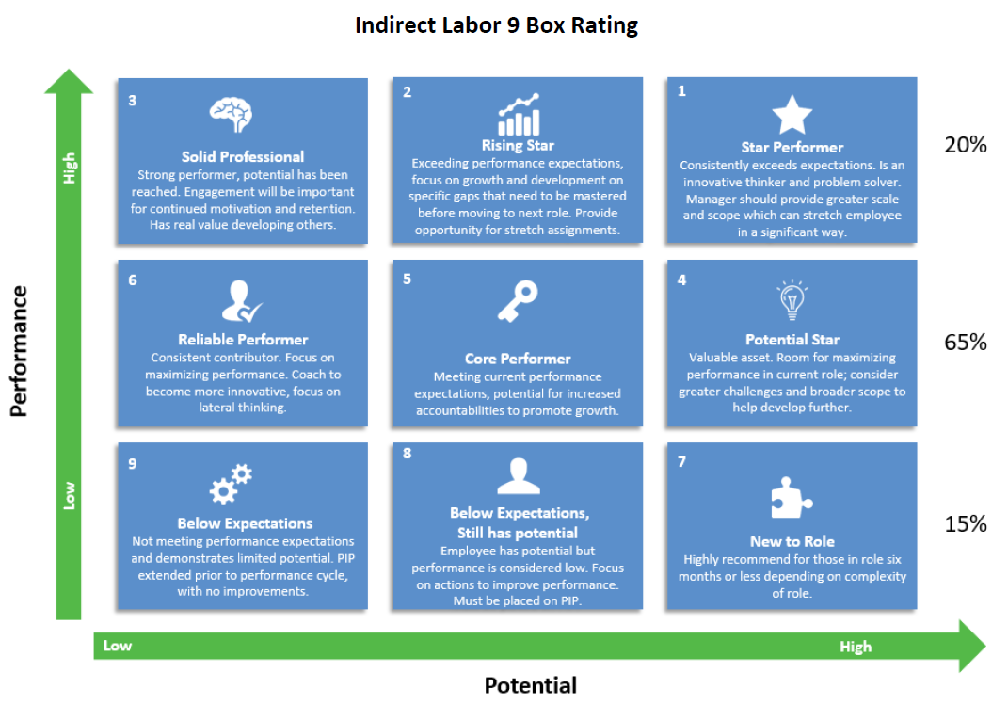
IDL Scoring (9 – Box) – 2019 Version
Notes:
IDL employees will be rated on the 9 box

Slide 6
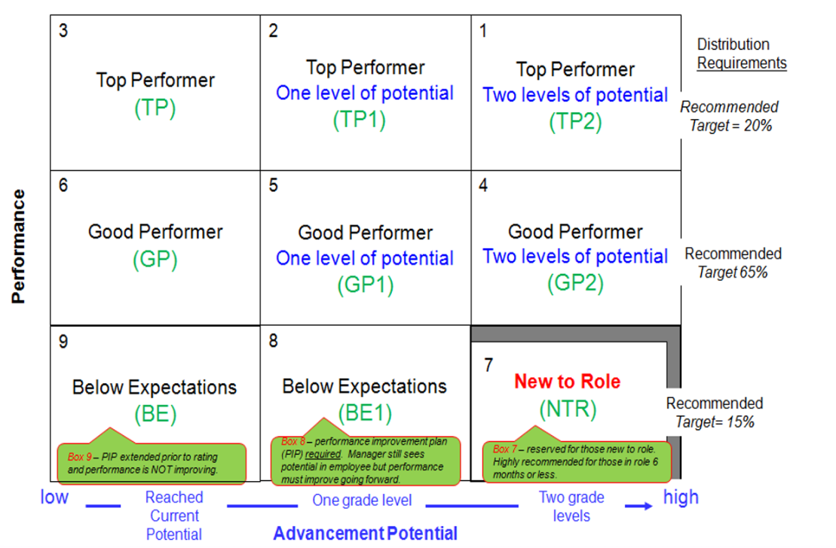
IDL Scoring (9 – Box)
Notes:
IDL employees will be rated on the 9 box

Slide 7
Nine-box Rating Descriptions 1/2
high
1
Total = 0-20%
Total = 0-100%
Total = 0-20%
Top Performer,
Two levels up potential
(TP2)
(0-3%)
2
Top Performer,
One level up potential
(TP1)
(0-10%)
3
Top Performer
(TP)
(0-20%)
Distribution
Requirements
Top Performer
Total = 0-20%
Target = 20%
4
Good Performer,
Two levels up potential
(GP2)
(0-10%)
5
Good Performer,
One level up potential
(GP1)
(0-100%)
Good Performer
(GP)
(0-20%)
6
Good Performer
Performance
Total = 60 -100%
Target 65%
7
Below Expectations,
Not Applicable*
(BE2)
(0-15%)
Below Expectations,
Not Applicable*
(BE1)
(0-15%)
8
Below Expectations
(BE)
(0-5%)
9
Below
Expectations
Total = 0-15%
Target= 15%
low
Box 7 – reserved for those new to role, but not required
high
Two or more grade levels
One grade level
Steady at current grade
low
Advancement Potential within 3-4 years
* Focus for Boxes 7 & 8 is performance improvement

Slide 8
Nine-box Rating Descriptions 2/2
1
TP2
2
TP1
3
TP
Consistently exceeds expectations
In top 20% of your performers
Consistently exceeds goals, budget, schedule
Realistic chance employee could advance two grade levels in
3-4 years
Consistently exceeds expectations
In top 20% of your performers
Consistently exceeds goals, budget, schedule
Realistic chance employee
could advance one grade level in
3-4 years
Consistently exceeds expectations
In top 20% of your performers
Consistently exceeds goals, budget, schedule
Likely employee will stay at current grade level over next 3-4 years
4
GP2
5
GP1
6
GP
Meets, sometimes exceeds expectations
Meets, sometimes exceeds goals, budget, schedule
Realistic chance employee could advance two grade levels in
3-4 years
Meets, sometimes exceeds expectations
Meets, sometimes exceeds goals, budget, schedule
Realistic chance employee could advance one grade level in
3-4 years
Meets, sometimes exceeds expectations
Meets, sometimes exceeds goals, budget, schedule
Likely employee will stay at current grade level over next 3-4 years
Performance
7
BE2
8
BE1
9
BE
In bottom 15% of your performers
New to role (box 7)
Does not always meet goals, budget, schedule
Promote-ability not applicable – key message is improve performance
In bottom 15% of your performers
Does not always meet goals, budget, schedule
Promote-ability not applicable – key message is improve performance
In bottom 15% of your performers
Does not always meet goals, budget, schedule
Employee must improve performance or be redirected
Advancement Potential within 3-4 years

Slide 9
Potential: definition
Potential is the assessment of a person’s ability to handle an expanded role in the future based on past performance
  It is not your intrinsic potential
  It is an evaluation of your potential based on the performance and behavior demonstrated the year of evaluation
  A high potential employee is someone with the ability, engagement and aspiration to rise and to succeed in more senior critical positions
Performance does not equal potential:
  Current performance is a necessary condition for potential, but does not guarantee success at the next level
  Statistics for illustration:
    only 7% of high potential employees are not high performers
    Only 30% of high performers are demonstrating high potential
Notes:
9-box with some suggested % guidelines; back-up slides have more descriptions of each box

Slide 10
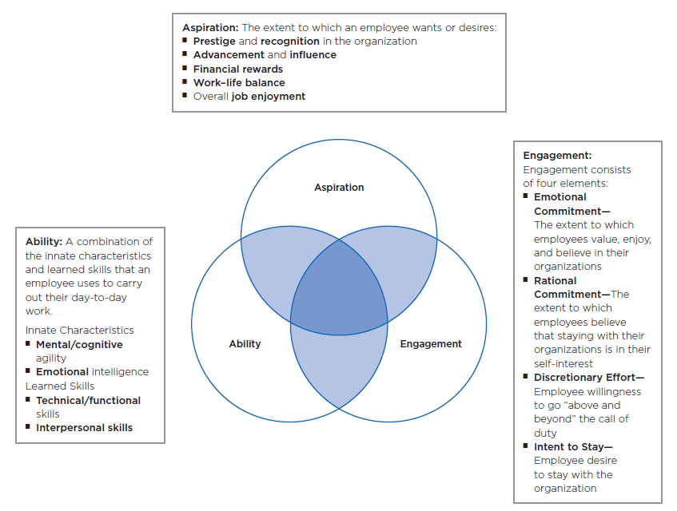
Elements of Potential
  A high potential employee is someone with the ability, engagement and aspiration to rise and to succeed in more senior critical positions

Slide 11
Tech Ladder
-
Competencies

Slide 12
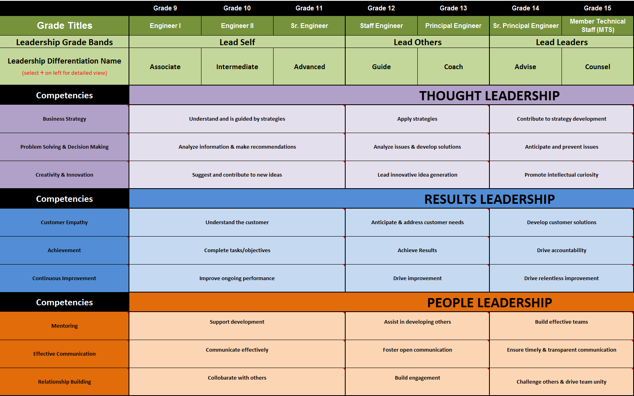
New Technical Ladder

Slide 13
Tech Ladder Competencies 1/2

Slide 14
Tech Ladder Competencies 2/2

Slide 15
What are the attributes of a performing leader?
Eleven leadership attributes used in succession planning process….
Intellectually sharp and agile
Business acumen
Strategic thinking
Self awareness
Ability to influence (especially across organizations)
Risk-taker
Innovative
Decisive
Results-oriented
Rigorously manages talent
Timely, value added communication

Slide 16
Core Values
&
Rules of Engagement

Slide 17
ON Semiconductor Values
Integrity
  We say what we mean and are accountable for delivering our commitments on time.
  We address issues in an objective, fact based and constructive fashion without fear of reprisal.
  When a decision has been made we all execute to support it.
  We comply with all legal requirements and hold ourselves to the highest standards of ethical conduct.
Respect
  We treat each other with dignity and respect.
  We share information and encourage divergent viewpoints in an open and honest environment.
  We draw out the best in each other recognizing that diversity of backgrounds and experience are key strengths.
  We all win when we support each other by placing the success of the Company above individual interests.
Initiative
  We take informed risks while making data based decisions.
  If a problem exists we are individually responsible to see it through to rapid resolution.
  We value people who demonstrate a positive, “can-do” attitude, while collaborating to win.
  We work smart and with a sense of urgency.
Return

Slide 18
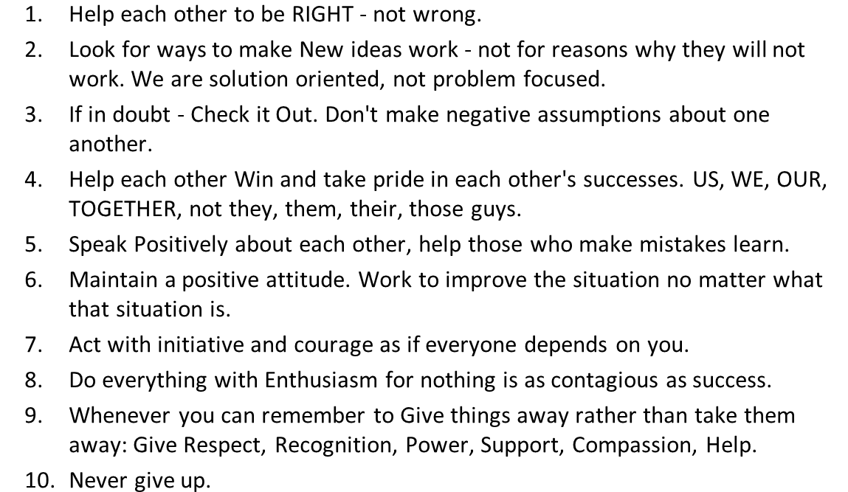
Team Rules of Engagement
Team Rules of Engagement

Slide 19
PA
Process

Slide 20
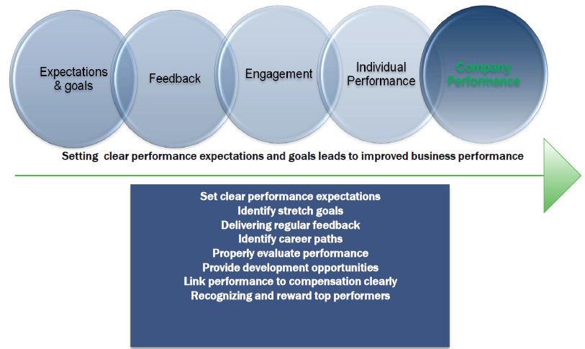
Importance of Performance Management

Slide 21
Expected outcomes of PA process
Accurately assess performance to goals of the organization
Recognize, acknowledge and reward impact of accomplishments
Provide honest and helpful feedback on strengths and opportunities to improve
Provide encouragement and help to achieve even better performance in the future
Enhance mutual understanding and trust between managers and employees
Provide meaningful merit and equity allocations according to each employee's performance and contributions

Slide 22
Employee Development Process

